Slide 1
Advocacy for our Common Home
Using the See-Judge-Act model for parishes to lead in advocacy for Care of Creation
Notes:
Welcome everyone to Advocacy for Our Common Home. Today’s workshop invites us to reflect on how we, as Catholics, can bring our faith into public life by caring for creation and advocating for policies that protect our common home. We’ll explore how the See–Judge–Act model can guide us as individuals and parish communities.

Slide 2
Opening Prayer
Touch the hearts of those who seek gain
at the cost of the earth and the vulnerable.
Teach us to see the worth of each living thing,
to walk gently with all creation,
and to strive for justice, love, and peace.
God of justice,
give us the courage to raise our voices on behalf of your creation
and the wisdom to advocate with love and truth.
Guide our efforts to shape policies rooted in the common good.
Help us work not for power, but for protection—
of the earth, of the poor, and of future generations.
May our advocacy reflect your mercy and your vision for a just world.
Amen. (Adapted from Laudato Si)
All-powerful God,
you are present in the whole universe
and in the smallest of your creatures.
Pour out upon us the power of your love,
that we may protect your creation.
Fill us with peace,
that we may live as brothers and sisters, harming no one.
God of the poor,
help us care for those forgotten and abandoned,
so precious in your eyes.
May we protect the world and not prey on it,
sowing beauty, not destruction.
Notes:
Let us begin in prayer, grounding ourselves in the presence of God. This prayer, adapted from Laudato Si’, reminds us of our role as stewards of creation and advocates for justice. As we pray, let us open our hearts to the needs of the earth and of all people.
Would anyone like to volunteer to read the prayer?

Slide 3
Who We Are: Encounter GA
Encounter GA is a non-partisan and faith-based Catholic advocacy organization building relationships with legislators to support climate solutions for Georgia and beyond.
We are the Georgia Chapter of the Catholic Climate Covenant's Encounter for Our Common Home campaign.
We are the Advocacy Wing of the Laudato Si’ Initiative of the Archdiocese of Atlanta.
Learn more at www.encounterga.org
Notes:
Encounter GA is the advocacy wing of the Laudato Si’ Initiative in the Archdiocese of Atlanta and part of the national Encounter for Our Common Home campaign. We’re a faith-based, non-partisan group focused on building relationships with legislators to support climate solutions. Our mission is rooted in Catholic teaching and inspired by Pope Francis’s call to care for creation.
(Consider adapting to include your organization or Care Creation Team)

Slide 4
Why Advocacy? Why now?

Slide 5
God blessed them, and God said to them, “Be fruitful and multiply, and fill the earth and subdue it; and have dominion over the fish of the sea and over the bids of the air and over every living thing that moves upon the earth.” - Genesis 1:28
God’s first mandate: Stewardship of Creation
Dominion comes from the Hebrew word “radah”, which emphasizes stewardship and responsibility.
In Laudato Si, Pope Francis argues harmony between God, humanity, and creation was broken when we tried to take God’s place and ignored our limits. This distorted our call to “have dominion” (Gen 1:28) and to “till and keep” the earth (Gen 2:15).
Notes:
Genesis 1:28 has often been misunderstood. “Dominion” does not mean domination — it means stewardship. When we forget our creaturely limits, we distort this call. Laudato Si’ reminds us that creation care is not optional. It’s the first task we were given and one we’re called to renew today through prayer, discernment, and action.

Slide 6
"A true ecological approach always becomes a social approach; it must integrate questions of justice in debates on the environment, so as to hear both the cry of the earth and the cry of the poor… Everything is connected. Concern for the environment thus needs to be joined to a sincere love for our fellow human beings and an unwavering commitment to resolving the problems of society." (Pope Francis, On Care for Our Common Home [Laudato Si'],nos. 49, 91)
Care for Creation is a core theme of CST
Catholic Social Teaching states clearly that Care for Creation is a part of our responsibility as Catholics.
St. Francis who speaks of “Brother Sun, Sister Moon” in the Canticle of the Creatures reminds us of the importance of relationship with our earth and with its people, including the poor and vulnerable.
Notes:
Care for creation is deeply woven into Catholic Social Teaching. Pope Francis reminds us that concern for the earth must go hand-in-hand with love for our fellow human beings. Our care for creation is inseparable from our commitment to justice for the poor and vulnerable.

Slide 7
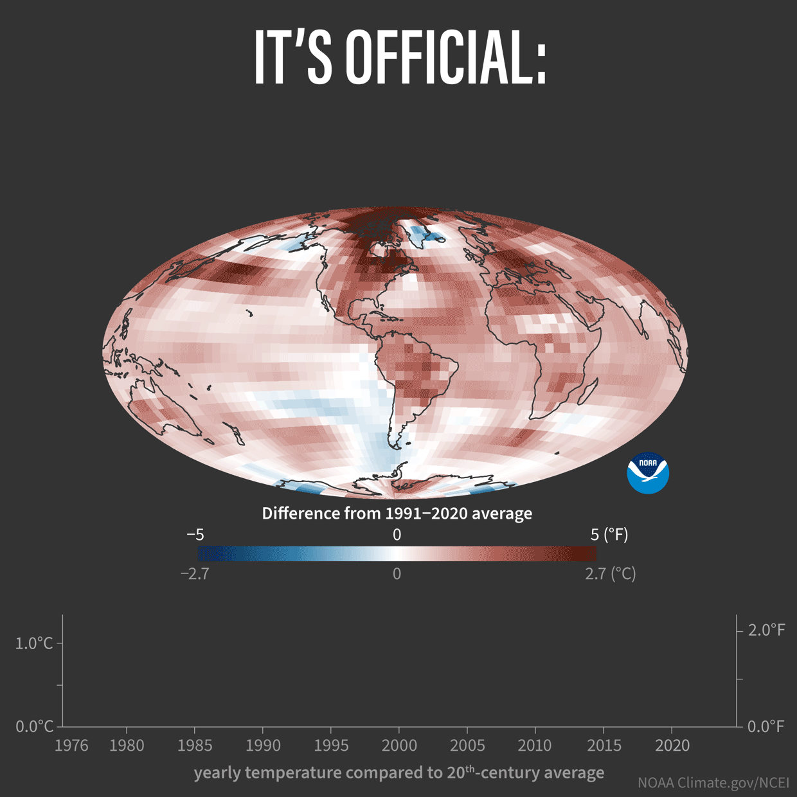
Urgency of the Crisis
We are on track to exceed the 1.5°C threshold set by the Paris Climate agreement within the next decade, possibly sooner.
The consequences of this change will include:
Extreme weather
Sea-level rise
Food and water insecurity
Loss of biodiversity
Climate migration and conflict
It will affect everyone, though the burden will fall on the worlds poorest.
Notes:
The climate crisis is no longer distant or theoretical. We are on track to exceed the 1.5°C threshold set by the Paris Agreement — a shift that will have devastating effects, especially for the world’s poorest. As Catholics, we are called not only to lament this reality but to act on it with courage and hope.

Slide 8
Catholic Social Teaching and Care for Creation
Ecological Conversion
The Common Good and Global Solidarity
Integral Ecology
Notes:
Given this crisis, how do we respond? What is our church asking us to do?
Here are three key CST principles that shape our approach to creation care:
Integral Ecology, which sees the interconnectedness of all life;
Ecological Conversion, a transformation of heart and habits; and
The Common Good and Global Solidarity, a call to put the needs of others before our own, especially those most impacted by environmental harm.

Slide 9
Whole-Group Discussion
?
What are the challenges related to care for creation, the environment, and climate change that are most important to you? Why?
What are some of the pains, difficulties, or concerns that you experience related to these issues?
Notes:
Let’s take a few minutes to reflect and share. What environmental or climate-related concerns matter most to you personally? What challenges do you or your community experience when it comes to care for creation?

Slide 10
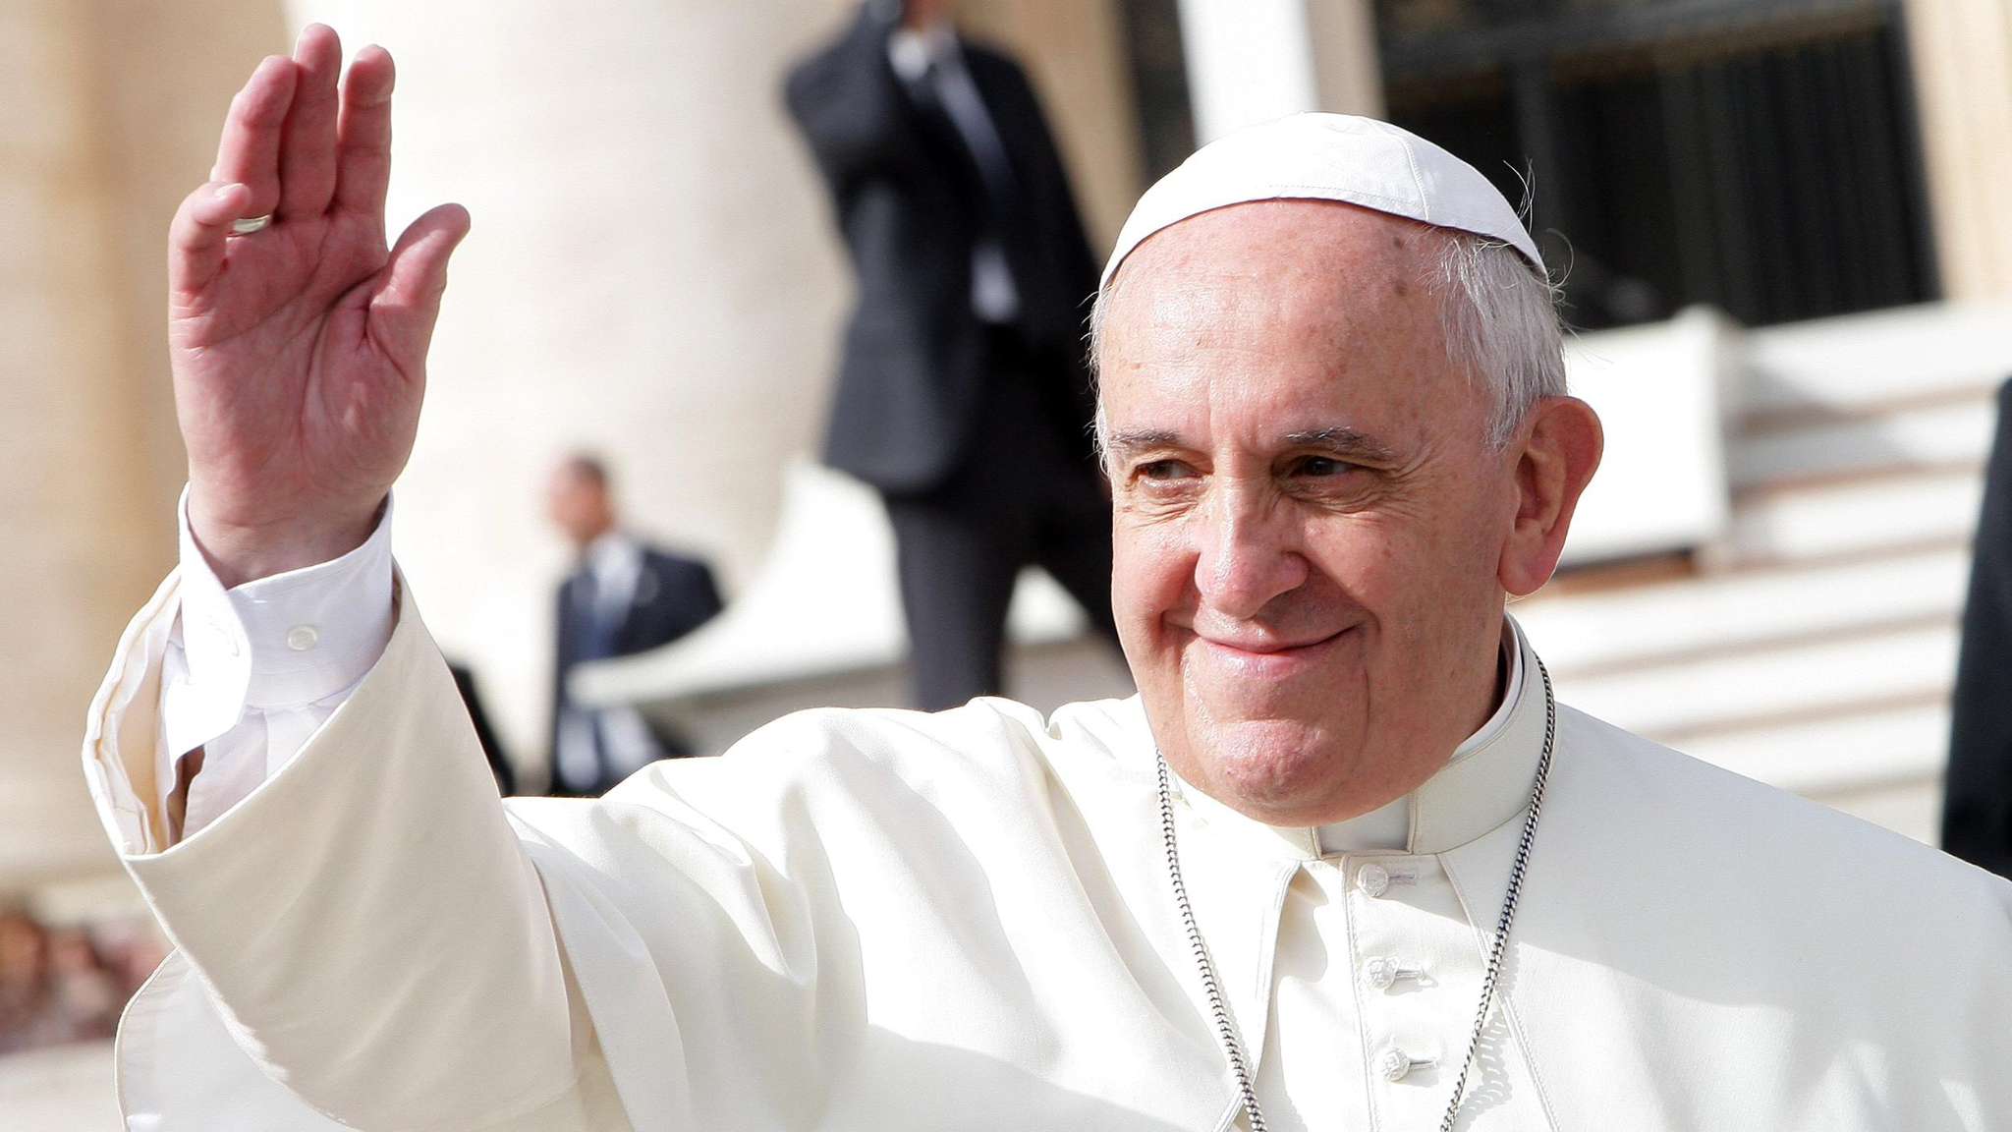
The “See, Judge, Act” Method for Social Change

Slide 11
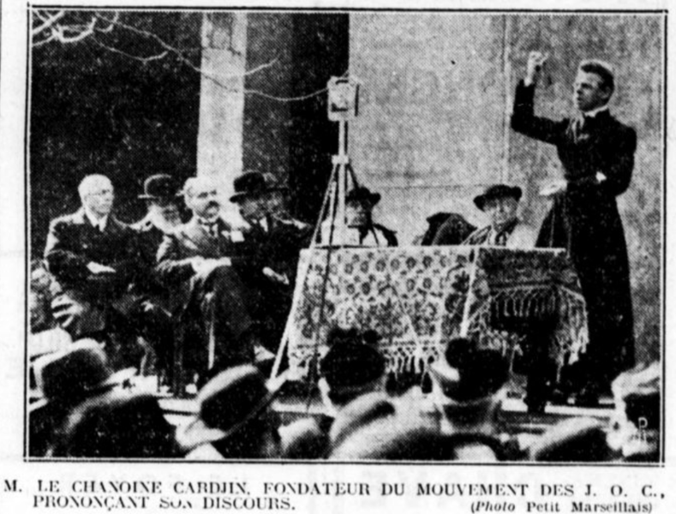
Where does the See-Judge-Act Model come from?
Rooted in Catholic Social Tradition
Fr. Joseph Cardijn / Young Christian Workers
Adopted by the Church
Formally recognized in Pope John XXIII’s 1961 encyclical Mater et Magistra
Encouraged as a pastoral method for laypeople
Still Used Today
Widely used in Catholic ministries
Notes:
The See–Judge–Act model is a practical, faith-filled approach to social action. Developed by Fr. Joseph Cardijn and embraced by the Church, it invites us to observe reality, reflect through the lens of faith, and respond in love. It’s a model that empowers both individuals and communities to take meaningful action.
Rooted in Catholic Social Tradition
Developed in the early 20th century by Fr. Joseph Cardijn, a Belgian priest and founder of the Young Christian Workers movement
Embraced as a tool for social action among working-class Catholics facing injustice
Adopted by the Church
Formally recognized in Pope John XXIII’s 1961 encyclical Mater et Magistra
Encouraged as a pastoral method to help laypeople engage the world through faith, reflection, and action
Still Used Today
Widely used in Catholic education, parish organizing, and justice ministries
Central to modern movements for environmental, social, and economic justic

Slide 12
Step #1: See
Notes:
Let's dive deeper into the first step of our method: See.

Slide 13
Step #1: See
Observation and Awareness
Gather Information
Reflect on Experiences
Notes:
To “see” means to become aware — to really look at what’s happening around us. That might be how our parish uses energy, what we throw away, or what we hear from those suffering environmental harm. Seeing also includes noticing what’s happening in our state and policy landscape.

Slide 14
Step 1: What it means to ”see”
Before we act, we must assess the problem and open our eyes and ears to the realities around us — in our parish, our community, and our common home.
Parish-Level Examples
Parish energy use
Waste a parish events
Lack of discussion or education
Listening to parishioners
State/National-Level Examples
Local pollution
State policies weakening protections
Lack of elected official engagement
Changes in state/federal regulations
Notes:
Parish-Level Examples:
Noticing high energy use in church buildings or outdated infrastructure (e.g. energy/waste assessments)
Seeing waste from parish festivals with no compost or recycling
Observing a lack of homilies or education around environmental issues
Hearing stories from parishioners impacted by heat, flooding, or pollution
State/National-Level Examples:
Learning that polluting industries are located near low-income communities or communities of color
Reading about proposed state legislation to weaken or strengthen environmental protections
Noticing a lack of elected official engagement with climate justice
Tracking the rollback of federal clean air, water, or energy standards

Slide 15
Small Group Discussion: See
?
What signs of environmental harm or concern do we see in our parish or community?
Who is most affected by these issues — and how are they impacted?
Are there local or state-level environmental issues we should be paying more attention to?
Notes:
Let’s break into small groups and discuss. Use these questions to reflect on what you’re noticing — in your parish, neighborhood, or community. Try to be as specific as possible and listen carefully to each other’s insights.

Slide 16
Step #2: Judge

Slide 17
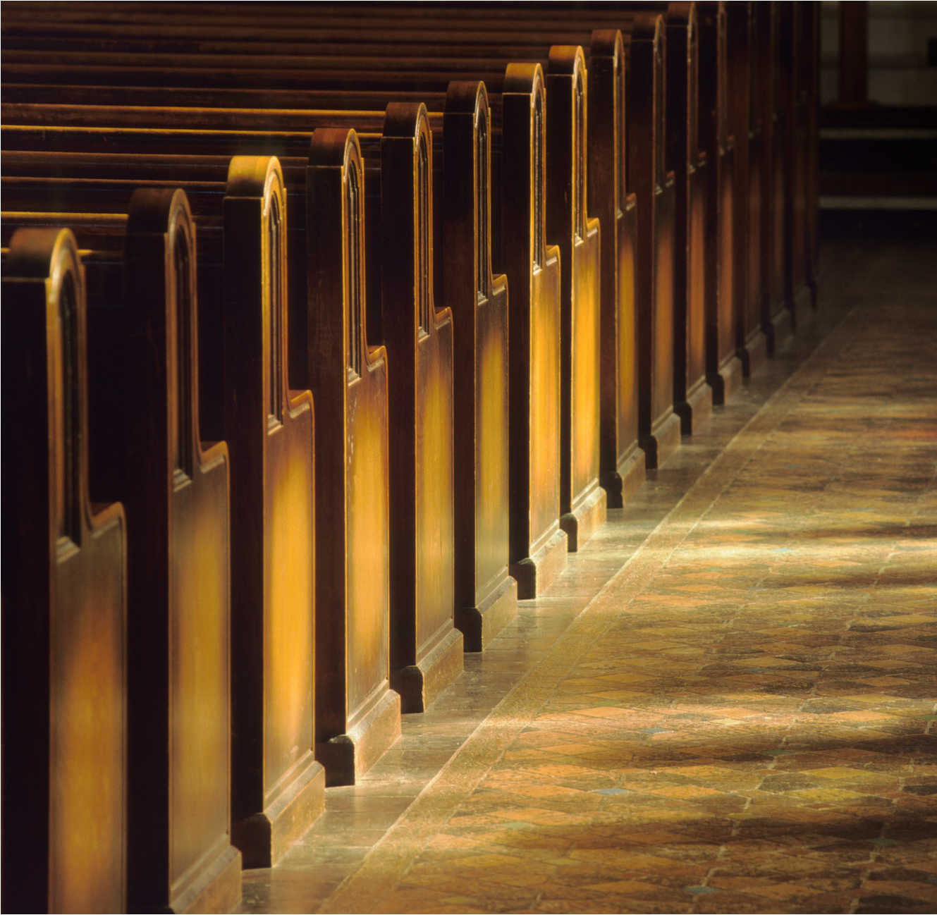
Step #2: Judge
Moral Reflection
Discernment
Formulate a Response
Notes:
Once we’ve seen the reality, we move to “judge” — not in a condemning way, but in a discerning way. We ask: what does our faith say? What does Scripture tell us about stewardship? What values from Catholic Social Teaching apply to the policies and practices we observe?

Slide 18
Step 2: What it means to “judge”
Through the lens of faith, we ask: What does Catholic Social Teaching say? What does our conscience tell us?
Parish-Level Reflection
Reflecting on scripture, stewardship
Recognizing how parish actions/inaction) impact the community
Asking: Are we living in right relationship with creation and the poor?
State/National-Level Reflection
Using CST principles and reflecting:
Does this policy protect the most vulnerable?
Does it uphold human dignity and environmental justice?
Does it reflect the Church’s call to care for our common home?
Notes:
Parish-Level Reflection:
Reflecting on scripture, stewardship
Recognizing how parish actions/inaction) impact the community
Asking: Are we living in right relationship with creation and the poor?
State/National-Level Reflection:
Using CST principles like the common good, preferential option for the poor, and solidarity to assess proposed policies
Asking:
Does this policy protect the most vulnerable?
Does it uphold human dignity and environmental justice?
Does it reflect the Church’s call to care for our common home?

Slide 19
Small Group Discussion: Judge
?
What do Scripture and Catholic Social Teaching say about our responsibility to care for creation?
How do these teachings challenge or affirm how we’re currently responding?
What values should shape our response to environmental injustice?
Notes:
Now let’s reflect together. How do Scripture and Catholic Social Teaching speak to the issues you identified? What values do you think should guide your parish or community response?

Slide 20
Step #3: Act

Slide 21
Step #3: Act
Take Action
Community Involvement
Evaluate Outcomes
Notes:
Faith leads us to action — rooted in love, not ideology. That might mean launching a green team, improving parish sustainability, or stepping into advocacy at the state level. Our actions are most powerful when they reflect our Catholic identity and are pursued with humility and persistence.

Slide 22
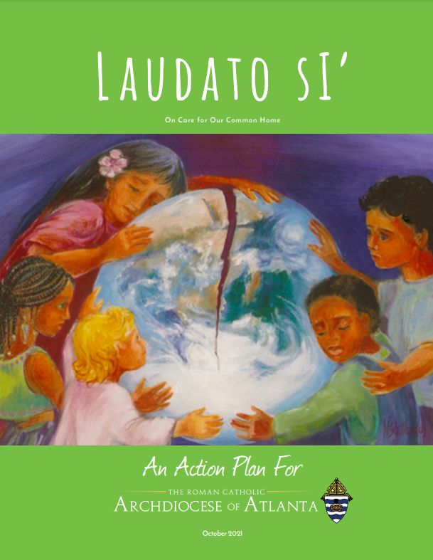
Step 3: What it means to “act”
Our faith compels us not just to care, but to act — with courage, compassion, and commitment.
Parish-Level Actions
Launch green team, explore Laudato Si’ Action Platform
Host a creation care liturgy or education event
Reduce waste, improve energy use, or plant native gardens
Launch education programs
State/National-Level Advocacy
Go to state capitol and meet with legislators about a bill
Participate in national campaigns like Encounter for Our Common Home
Letter-writing campaign or petition
Speak at public hearings or submit comments on key policies
Notes:
Parish-Level Actions:
Launch a green team or revive your Laudato Si’ Action Platform plan
Host a creation care liturgy or education event
Reduce waste, improve energy use, or plant native gardens
Preach and teach about care for creation in homilies and formation programs
State/National-Level Advocacy:
Attend Capitol Conservation Day or meet with legislators about a bill
Participate in national campaigns like Encounter for Our Common Home
Organize or join a letter-writing campaign or petition
Speak at public hearings or submit comments on key policies
For ideas, see the Laudato Si Action Plan for the Archdiocese of Atlanta.

Slide 23
Small Group Discussion: Act
?
What’s one action our parish could take to care for creation more faithfully?
How can we participate in advocacy efforts at the state or national level?
What small step can you or your ministry commit to this month?
Notes:
Let’s consider what steps we can take — personally and as a parish. What’s one action your community could take in the next few months? What policy work or advocacy could you join or initiate? And what is one small thing you personally feel called to do?

Slide 24
Encounter GA: Advocacy Model for Social Change
See
Individual
Family
Parish
Community
State/Country
Planet
Analysis
+
Theological reflection
Act
Judge
Evaluation
Notes:
Here we present a See-Judge-Act model in its entirety.
First, we see – that is, listen, observe, and take in the challenges that are around our community
Then, we judge – that is, we engage in discernment, analysis, and theological reflection. We take what we are experiencing and look for guidance in scripture and Catholic Social Teaching to inform our response This process involves theological reflection, prayer, and contemplative discernment.
Lastly, we act – that is, we take specific steps in applied, real settings to make a change in our social environment. This goes beyond individual changes and requires changes at the community level and beyond – changing the very structures and policies that have given rise to the climate crisis and environmental problems in the first place.
On the left hand side, we see that this method can take place on every level – from individual to state, country, and global levels. For example, your family can adopt new practices around waste management by starting to compost. Your parish can assess its energy use, reduce use, or explore alternative energy sources like solar. And you can also write your legislator to advocate for conserving ecosystems, environmental justice, or reducing carbon

Slide 25
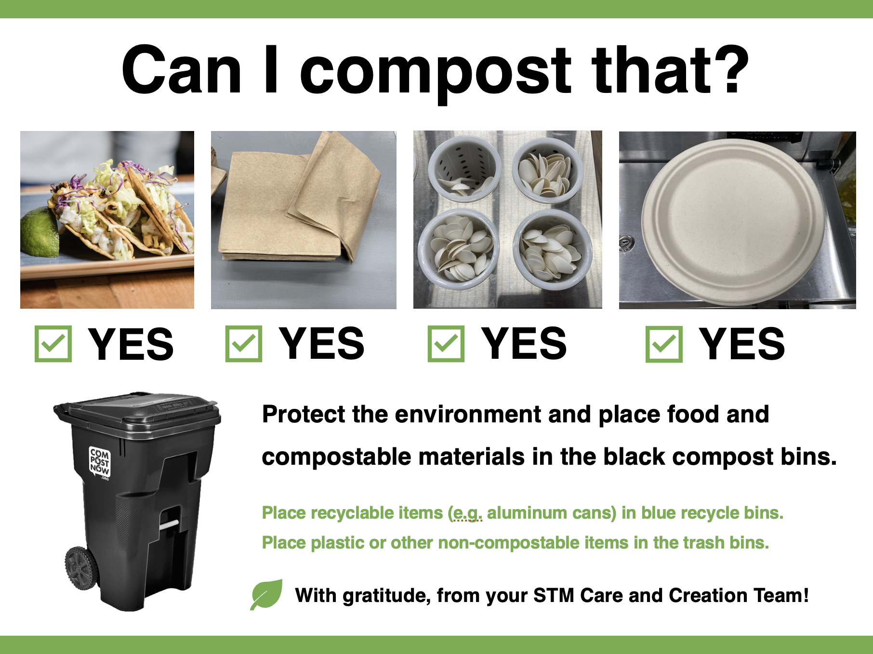
Case Study: Composting at St. Thomas More, Decatur GA
See – Parishioners observed lots of waste at fish-frys
Judge – Parishioners believed the waste was contrary to our parish’s values
Act – Parishioners developed a composting program, educated parishioners, and even moved to real plates (no Styrofoam) and volunteered to wash dishes.
Notes:
Here’s an example of how one parish responded. By noticing waste at parish events, judging it as misaligned with their values, and acting with creativity and teamwork, they launched a successful composting initiative. This is a great example of grassroots See–Judge–Act in action.

Slide 26
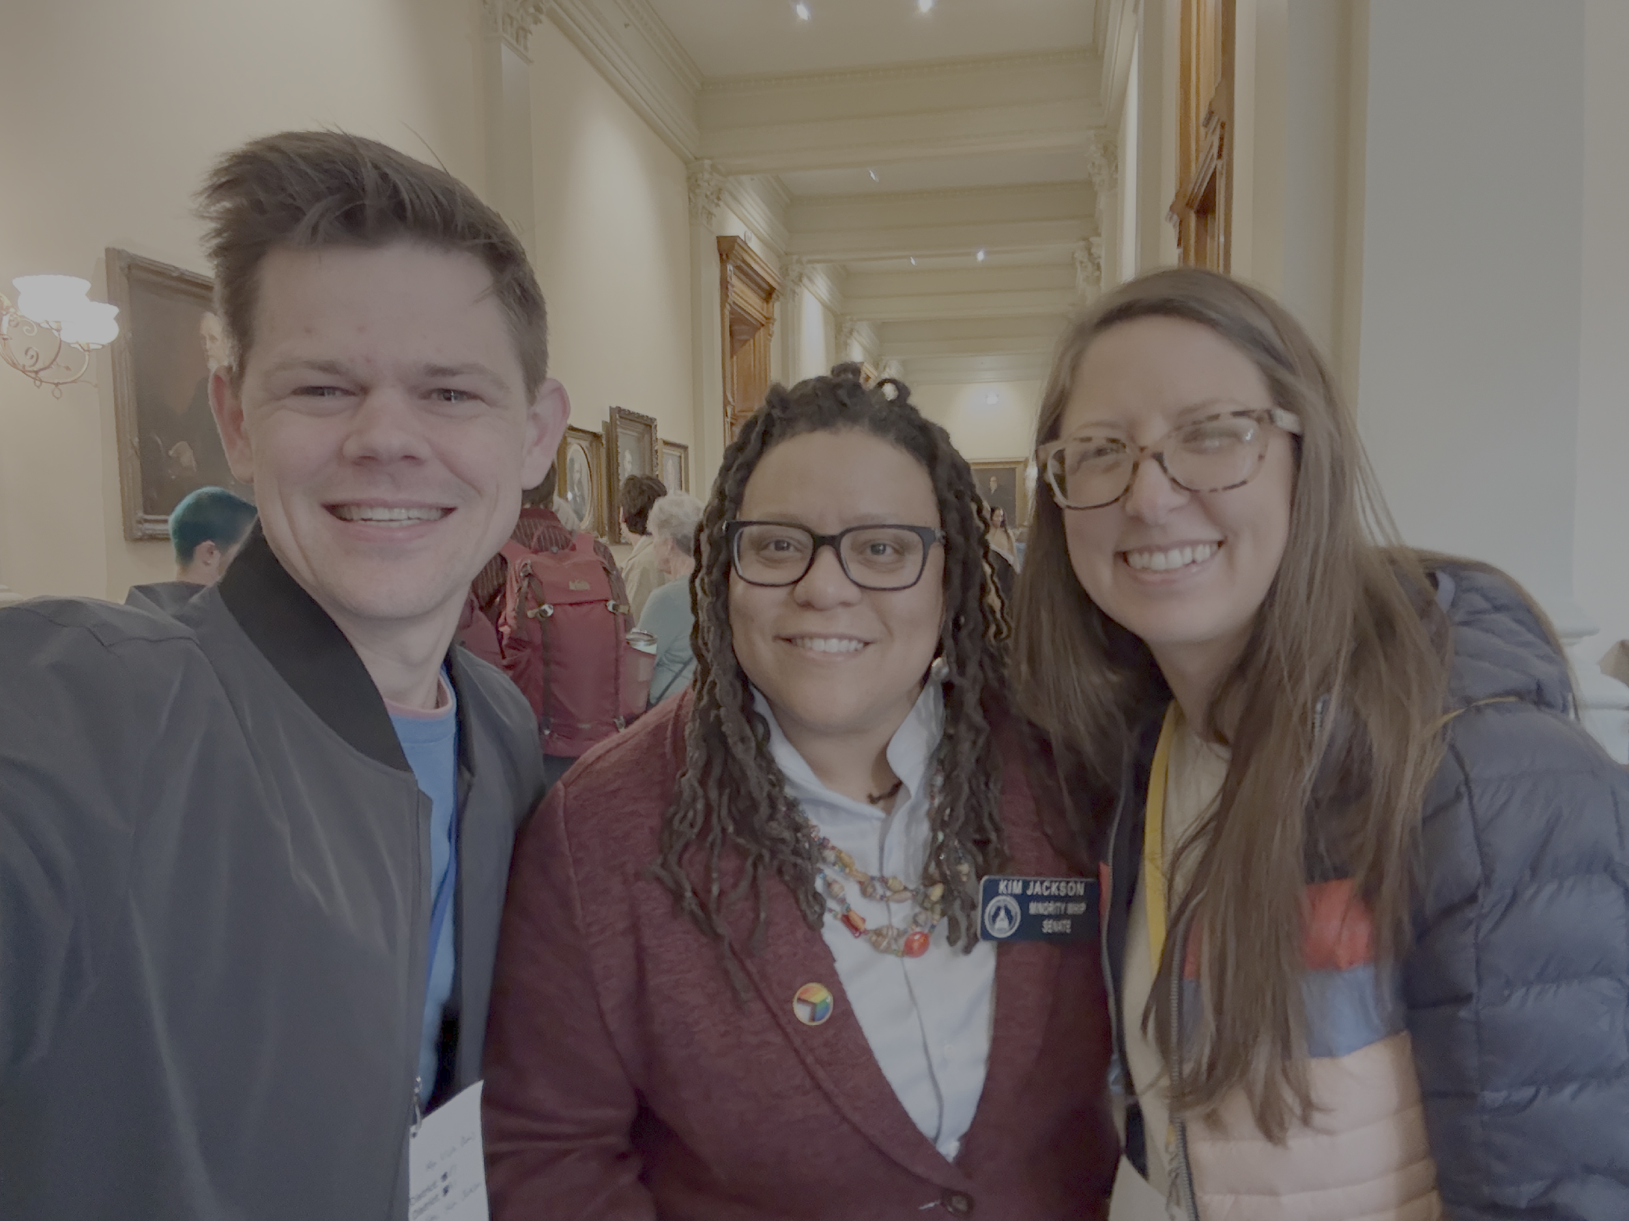
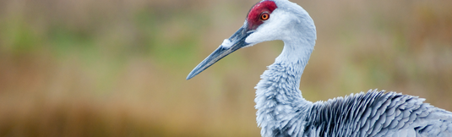
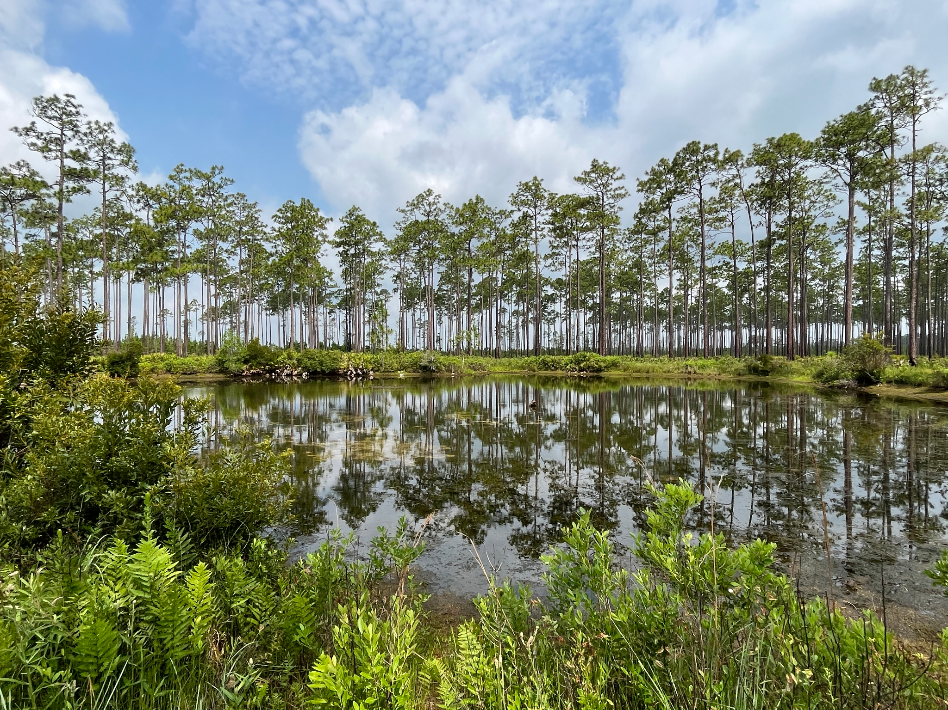
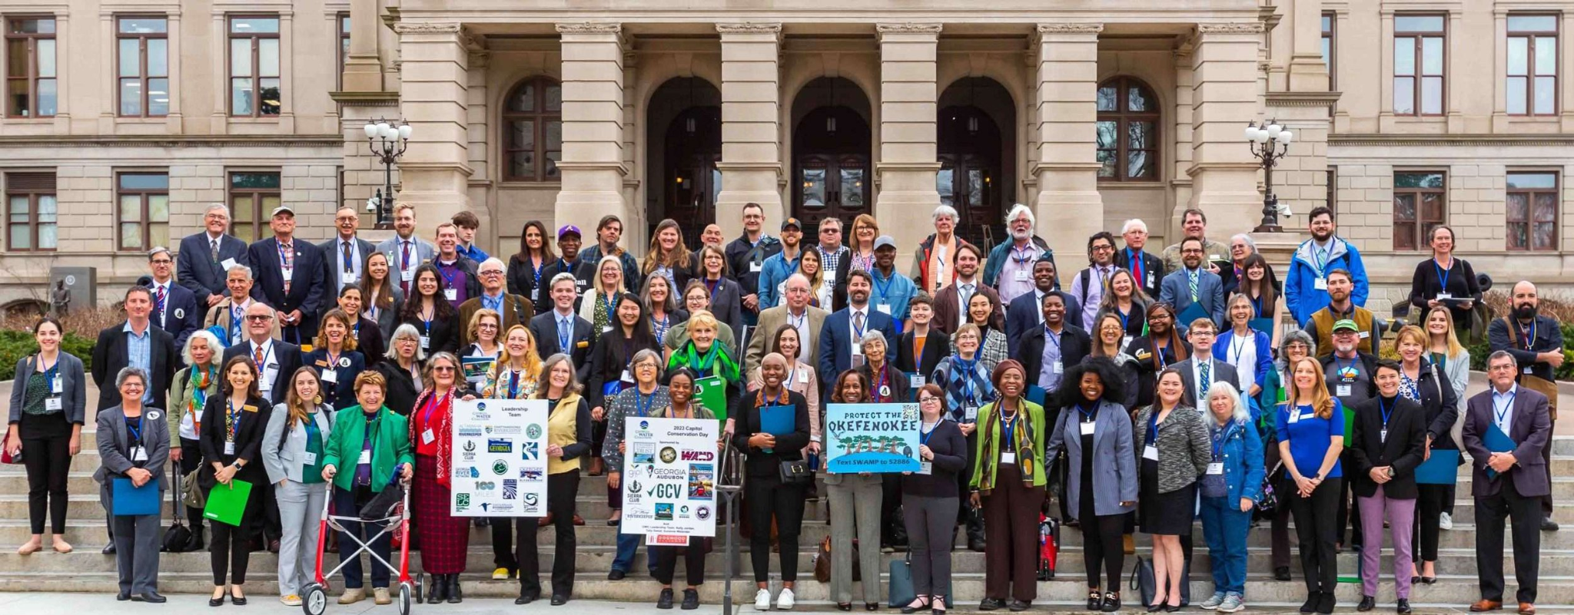
Case Study: Advocacy for the Okefenokee
See – observed that mining company sought a permit that would damage hydrology of the swamp
Judge – this action runs contrary to our common call to protect God’s creation
Act – Encounter GA members attended Capitol Conservation Day (2024-25), partnered with advocacy organizations Georgia Water Coalition and Georgia Interfaith Power and Light, and held Encounter meetings with state legislators
Notes:
This example shows how advocacy can protect sacred and natural spaces. Parishioners worked with partners, showed up at the Capitol, and had respectful conversations with lawmakers from both parties. Advocacy grounded in faith can bridge divides and create meaningful change

Slide 27
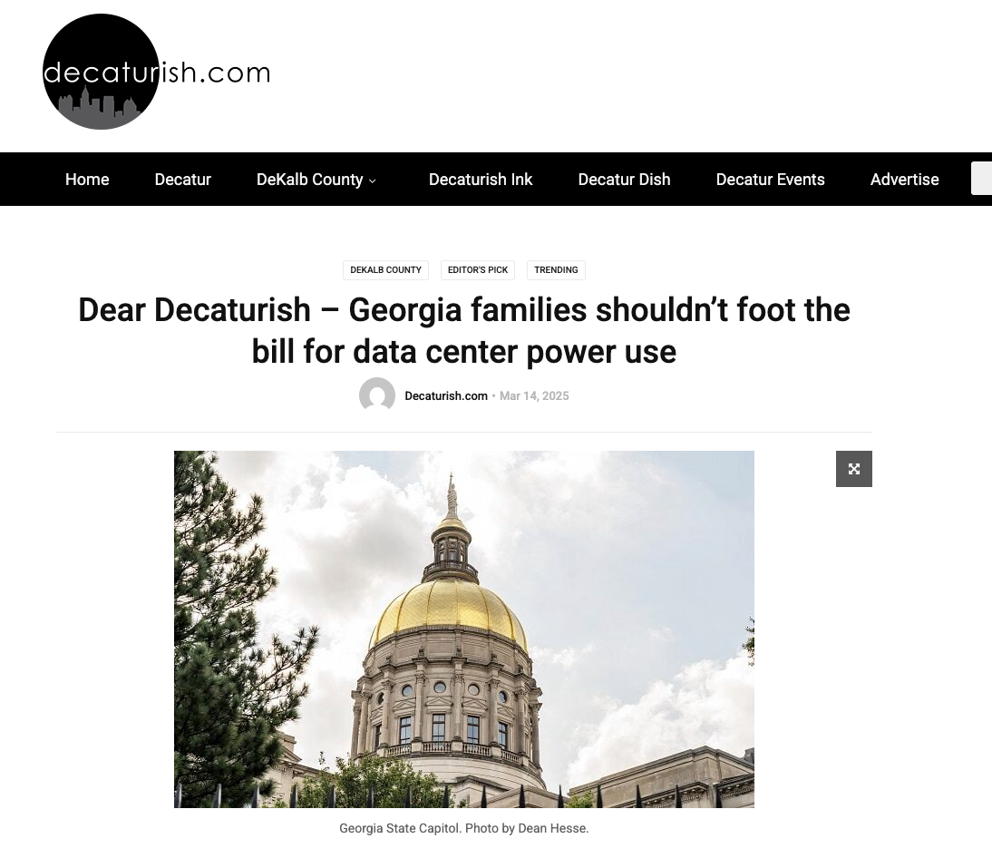
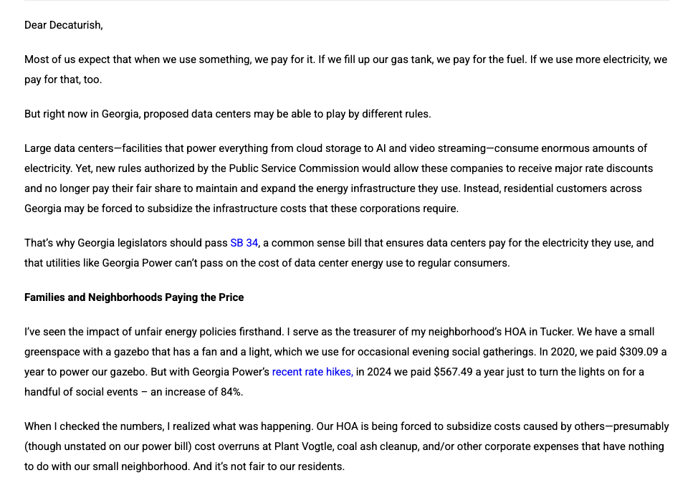
Case Study: State-Level Energy Advocacy
See – Encounter GA members observed that decisions made by the Georgia Public Service Commission (PSC) greatly influence energy policy
Judge – Encounter GA members understand that decisions often don’t align with environmental protection
Act – Encounter GA members attended public comment hearings, wrote op-eds, and will engage in get-out-the-vote activities for PSC elections in 2025
Notes:
This case highlights how energy policy decisions are made at the state level — and how faith communities can speak up. From writing op-eds to attending hearings, this work reflects Catholic values in the public square, without partisanship

Slide 28
For Discussion
?
Which levels of actions (individual, parish and community, or state and global) have you engaged in?
Which areas do you find most exciting? Challenging? Difficult?
Notes:
Let’s reflect on where each of us feels called. Are you more drawn to local efforts or advocacy at the state level? What’s exciting? What’s intimidating? Sharing these thoughts can help us begin to discern our next faithful steps.

Slide 29
Next Steps
We completed a quick “see judge act” approach today. But usually, it takes a lot of time – listening, engaging, encountering, discerning, and moving together.
Successful advocacy initiatives move at the speed of trust – which is usually slow. Take your time and focus on process and relationships over outcomes.
Work with a core team (like a Care Creation Team) to begin seeing, listening, and assessing.
Notes:
This workshop is a starting point. Real advocacy work takes time, relationship, and trust. Begin with a small, committed team, take time to listen and discern, and stay rooted in faith and community. Remember, we are not alone in this work — we walk together.

Slide 30
Thank you!

