Slide 1
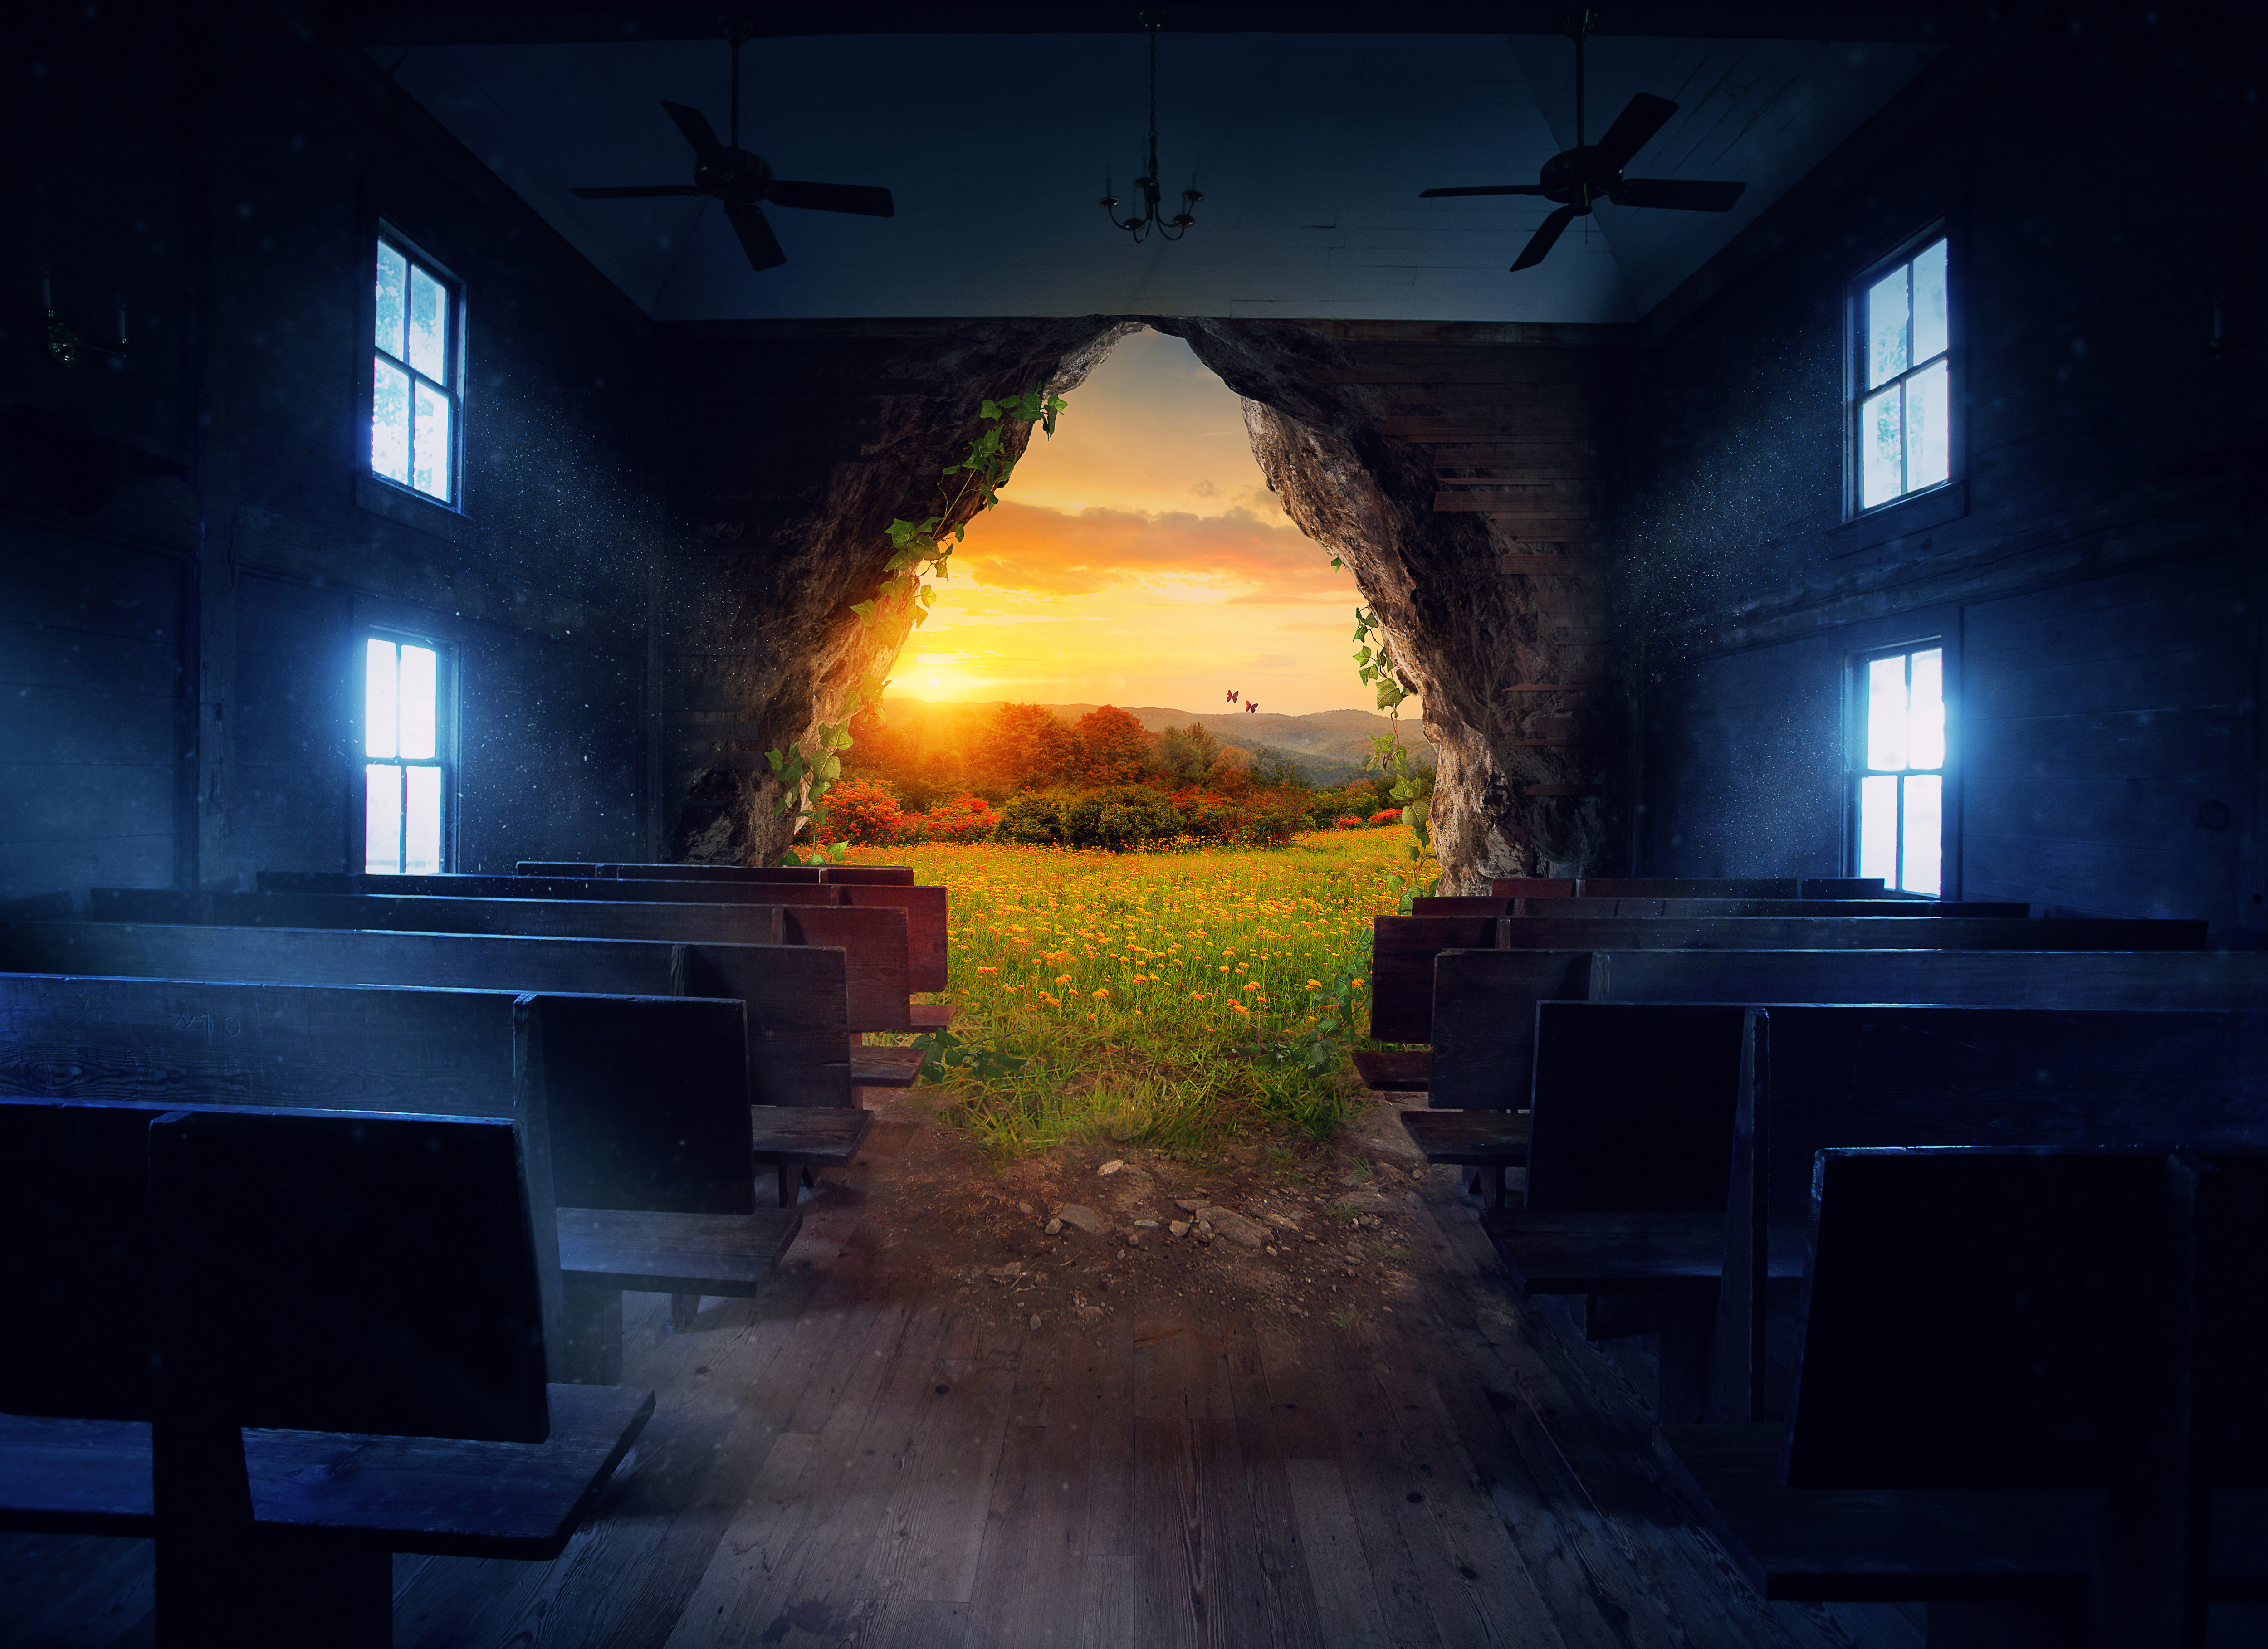

Together in the Journey:
The Synod, the Laudato Si' Action Platform, and the Eucharistic Revival
February 10th, 2022

Slide 2
Together in the Journey:
The Synod, the Laudato Si' Action Platform, and the Eucharistic Revival
1) This webinar to promote diocesan activity for the synod is made possible by the Seelos Foundation in thanksgiving to Blessed Francis X. Seelos, C.Ss. R.
2) The webinar is being recorded and will a link to the recording will be sent to everyone who registered within the next 24-48 hours.
3) Please type your questions in the Q/A box. If you know who the question is directed to, please add that info

Slide 3
Together in the Journey:
The Synod, the Laudato Si' Action Platform, and the Eucharistic Revival
Prayer for the Synod on Synodality, USCCB
We stand before You, Holy Spirit, as we gather together in Your name.
With You alone to guide us, make Yourself at home in our hearts;
Teach us the way we must go and how we are to pursue it.
We are weak and sinful; do not let us promote disorder.
Do not let ignorance lead us down the wrong path nor partiality influence our actions.
Let us find in You our unity so that we may journey together to eternal life and not stray from the way of truth and what is right.
All this we ask of You, who are at work in every place and time, in the communion of the Father and the Son, forever and ever.
Amen.

Slide 4
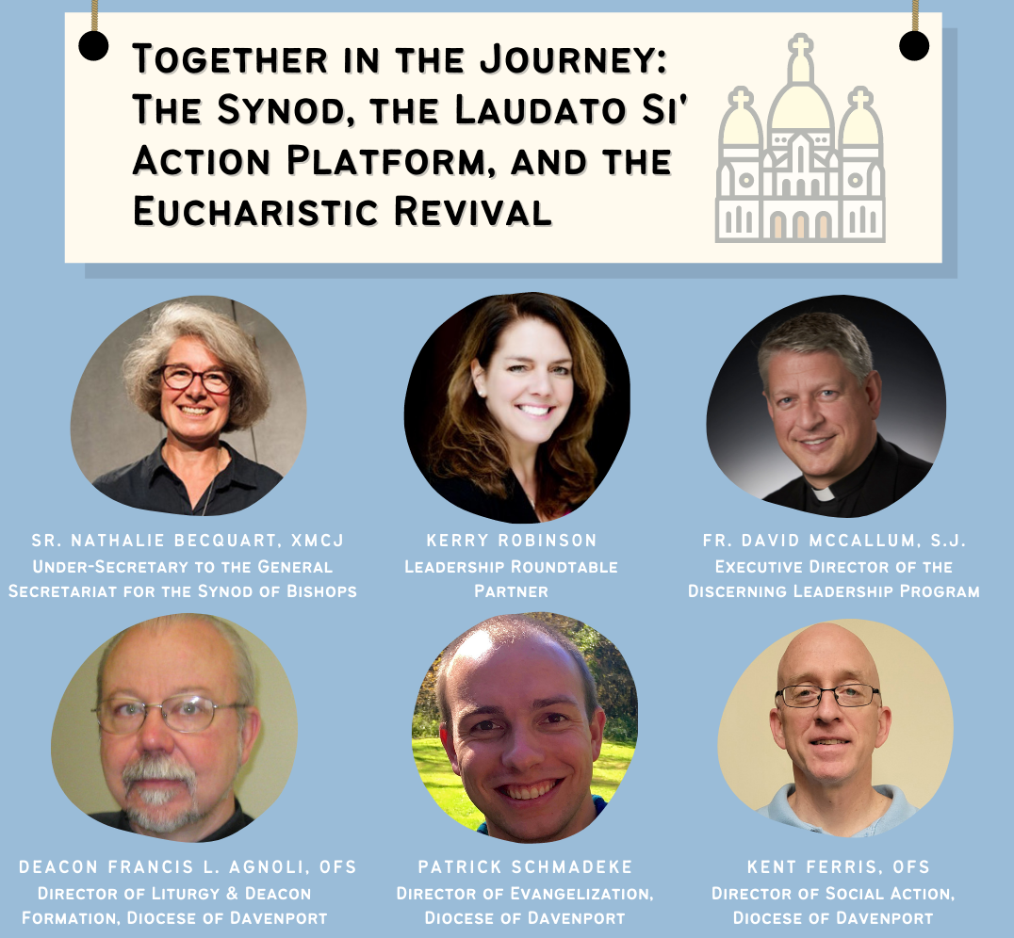

Moderator: Jose Aguto.
Executive Director
Catholic Climate Covenant

Slide 5
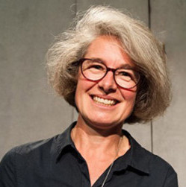
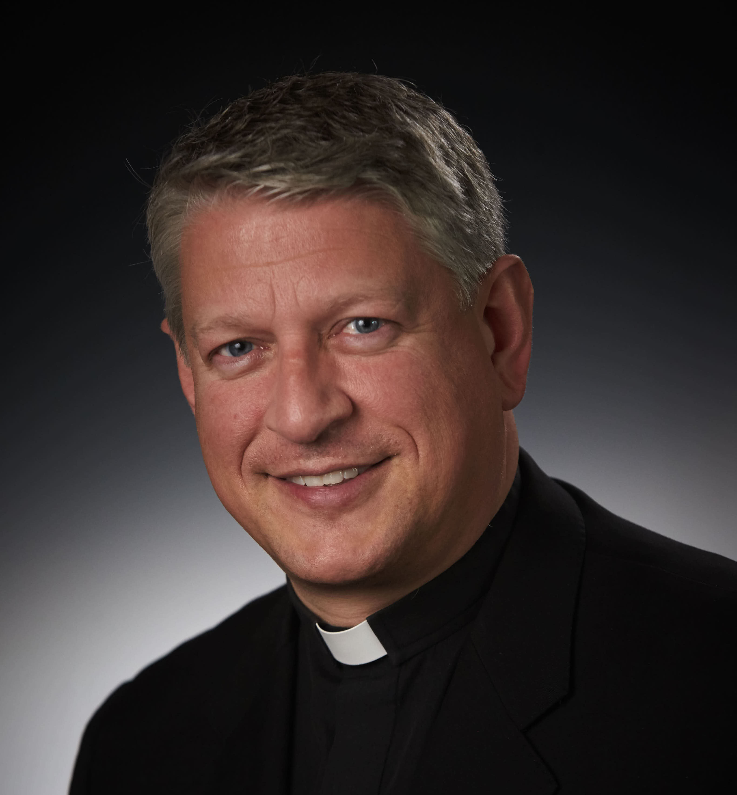
Together in the Journey:
The Synod, the Laudato Si' Action Platform, and the Eucharistic Revival
Sr. Nathalie Becquart, XMCJ
Under-Secretary to the General Secretariat for the Synod of Bishops
Fr. David McCallum, S.J.
Executive Director of the Discerning Leadership Program

Slide 6
"Together in the Journey: The Synod, the Laudato Si' Action Platform and the Eucharistic Revival"
For a Synodal Church:
Communion, Participation, and Mission
Sr Nathalie Becquart, xmcj, Under-Secretary
to the General Secretariat for the Synod of Bishops
Fr David McCallum, sj, Director of Discerning Leadership, member of the Synod Commission on Methodology

Slide 7

Notes:
“This is important: the way to understand and interpret is through a pilgrim hermeneutic, one that is always journeying. The journey that began after the Council? No. The journey that began with the first Apostles and has continued ever since. Once the Church stops, she is no longer Church, but a lovely pious association, for she keeps the Holy Spirit in a cage. A pilgrim hermeneutic capable of persevering in the journey begun in the Acts of the Apostles. Otherwise, the Holy Spirit would be demeaned.”
https://www.vatican.va/content/francesco/en/speeches/2021/september/documents/20210918-fedeli-diocesiroma.html

Slide 8
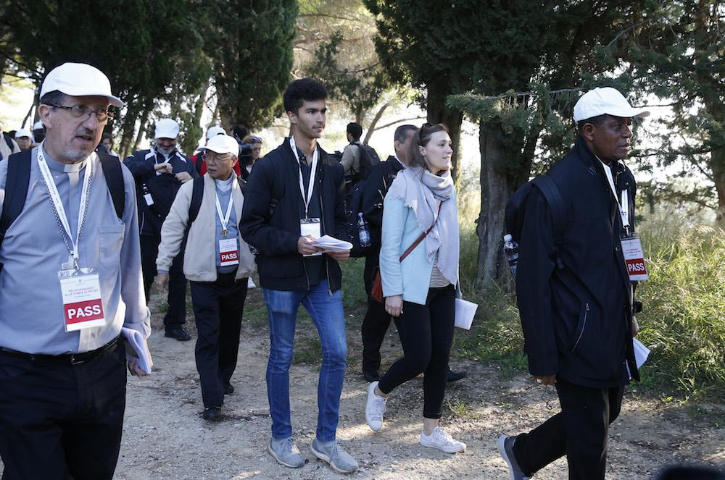
“Synodality is the way of being the Church today according to the will of God, in a dynamic of discerning and listening together to the voice of the Holy Spirit.”
Pope Francis
Notes:
This sense of being a pilgrim people, walking with God and one another through history, learning, growing, evolving as Church, is a process that demands discernment, and involves adaptation and even transformation along the way.

Slide 9
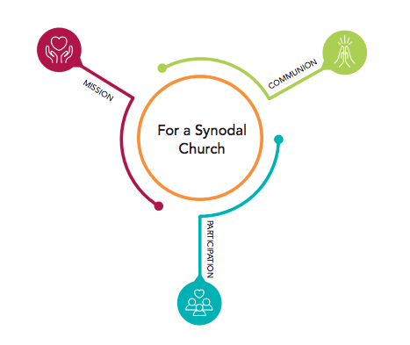
Communion, Participation
and Mission –
3 inseparable keys
at the heart
of a Synodal Church
Notes:
Our quality of relationship with one another (communion) and the way in which we are involved and engaged with one another matters and gives witness for the integrity of the mission of the Church. Each element is integral to the others.

Slide 10
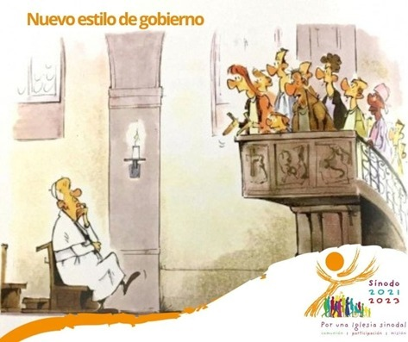
Video Synod on Synodality https://www.youtube.com/watch?v=I5lAktuejwo&ab_channel=Rahai
All You Need to Know about the synod and synodality (through Sketches and images) || Rahai
#synod #synodality #listeningchurch
Notes:
This brief video is helpful for establishing some context for this historical moment that we’re in, and provides some helpful ways of framing the scope of this synodal journey…

Slide 11
Synodality and Integral Ecology : two key themes of Pope Francis’ Pontificate
🡪 A deep connection between those 2 concepts/practices
Same principles and methodology
Notes:
For us, it is a kind of testimony to the work of the Holy Spirit when we discover so much coherence and unity in these emerging movements within the Church and the world… because the Church is in, though not entirely of the world. It is essential that the way we understand the natural and the divine orders of creation go hand in hand, and are not at odds with one another…
Synodality enhances Integral Ecology and Integral Ecology enhances synodality; they are mutually beneficial to one another, and not two separate projects

Slide 12
A reading of the signs of the times : a fragmented world in need of connectivity and solidarity
“The world in which we live, and which we are called to love and serve, even with its contradictions, demands that the Church strengthen cooperation in all areas of her mission. It is precisely this path of synodality which God expects of the Church of the third millennium.”
Pope Francis, ceremony commemorating the 50th Anniversary of the institution of the Synod of Bishops, 17 October 2015
« Everything is interconnected, everything is interrelated »
cf LS138
Notes:
And while nature teaches us of this profound interconnectedness and of the importance of harmony, balance, and reciprocity, we have not always listened.
Nature is also our teacher when we look at the need for a more coherent, less fragmented and polarized society

Slide 13
Preparatory Document for the Synod 2021-2023
Part I. The call to walk together
Discerning the signs of the times in the light of the Gospel
The global tragedy of the COVID-19 pandemic
Inequalities and injustices: massification, fragmentation, the conditions faced by migrants, divisions across the family of humanity
The cry of the poor and the cry of the earth
We are all in the same boat…
We are one human family living in our common home.
(Laudato Si’ and Fratelli Tutti)
“The synodal journey unfolds within a historical context marked by epochal changes in society and by a crucial transition in the life of the Church, which cannot be ignored: it is within the folds of the complexity of this context, in its tensions and contradictions, that we are called to “scrutinize the signs of the times and interpret them in the light of the Gospel” (GS, 4).” (PD, 4)
Notes:
This reminder of the sibling quality of our relatedness as a human species, the essential universal dignity of persons, is mirrored back to us when we have a proper reverence for the gift of all life, and respect for the cycles of life, death, and regeneration

Slide 14
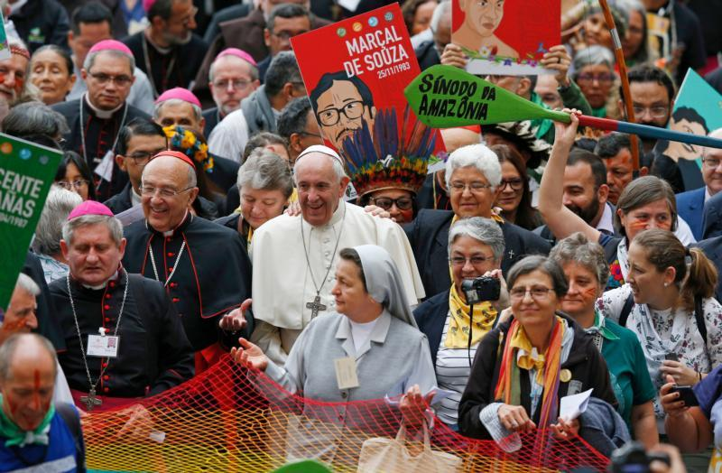
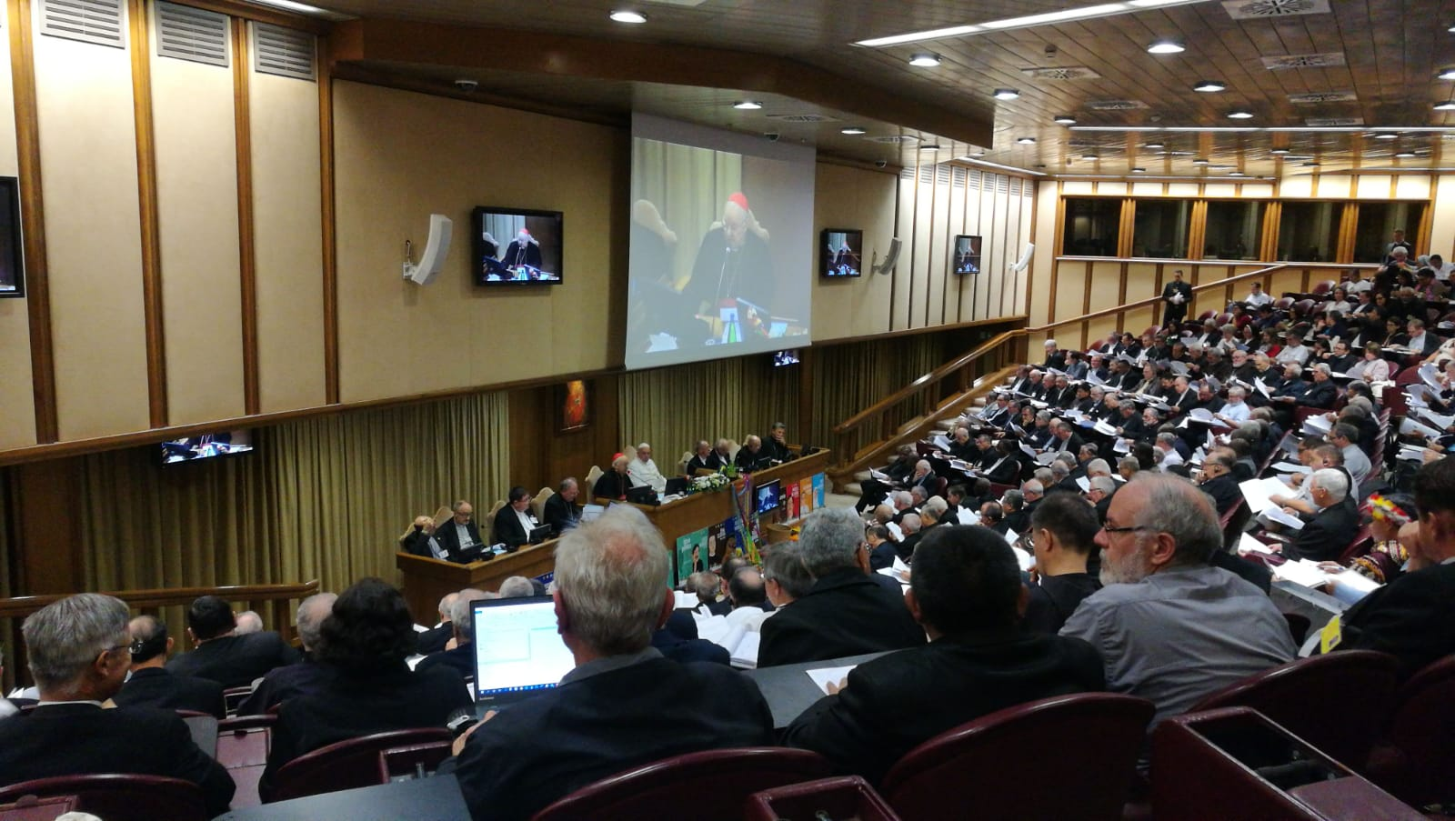
The experience of the synod on the Amazon
“new paths for the Church and for an integral ecology”.
The vision of integral ecology and synodality are deeply articulated
Notes:
citizens at once of the Church and of the world, needing both, loving both, caring for both. “Setting others free from their forms of bondage surely involves caring for the environment and defending it, but, even more, helping the human heart to be open with trust to the God who not only has created all that exists, but has also given us himself in Jesus Christ” (QA 41).
It is good thing to work for the good of the earth motivated by a secular vision of ecology, yet a transcendental theological understanding of the integrity of creation can enrich and deepen our commitment to an integral ecology, and help repair the variety of ways that human beings have misunderstood and abused the gifts and fruits of the earth.

Slide 15

The Amazon region, a laboratory for society and for the Church
The implementation of Laudato Si requires a synodal Church and synodality is the way for a missionary Church promoting integral ecology in our societies.
Ecological conversion and synodal conversion go hand in hand
Notes:
What resonances do you see between synodality and ecology and Laudato Si?
Everyone’s talents are needed.
Hearing the cries of the poor, the earth, all the peripheries
It´s all connected
An opportunity for the church to truly hear the cry of the earth and the cry of the poor
the emphasis on listening
Walking together
The process, trust and co-ownership. To change everything we need everyone
I really liked the "if you want to be Heard you should be ready to listen". Listening to others is the most vital part.
I heard the invitation to listen to the margins in the synodal process. Which echoes Laudato Si - hearing the cry of the earth and the cry of the poor.
the inclusivity of this synod
Listening to the Holy Spirit through members of creation
need to listen
Listen to everyone, esp the poor and the earth
Listening and participation.
Talking and walking Together
Union of all creatures, all are needed, all are equal
Guidance from by the holly spirit
Walking together in the light of God's word
To listen and support - everyone and everything is always saying something.
Interconnectedness. Different parts of the body, all part of one body/system.
Truly important to listen to those who are not considering ecology and Laudato Si´as an important thing in order to understand and work on how to share with them this important message
synodality is a sign that we care of our common home and not of our own plans ..to change course
Listening and then wallking together
All of us can walk together in the same path, listen to one another about caring our common home. We can learn from each other
We are all one
Walking together is discovering the rhythm at which another walks.
Acknowledging the dignity, the Holy Spirit in every person, in every creature, in all God's creation; and listening to each
Listen and walk together, how beautiful! Invitation to be with others in movement and listening to the Holy Spirit and the brothers and not to be alone and static.

Slide 16
Called to integral conversion
From the Final Document of the Synod of the Amazon
17. Listening to the cry of the earth and the cry of the poor and of the peoples of the Amazon with whom we walk, calls us to a true integral conversion, to a simple and modest style of life, all nourished by a mystical spirituality in the style of St Francis of Assisi, a model of integral conversion lived with Christian happiness and joy (cf. LS 12). A prayerful reading of God's Word will help us to deepen and discover the groaning of the Spirit and encourage us in our commitment to care for our common home.
18. As a Church of missionary disciples, we pray for the grace of that conversion “whereby the effects of their encounter with Jesus Christ become evident in their relationship with the world around them" (LS 217); a personal and communal conversion which commits us to relate harmoniously with God's work of creation, which is our common home; a conversion which promotes new structures in harmony with the care of creation; a pastoral conversion based on synodality, which recognizes the interaction of all that is created. Such conversion will lead us to be a Church that reaches out and enters the hearts of all the Amazonian peoples. Thus, the conversion to the living Gospel, which is Jesus Christ, can only unfold in interconnected dimensions to prompt our reaching out to the existential, social and geographical peripheries of the Amazon. These dimensions are pastoral, cultural, ecological and synodal, and are developed in the next four chapters.
Notes:
This call to conversion is profound, and we know there are many ways in which we resist it, even if we know that it is good for us and for the greater good of others and the planet
We must explore together how to support one another in making this conversion, this metanoia, which involves the head, the heart, and the will, as well as a social commitment

Slide 17
The aim of the Synod 2021-2023
To (re)learn synodality
Reread and Practice
The Synodal conversion of the Church
Putting into practice the Synodal nature of the entire Church
Towards a “synodalization” of the whole Church at all levels
Walking together as a people of missionary pilgrims
to learn and practice synodality
Notes:
History suggests that we need a new way of organizing ourselves and acting collectively, that the use of power and the models of collective agency must evolve… We need to understand competition in its proper place, and develop more mature forms of economy, cooperation, collaboration, and co-creativity…

Slide 18
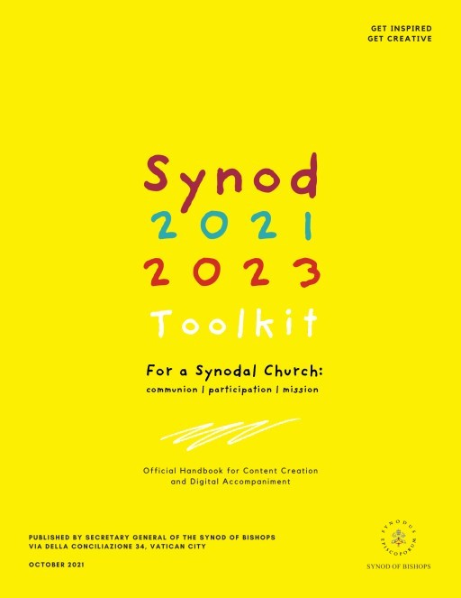
Among the objecfives of the synod
recalling how the Spirit has guided the Church’s journey through history and, today
living a participative and inclusive ecclesial process that offers everyone—especially those who for various reasons find themselves on the margins—the opportunity to express themselves and to be heard in order to contribute to the edification of the People of God;
recognizing and appreciating the wealth and the variety of the gifts and charisms
Notes:
The objectives of the Synod
recalling how the Spirit has guided the Church’s journey through history and, today, calls us to be, together, witnesses of God’s love;
living a participative and inclusive ecclesial process that offers everyone—especially those who for various reasons find themselves on the margins—the opportunity to express themselves and to be heard in order to contribute to the edification of the People of God;
recognizing and appreciating the wealth and the variety of the gifts and charisms that the Spirit liberally bestows for the good of the community and the benefit of the entire human family;
exploring participatory ways of exercising responsibility in the proclamation of the Gospel and in the effort to build a more beautiful and habitable world;
examining how responsibility and power are lived in the Church as well as the structures by which they are managed, bringing to light and trying to convert prejudices and distorted practices that are not rooted in the Gospel;
accrediting the Christian community as a credible subject and reliable partner in paths of social dialogue, healing, reconciliation, inclusion and participation, the reconstruction of democracy, the promotion of fraternity and social friendship;
regenerating relationships among members of Christian communities as well as between communities and other social groups, e.g., communities of believers of other denominations and religions, civil society organizations, popular movements, etc.;
fostering the appreciation and appropriation of the fruits of recent synodal experiences on the universal, regional, national, and local levels.

Slide 19
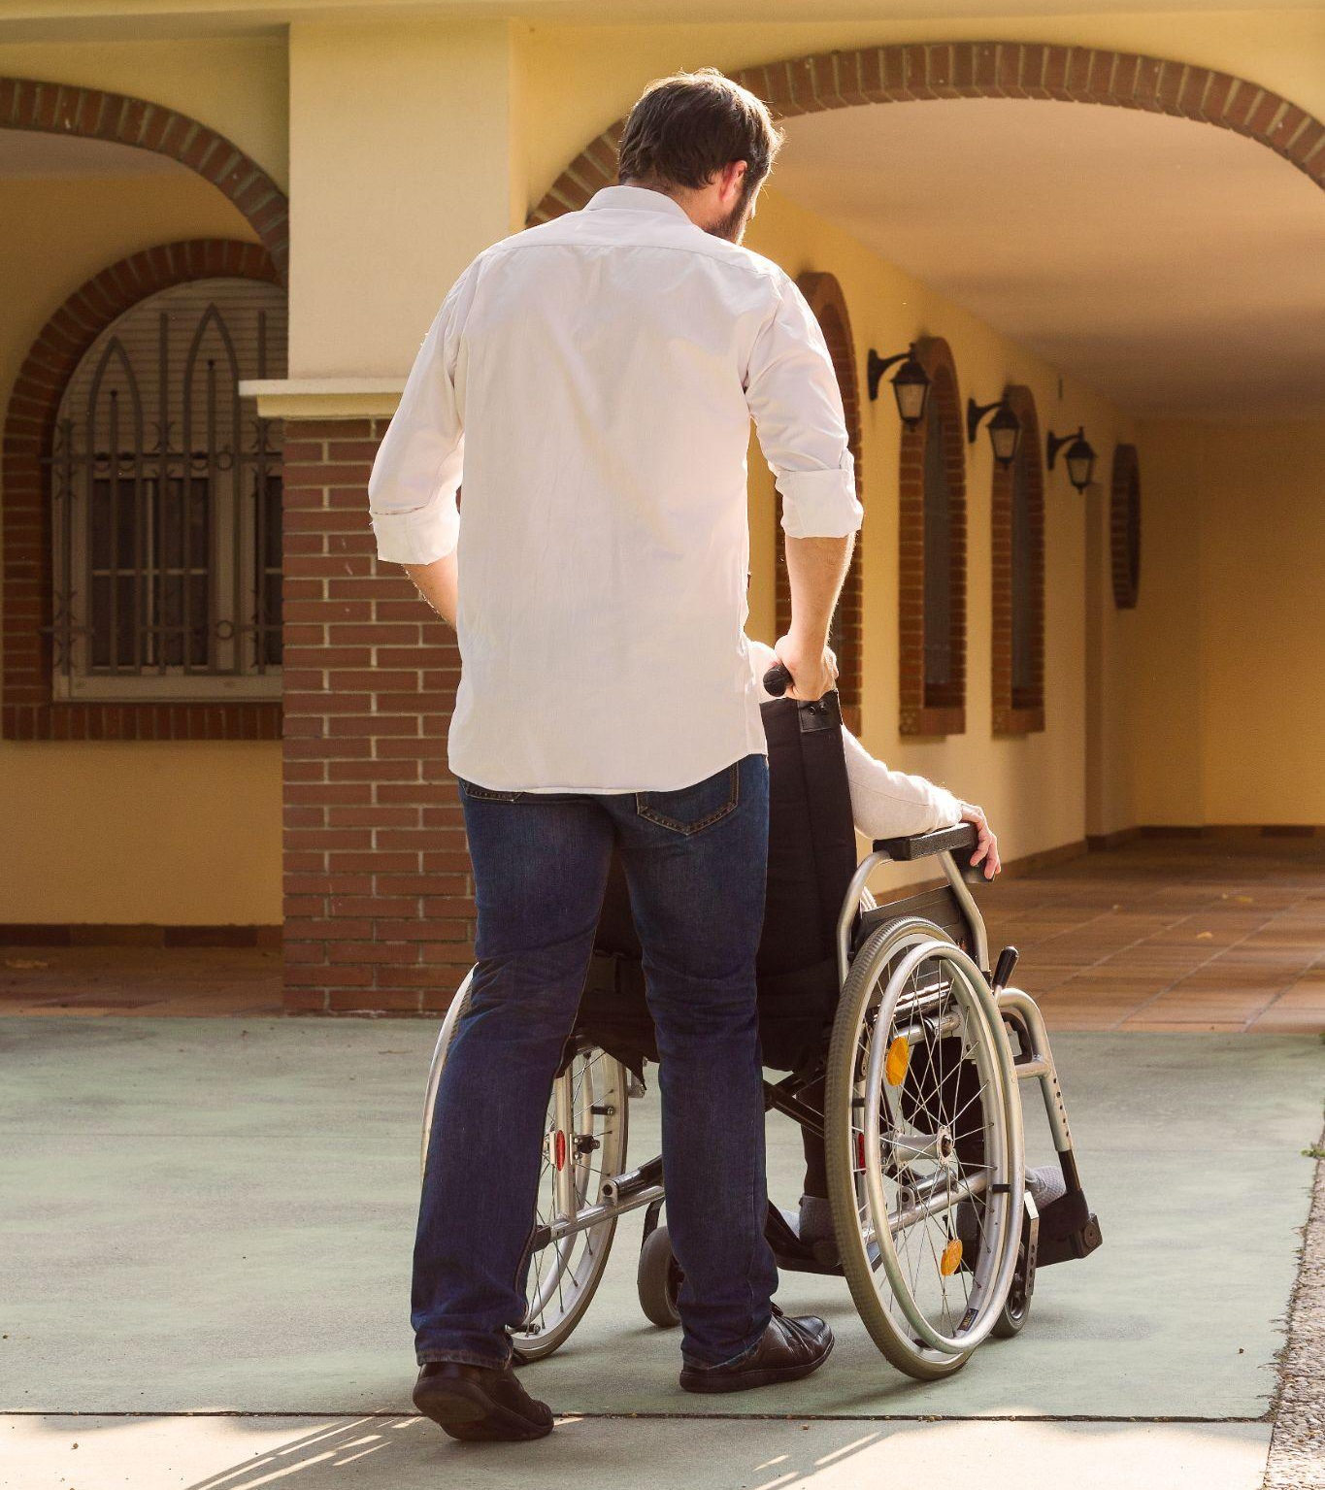
FOSTERING WIDE PARTICIPATION IN THE SYNODAL PROCESS WITH THE LAUDATO SI’ACTION PLATFORM
The goal is to ensure the participation of the greatest number possible, in order to listen to the living voice of the entire People of God.
This is not possible unless we make special efforts to actively reach out to people where they’re at, especially those who are often excluded or who are not involved in the life of the Church.
There must be a clear focus on the participation of the poor, marginalized, vulnerable, and excluded, in order to listen to their voices and experiences.
The Synodal Process must be simple, accessible, and welcoming for all.
Notes:
Networks can be a powerful instrument of synodality

Slide 20

CREATING A SYNODAL EXPERIENCE AND GATHERING THE FRUITS
The Vademecum aims to promote the practice of synodality on the local level: the goal is not simply to provide responses to pre-determined questions, but to open a space for sharing a synodal experience with one another at the local level.
To foster a synodal experience, the Vademecum proposes diverse methodologies and tools that can be adapted locally.
The diocesan synthesis should collect the fruits and honest feedback of participants from the local synodal experience, rather than transmitting generic summaries.
Notes:
The leveraging of diversity is a lesson from Integral Ecology, to produce greater creativity and fruitfulness

Slide 21
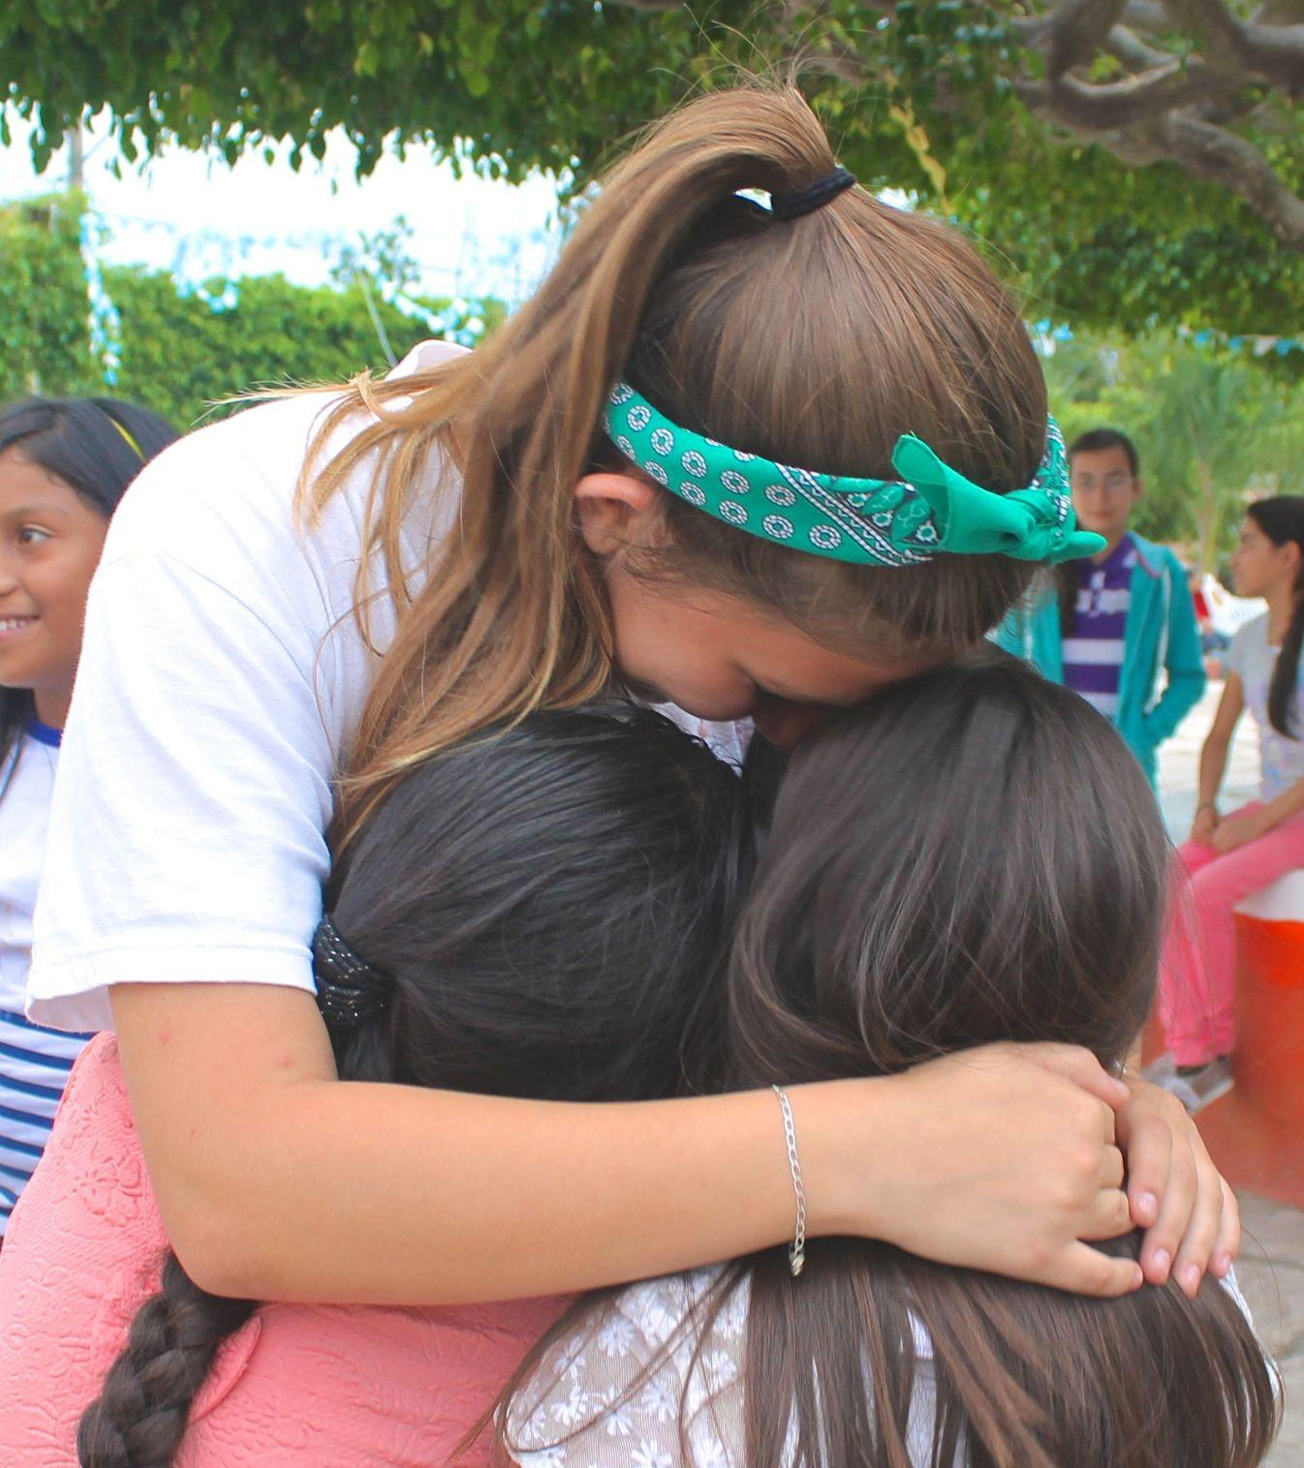
Basic Question of the Synodal Process
A basic question prompts and guides us: How does this “journeying together,” which takes place today on different levels (from the local level to the universal one), allow the Church to proclaim the Gospel in accordance with the mission entrusted to her; and what steps does the Spirit invite us to take in order to grow as a synodal Church? (PD, 2)
The fundamental question for the consultation of the People of God
A synodal Church, in announcing the Gospel, “journeys together:” How is this “journeying together” happening today in your local Church? What steps does the Spirit invite us to take in order to grow in our “journeying together”? (PD, 26)

Slide 22
Ten Themes to Explore
VI. DIALOGUE IN CHURCH AND SOCIETY
Dialogue is a path of perseverance that also includes silences and sufferings, but which is capable of gathering the experience of persons and peoples.
What are the places and modes of dialogue within our particular Church?
VII. ECUMENISM
The dialogue between Christians of different confessions, united by one baptism, has a special place in the synodal journey.
VIII. AUTHORITY AND PARTICIPATION
A synodal Church is a participatory and co-responsible Church. What are the practices of teamwork and coresponsability?
IX. DISCERNING AND DECIDING
In a synodal style, decisions are made through discernment, based on a consensus that flows from the common obedience to the Spirit.
X. FORMING OURSELVES IN SYNODALITY
The spirituality of journeying together is called to become an educational principle for the formation of the human person and of the Christian, of the families, and of the communities.
I. COMPANIONS ON THE JOURNEY
In the Church and in society, we are side by side on the same road.
II. LISTENING
Listening is the first step, but it requires having an open mind and heart, without prejudice.
III. SPEAKING OUT
All are invited to speak with courage and parrhesia, that is, integrating freedom, truth, and charity.
IV. CELEBRATION
“Journeying together” is only possible if it is based on communal listening to the Word and the celebration of the Eucharist.
V. SHARING RESPONSIBILITY FOR OUR COMMON MISSION
Synodality is at the service of the mission of the Church, in which all members are called to participate. How does the community support its members committed to service in society (… in caring for the Common home…)

Slide 23
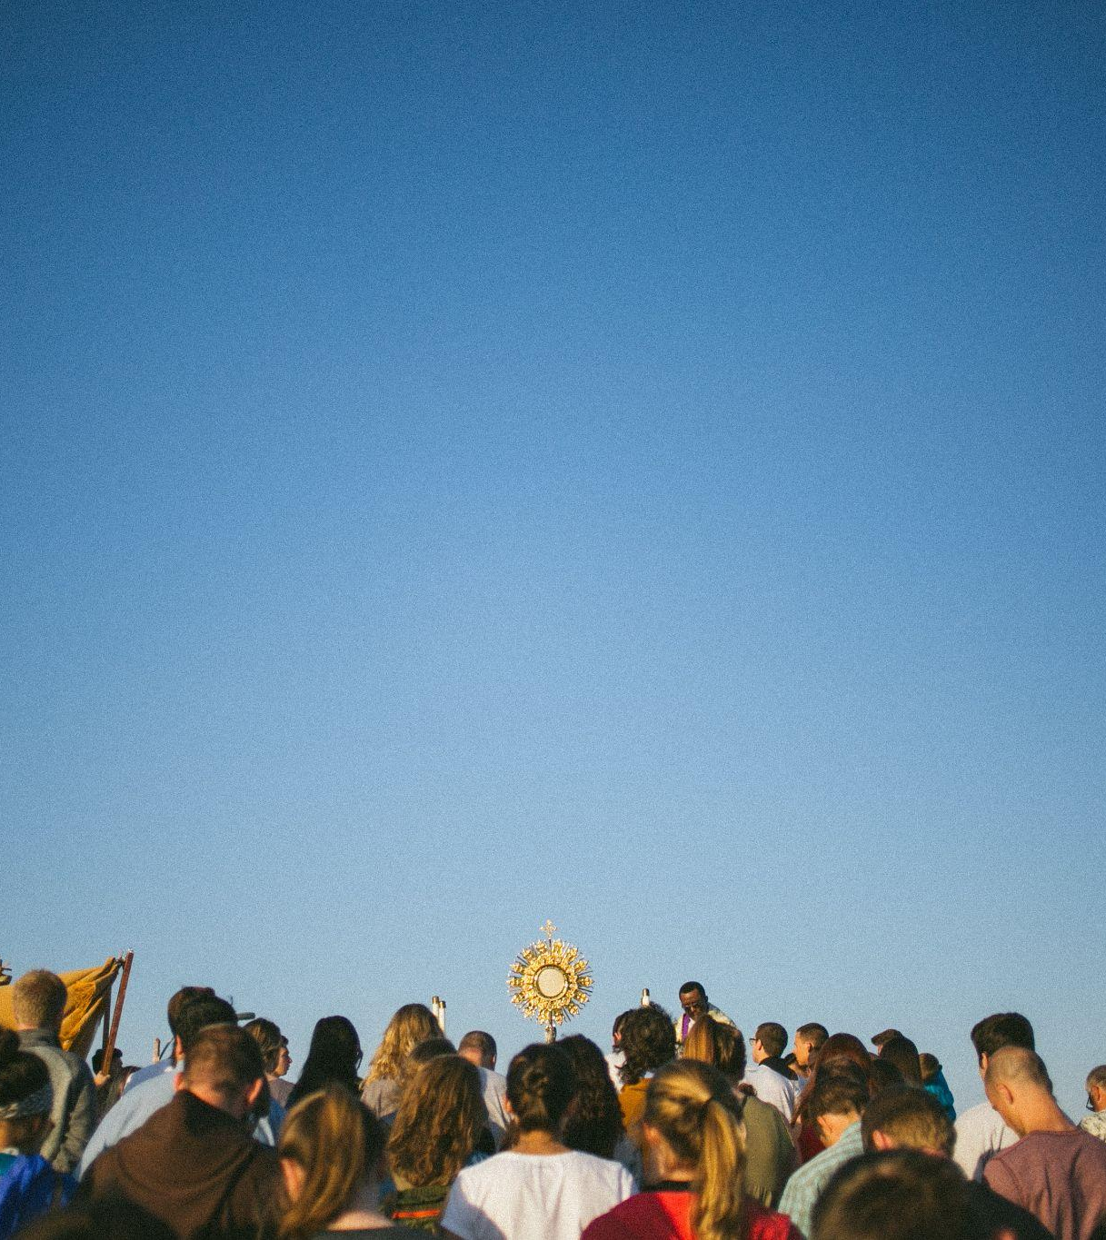
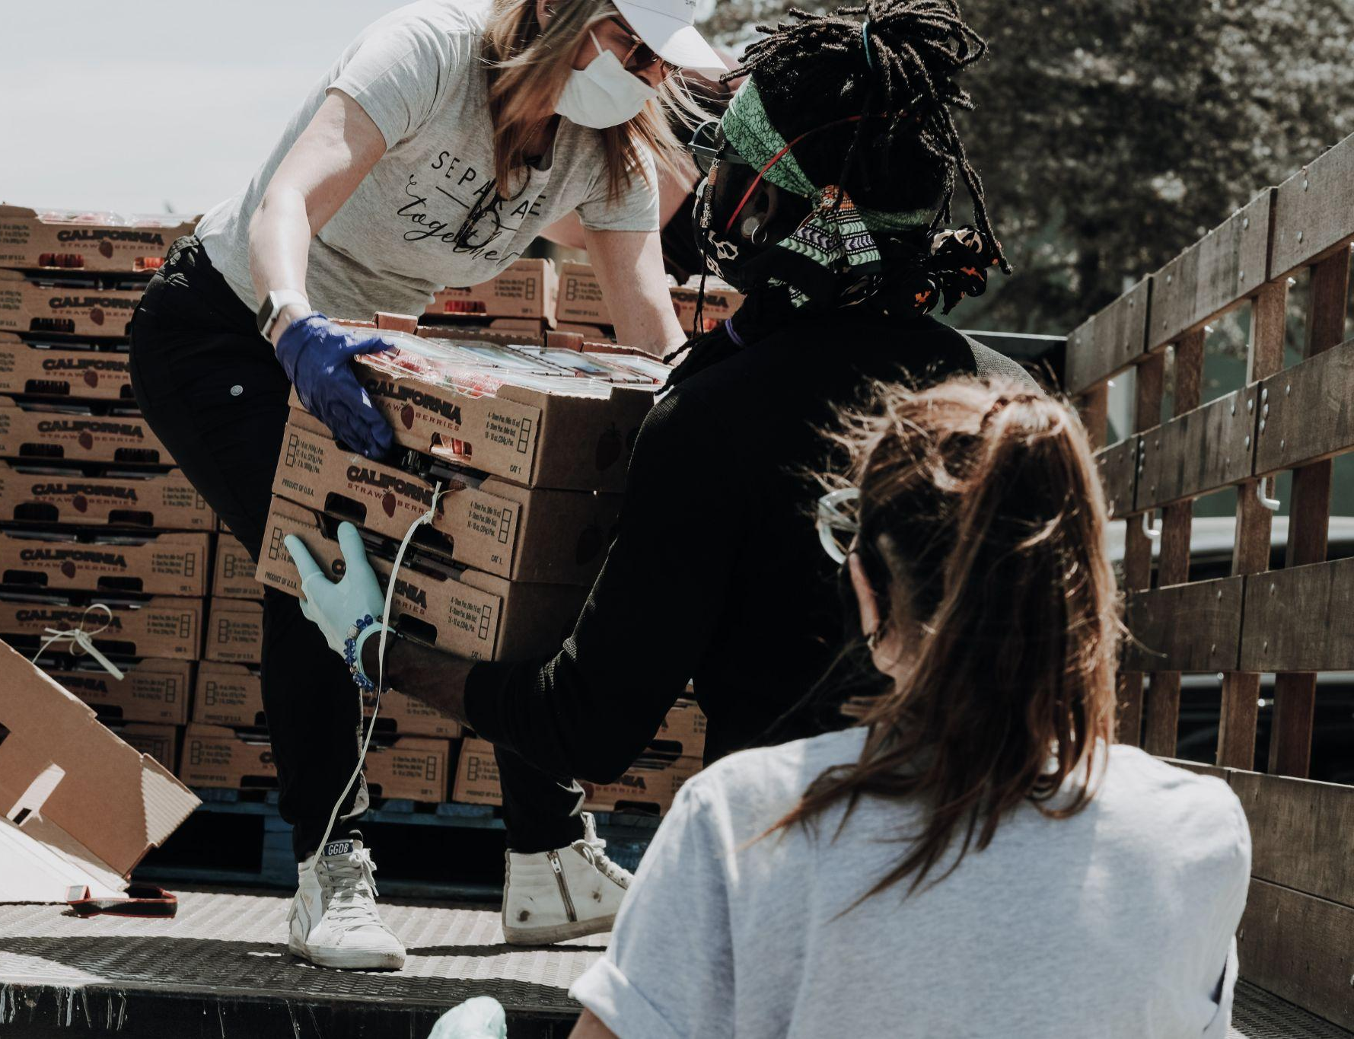
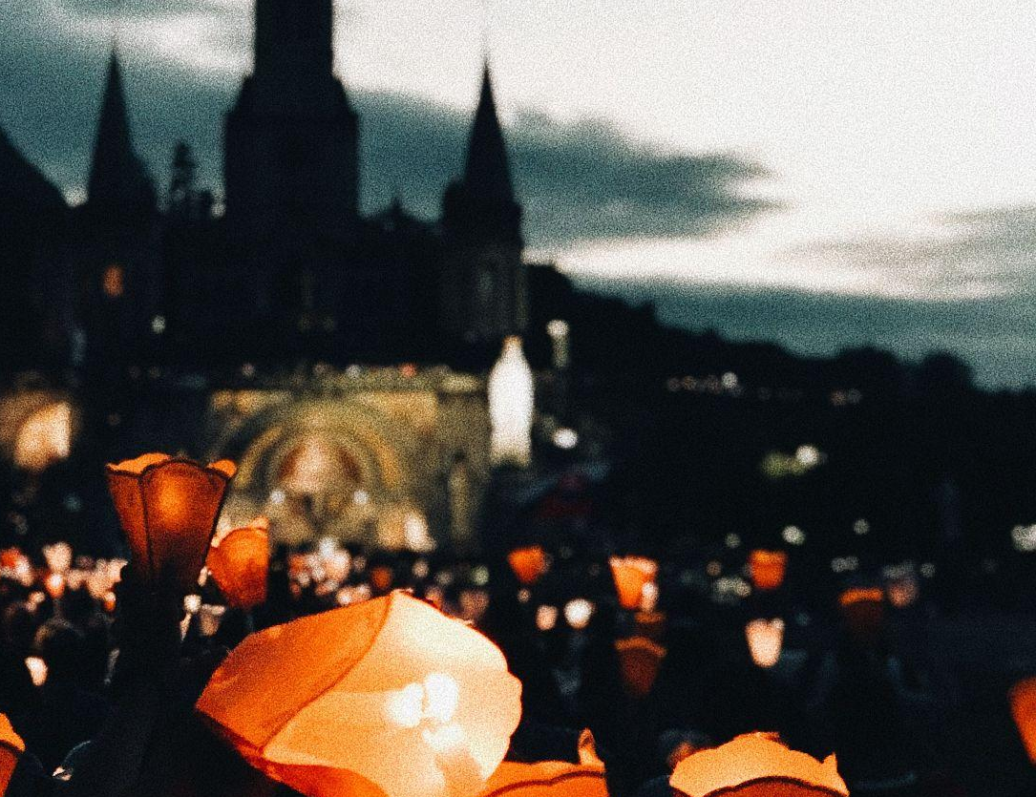
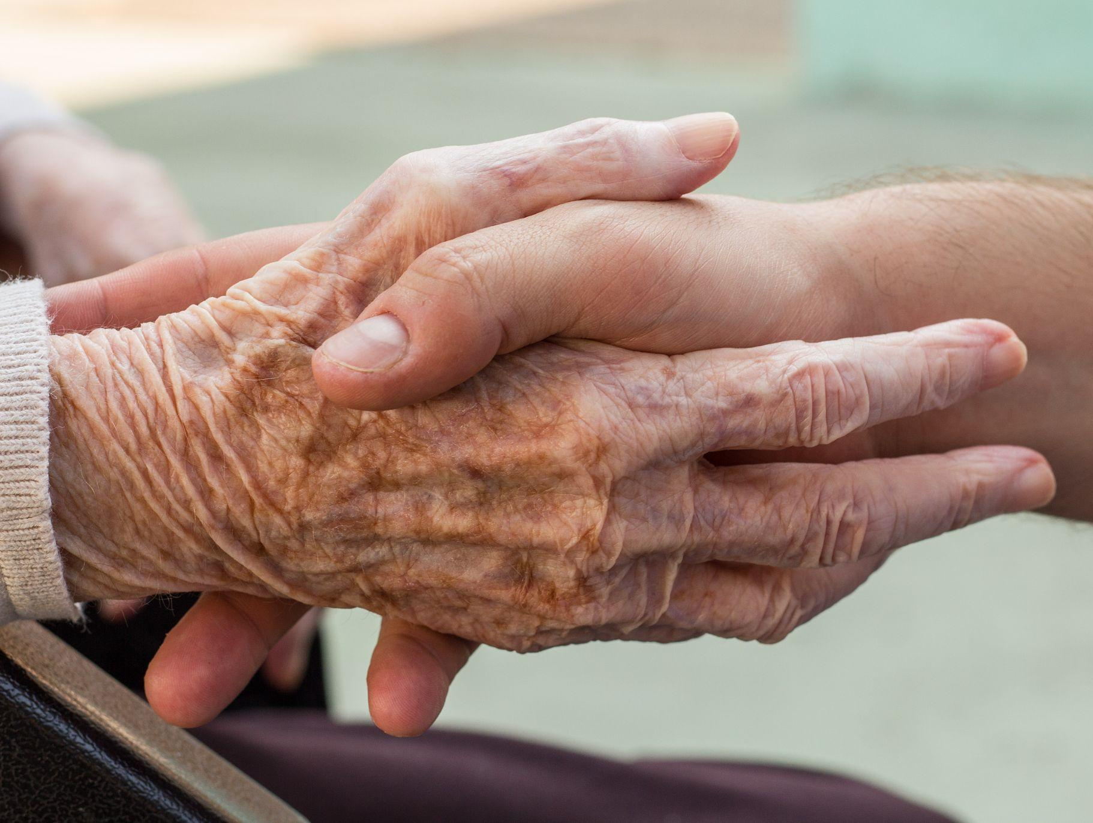
“The purpose of the Synod, and therefore of this consultation, is not to produce documents, but “to plant dreams, draw forth prophecies and visions, allow hope to be nourished, inspire trust, bind up wounds, weave together relationships, awaken a dawn of hope, learn from one another, and create a bright resourcefulness that will enlighten minds, warm hearts, give strength to our hands.”” (PD, 32)
Notes:
Synodality, a manifestation of the Holy Spirit’s initiative for the Church, is motivated not by fear of scarcity or simply the avoidance of calamity, but rather, is a positive, hope-filled way forward, creating space and the conditions for a co-creative vision of an eco-social future that is inspired and inspiring

Slide 24
Conclusion :
Synodality is to pass from the « I » to the « WE »
The vision of an ecclesial « we »
Synodality awakens and strengthens the ecclesial "we".
Synodality aims at and produces communion in the service of the "common home”
With Laudato Si the proposal to build an « us » for the « common home »
Recovering the primacy of the community sense
Synodality and Laudato Si rooted in a relational anthropology « the human family’s innate vocation to fraternity » FT26 « we need to think of ourselves more and more as a single family dwelling in the common home » FT17
EG and FT as a connector between LS and Synodality
QA 20 "Life is a community journey in which tasks and responsibilities are distributed and shared according to the common good".

Slide 25
A dynamic and systemic vision
An integral ecclesiology
Relationship and community
Listening and dialogue
Participation and co-responsibility
Reciprocity and circularity
The enhancement of charisms
"Synodality is the secret of links “
  G. Costa, sj », special secretary at the synod on youth
Synodality is to get out of a competitive vision
Synodality is moving from "I" to "we”
Notes:
73. Inculturation elevates and fulfills. Certainly, we should esteem the indigenous mysticism that sees the interconnection and interdependence of the whole of creation, the mysticism of gratuitousness that loves life as a gift, the mysticism of a sacred wonder before nature and all its forms of life.
At the same time, though, we are called to turn this relationship with God present in the cosmos into an increasingly personal relationship with a “Thou” who sustains our lives and wants to give them a meaning, a “Thou” who knows us and loves us

Slide 26
Ressources to go further
Official website of the synod with all the documents https://www.synod.va/en.html
Preparatory document of the synod https://www.synod.va/en/news/preparatory-document.html
Handbook/Vademecum in english for the synodal consultation https://www.synod.va/en/news/vademecum-for-the-synod-on-synodality.html
Synod prayer site (find or share a prayer) https://www.prayforthesynod.va/en/
Synod Resource Site (find or share resources) https://www.synodresources.org/
Subscribe to the synod newsletter https://www.synod.va/en/documents/choose-your-mailing-list.html
USCCB website for the synod https://www.usccb.org/synod
Articles on the synod and synodality https://bc.academia.edu/NathalieBecquart

Slide 28


Thank you!

Slide 29
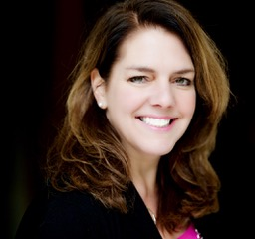
Together in the Journey:
The Synod, the Laudato Si' Action Platform, and the Eucharistic Revival
Kerry Robinson
Executive Partner
Leadership Roundtable

Slide 30
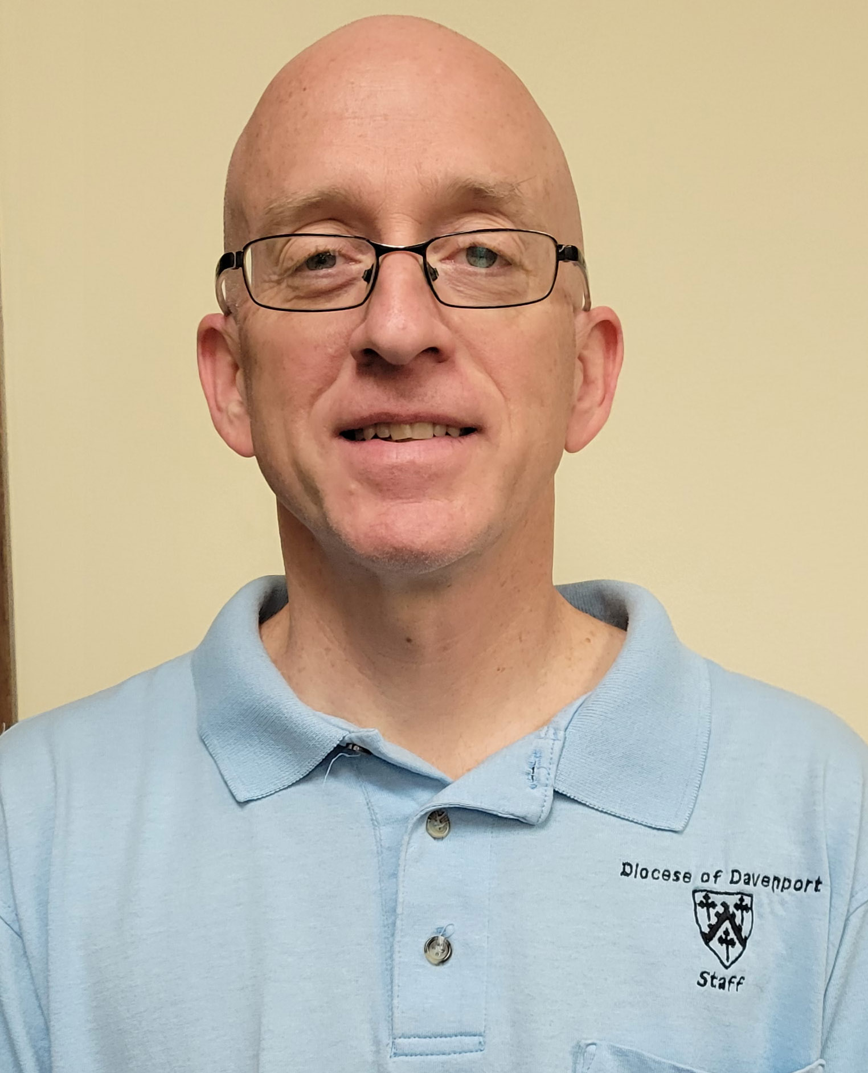
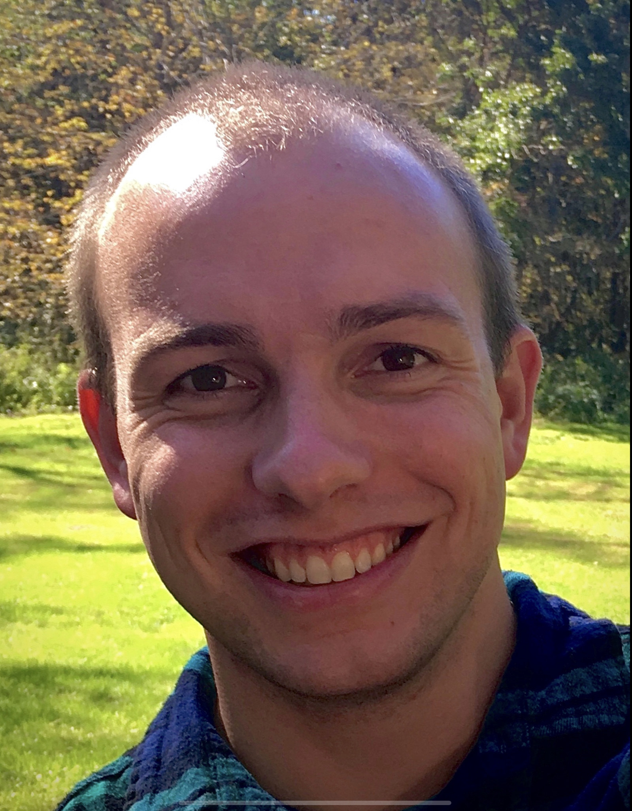
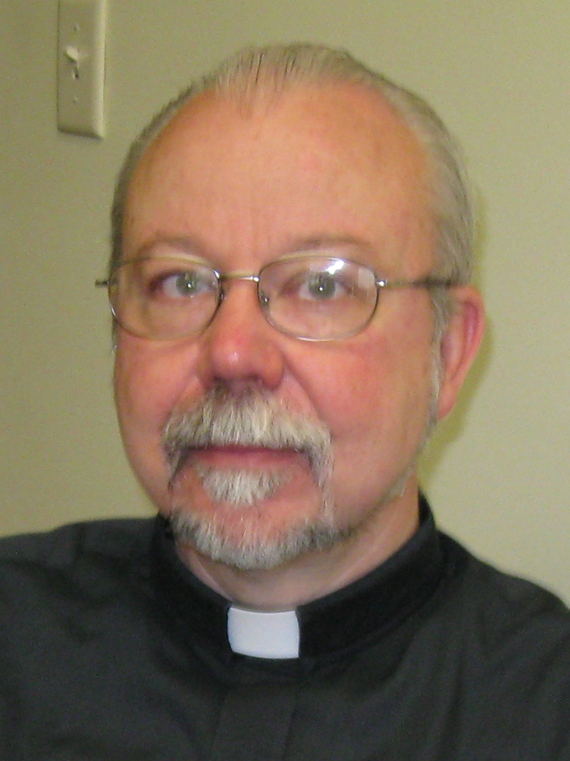
Together in the Journey:
The Synod, the Laudato Si' Action Platform, and the Eucharistic Revival
Kent Ferris OFS
Director of Social Action Diocese of Davenport
Patrick Schmadeke
Director of Evangelization Diocese of Davenport
Deacon Francis L. Agnoli, OFS Director of Liturgy & Director of Deacon Formation
Diocese of Davenport

Slide 31



Together in the Journey: The Synod, the Laudato Si' Action Platform and the Eucharistic Revival
Diocese of Davenport
Catholic Climate Covenant
February 10, 2022

Slide 32
Backstory
Deacon Frank Agnoli

Slide 33
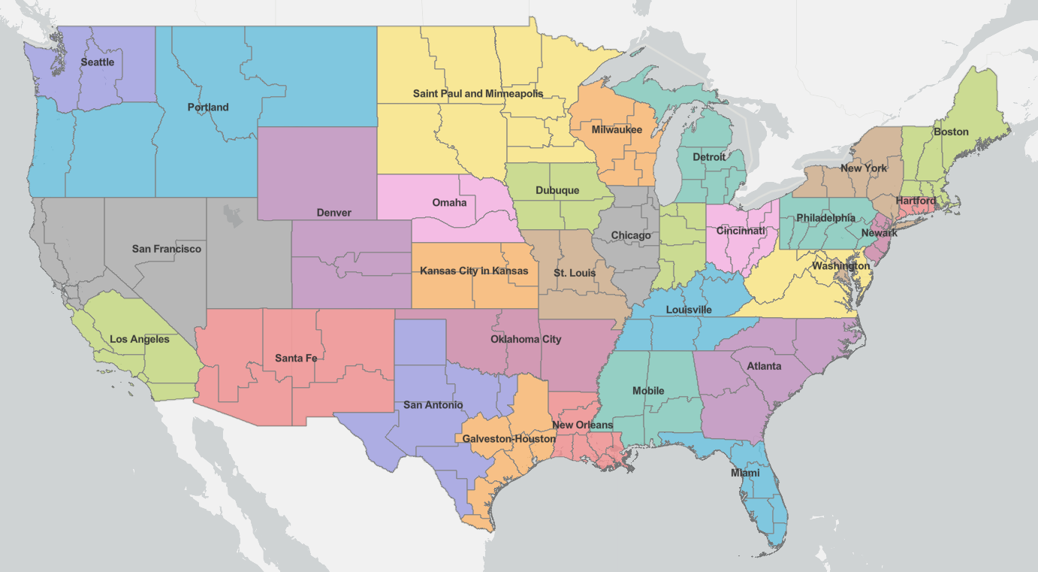
Image source: https://www.arcgis.com/apps/Media/index.html?appid=8d8afe7a04db4a14ad48c1a841012cfd

Slide 34
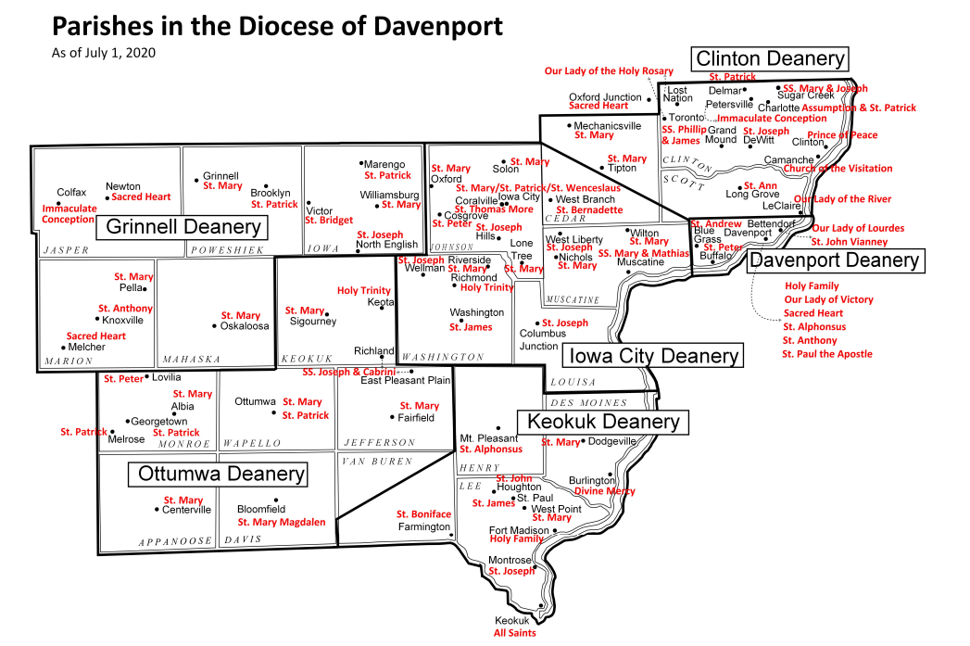
Total population: 775,422
Catholic population: 85,648 (11%)
Parishes: 74
Elementary Schools: 13
High Schools: 5
Catholic Universities: 1
Chancery Staff
>Ministry-Related: 12FT/8PT/4V
>Finance/Support: 23FT/2PT/3V

Slide 35
“We’re doing what… by when??”
Ongoing projects | Diocese of Davenport | 2021 |  |  | 2022 |  |  |  |  |  |  |  |  |  |  |  | 2023 |  |  |  |  |  |  |  |  |  |  |  | 2024 |  |  |  |  |  |  |  |  |  |  |  | 2025
 | O | N | D | J | F | M | A | M | J | J | A | S | O | N | D | J | F | M | A | M | J | J | A | S | O | N | D | J | F | M | A | M | J | J | A | S | O | N | D | J | F | M | A | M | J | J | A | S | O | N | D
Synod on Synodality
Diocesan phase
Episcopal conference phase (USCCB) |  |  |  |  |  |  | - | - | -
Continental phase
Synod of Bishops in Rome
Our ongoing focus on synodality
Laudato Si Action Platform
Dioceses around the world sign-up
Grant funding for Summer Student Intern
Earth Day at SAU and elsewhere in Diocese
Day of Prayer for Creation / Season of Creation
Feast Day of St. Francis; Official LSAP release* |  |  |  |  |  |  |  |  |  |  |  |  | *
7 years of discernment and action
Eucharistic Revival
Planning behind the scenes
Diocesan renewal
>Diocesan Eucharistic Procession (6/19)
>possible diocesan congress/gathering
>national Eucharistic preachers avail.
Parish renewal
>possible parish Euch Processions (6/18)
4-day National Eucharistic Congress (7/17-21)
Ongoing Renewal / Missionary Sending

Slide 36
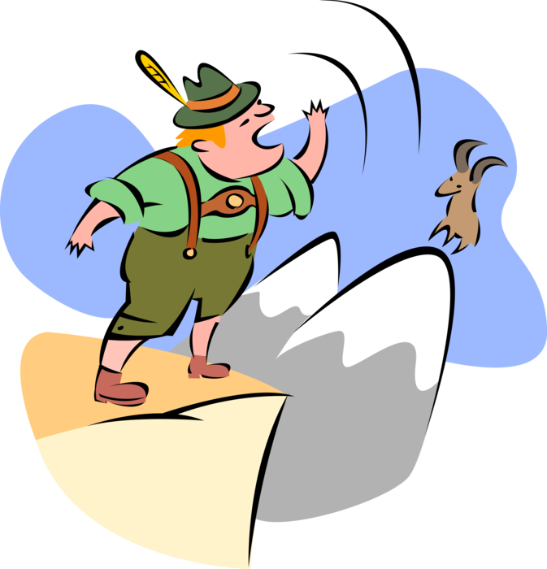
“OK… but who’s gonna do all this??”
Bishop
Key Offices / Contacts
Other Offices
Synod: Vicar General / Evangelization
Laudato Si’: Social Action
Eucharistic Revival: Liturgy
Faith Formation
Schools
Multicultural Ministry
Whole Chancery
Diaconate
The Catholic Messenger
incl. Marriage & Family Ministry
Communication / Chancellor
Synod-al-ay-ee-hoo!

Slide 37
“Why bother?”
Eucharistic Revival
Laudato Si’
Synod
What does a SYNODAL CHURCH, drawing its life from the EUCHARIST,
and responding to the CRY OF THE EARTH and the
CRY OF THE POOR,
look like?

Slide 38
Synod on Synodality
Patrick Schmadeke

Slide 39
Timeline
October 17 | Opening Liturgy
October – November (training and preparation) | Diocesan Synod website
 | Build and training parish Synod teams
 | “Homily helps,” synodal rosary, intercessions for Mass; Liturgy of the Word
December | Diocesan Synod guidebook published
January – April | Listening sessions across the diocese
May – June | Synthesize findings in listening session reports
June 30 | Diocesan 10 page report due to USCCB

Slide 40
A synodal Church, in announcing the Gospel, “journeys together.” How is this “journeying together” happening today in your local Church? What steps does the Spirit invite us to take in order to grow in our “journeying together”?
Question from the Vademecum:

Slide 41
“based on your personal experience, what breaks your heart and what fills your heart about the Catholic Church?”
Our question for the Synod:

Slide 42
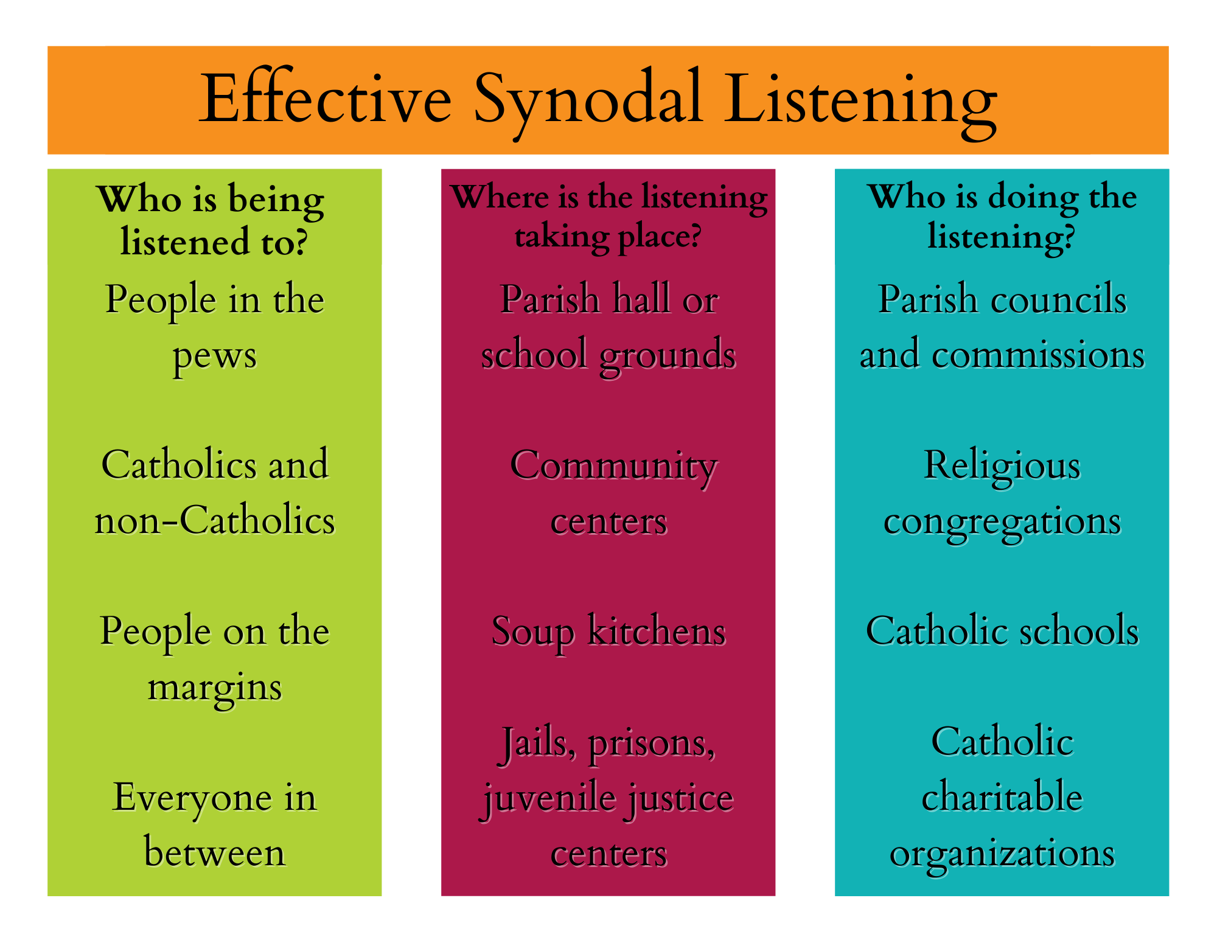

Slide 43
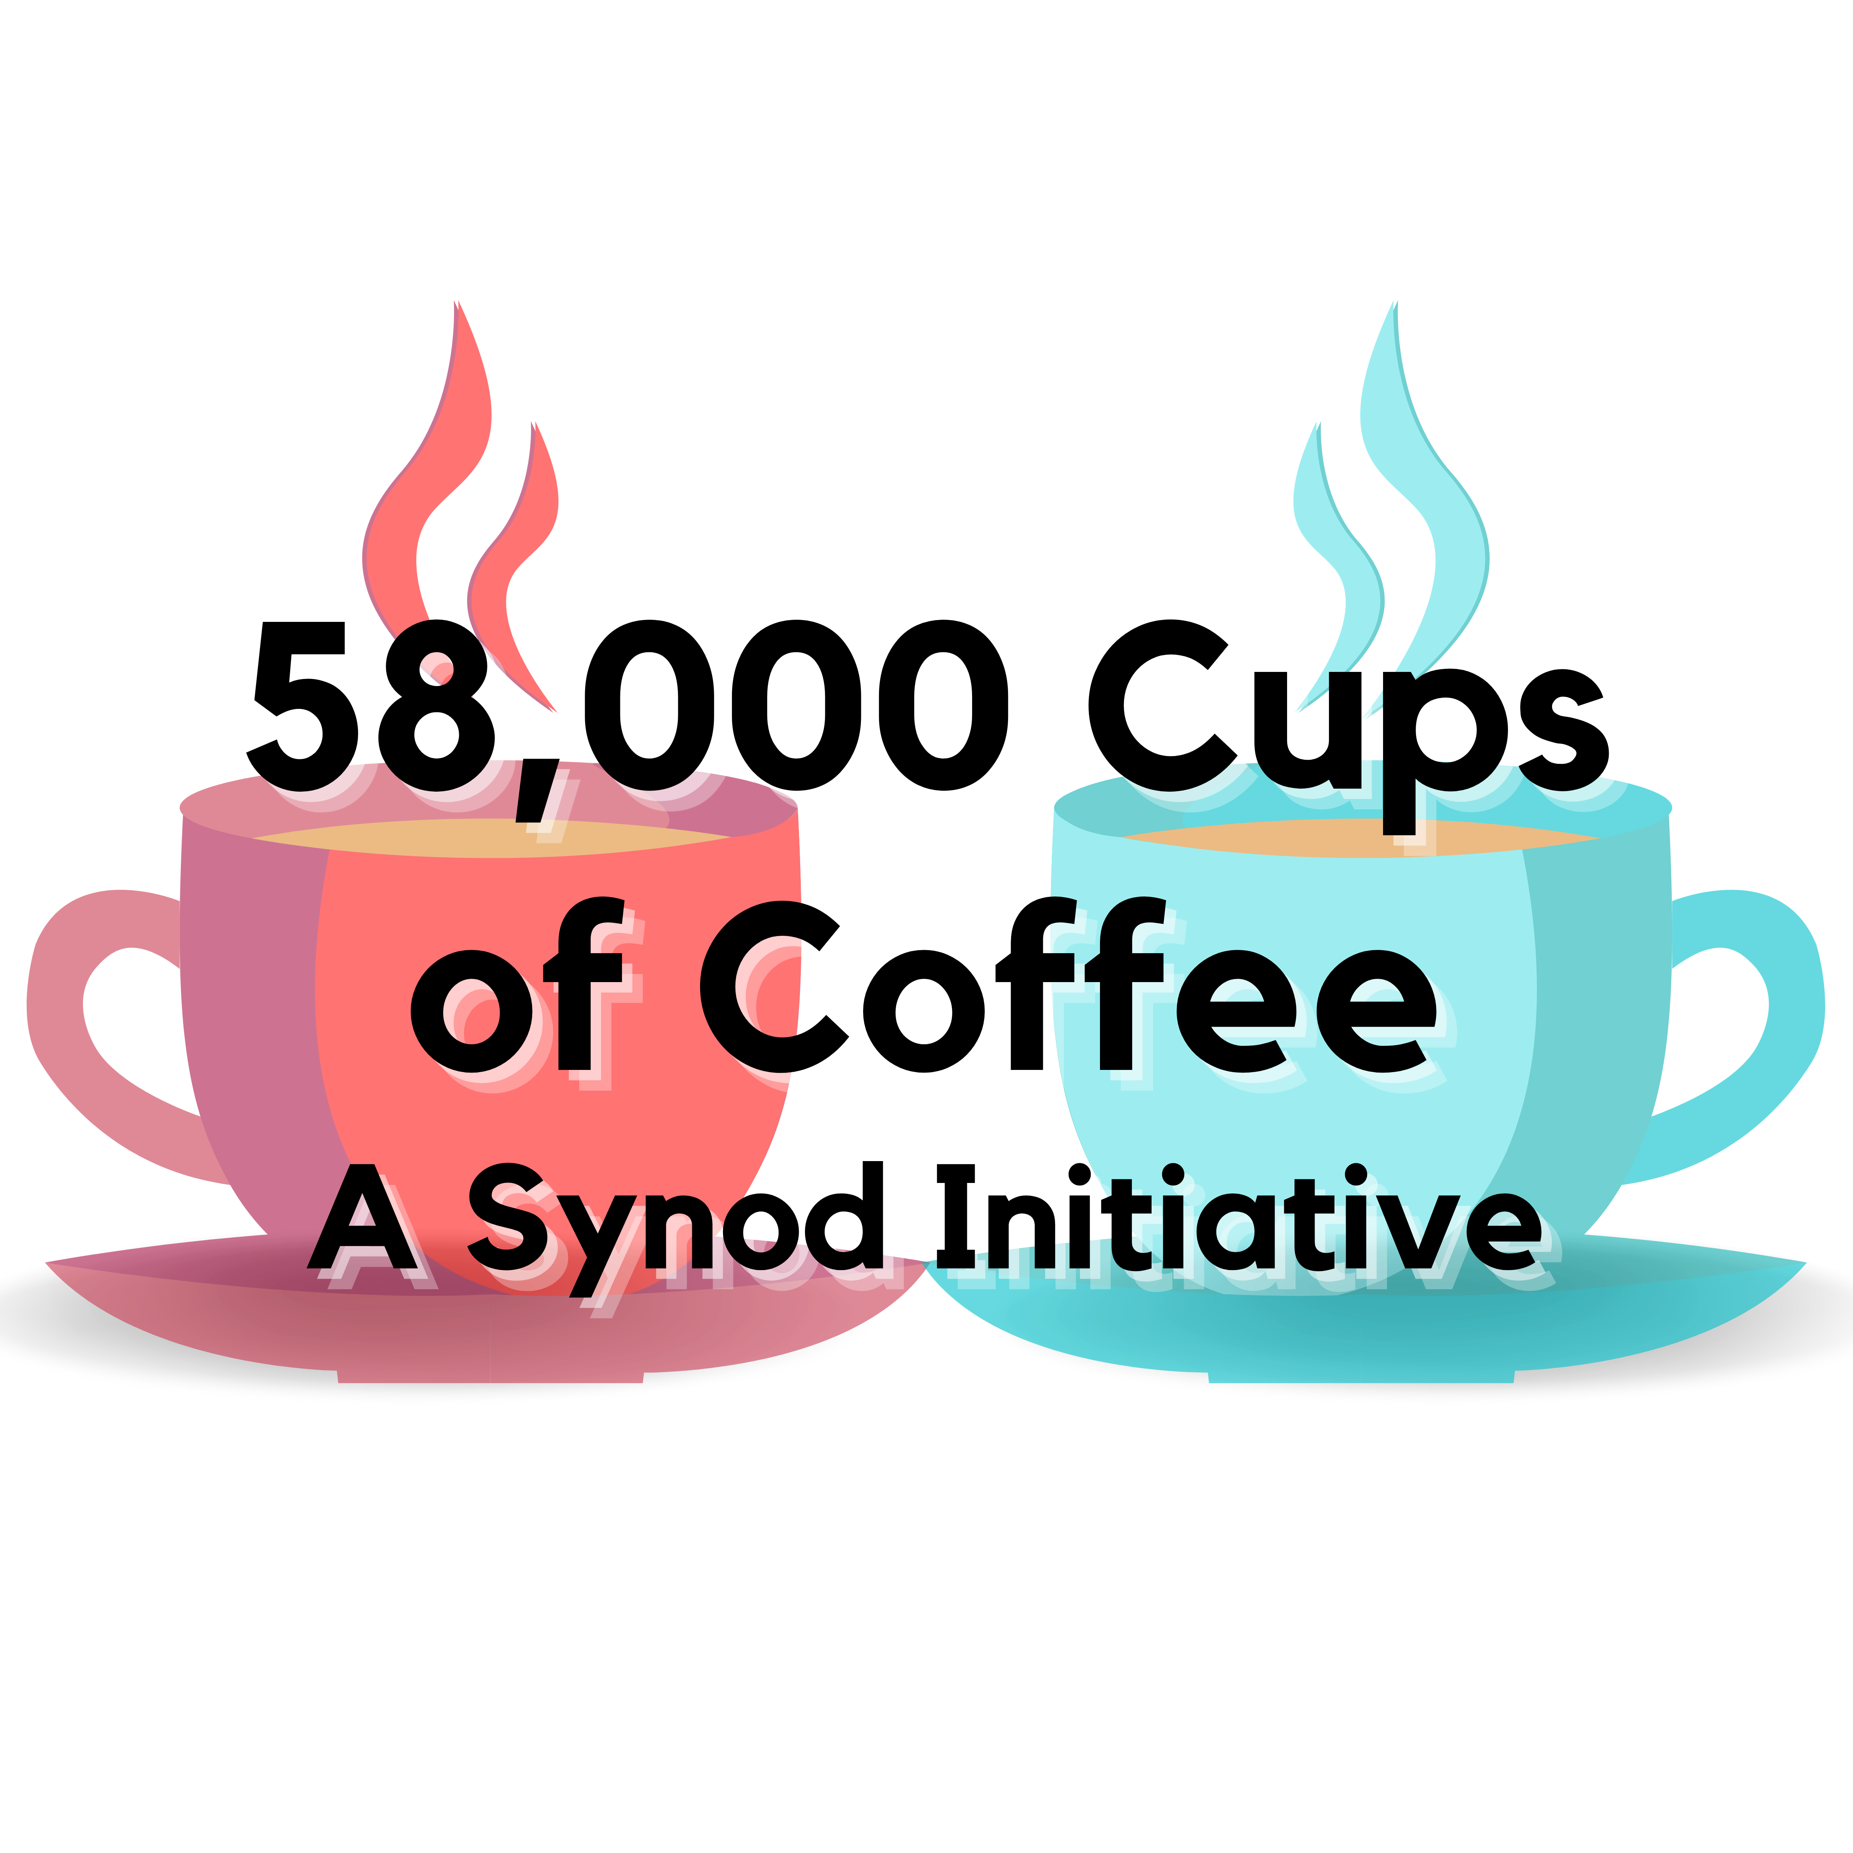

Slide 44
Backstory
Fall 2021 annual diocesan Mass Counts: 19,399. Just over 60% of pre-pandemic Mass Counts.
Bishop’s desire to focus on evangelization. Get outside the four walls of the parish. Bring joy of faith into everyday life.
Sr. Nathalie: “Synodality begins with coffee.”
Doing the math: 19,399 x 3 = 58,197

Slide 45
Here’s how it works:
We are inviting everyone who is currently in our pews to have at least one synod conversation with 3 people:
one person who is already in our pews,
one person who used to be in our pews but hasn’t been since the pandemic, and
one person who has either never been a part of a faith community or stopped practicing long ago.

Slide 46

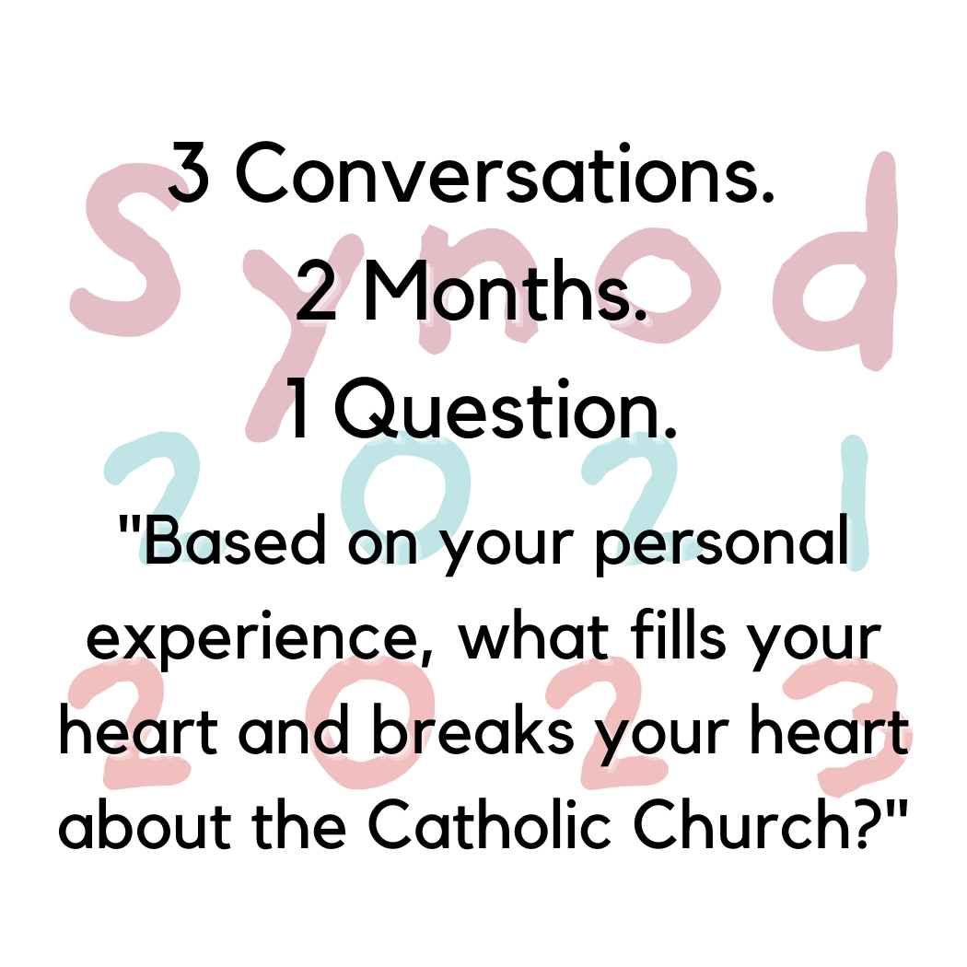
By the numbers: how is the Synod going?
Listening Sessions
36 reports in the last 37 days (1st session on January 4th)
Uptick coming in February, March, and April
58,000 Cups of Coffee
Ordered 10,000 coasters last week
Article in the diocesan newspaper today

Slide 47
Eucharistic Revival
Deacon Frank Agnoli

Slide 48
TRANS-FORMATION
Reception
SACRIFICE
Return-Gift
ENCOUNTER
Gift
MISSION
To renew the Church by enkindling a living relationship with the Lord Jesus Christ in the Holy Eucharist.
  VISION
  A movement of Catholics across the United States, healed, converted, formed, and unified by an encounter with Jesus in the Eucharist—and sent out in mission “for the life of the world.”

Slide 49





Foster encounters with Jesus through kerygmatic proclamation and experiences of Eucharistic devotion.
Contemplate and proclaim the doctrine of the Real Presence of Jesus in the Eucharist through the Truth of our teaching, Beauty of our worship, and Goodness of our accompaniment of persons in poverty and those who are vulnerable.
Empower grassroots creativity by partnering with movements, apostolates, parishes, and educational institutions.
Reach the smallest unit: parish small groups and families.
Embrace and learn from the various rich intercultural Eucharistic traditions.

Slide 50
Sacramentum caritatis
“A Mystery to be Celebrated”
We are baptized into Christ’s
Priestly Ministry
LEX ORANDI
-Beauty-
>Sacrament<
“A Mystery to be Lived”
We are baptized onto Christ’s
Royal Ministry
LEX VIVENDI
-Goodness-
>Ethics<
“A Mystery to be Believed”
We are baptized into Christ’s
Prophetic Ministry
LEX CREDENDI
-Truth-
>Scripture<
  “Worship pleasing to God can never be a purely private matter, without consequences for our relationships with others: it demands a public witness to our faith” (SC 83).

Slide 51
Eucharist as Sacrament of Unity (Mystery, 25)
Eucharist as Food for the Journey (Mystery, 51-5)
Connect to Baptism: Body of Christ (Mystery, 6, 26)
[USCCB Pillars 3-5]
Eucharistic Revival
Laudato Si’
Synod
Presence of Christ:
Encounter through assembly, minister, word, and sacrament;
[USCCB Pillar 1; Mystery, 21]
and in the poor (Mt 25)
and in creation (LS 99; cf Col)
Sacramentality
[SC 92 & LS, 233-37]
“Just as we are impelled by the Eucharist to hear the cry of the poor, and respond in love, we are also called to hear the cry of the earth and, likewise, respond with loving care.” (Mystery, 40)
[USCCB Pillar 2]
Mystery = The Mystery of the Eucharist in the Life of the Church

Slide 52
It is the entire Body of Christ that celebrates the Eucharist (full, conscious, active participation)
(CSL 14)
Respect the dialogical nature of the liturgy.
(GIRM 34)
Honor the gifts and ministries of all.
(CSL 28)
Preaching: address the questions that people are asking
(Pope Francis, EG 154-55)
Eucharistic Revival
Laudato Si’
Synod
If “what earth has given and human hands have made” is central to our worship:
Do we respect the symbols of the liturgy, using them fully and lavishly, rather than sparingly and minimally?
Do we use what is natural and authentic, rather than what is artificial and contrived?
How do we go about designing and building our churches?
Do we give voice to the “groaning” of creation?

Slide 53
Laudato Si ' Action Platform
Kent Ferris

Slide 54
Caring for Creation: not an overnight project
1224-Canticle of Brother Sun “All praise be yours, my Lord, through all that you have made…”
2009-First opportunity to meet with Executive Director of the Catholic Climate Covenant, Mr. Dan Misleh
2015-Release of Encylical, Laudato Si’ & Press Conference with IA Interfaith Power & Light, and the Iowa Catholic Conference
2015-Laudato Si’ Action Plan, U of Georgia and the Archdiocese of Atlanta
2019-Laudato Si’ Animator Training, Laudato Si’ Movement
2019-“Laudato Si’ and the U.S. Catholic Church”-Creighton University and the Catholic Climate Covenant
2019-Care for Common Home, Faith and Business Leaders, Diocese of Davenport, St. Ambrose University, In Solidarity
2021-“Laudato Si’ and the U.S. Catholic Church” 2nd Conference
2021-Faith, Business and Sustainability, Iowa Business for Clean Energy, In Solidarity, Diocese of Davenport
2021-Diocese of Davenport enrolls in the Laudato Si’ Action Platform, commits to LS’ Action Pla
2022-Building relationships with God, neighbors and the Earth, Bishop Zinkula, The Catholic Messenger Podcast
2022-Development of Diocesan plan, ongoing work with Catholic Climate Covenant, Creation Care Teams, Godsplanet.us

Slide 55
Overlap between Eucharistic Revival and Laudato Si’
Laudato Si #236
“Indeed the Eucharist is itself an act of cosmic love: “Yes, cosmic! Because even when it is celebrated on the humble altar of a country church, the Eucharist is always in some way celebrated on the altar of the world”. The Eucharist joins heaven and earth; it embraces and penetrates all creation.
“…the Eucharist is also a source of light and motivation, for our concerns for the environment, directing us to be stewards of all creation.”
Kevin Irwin, Models of the Eucharist
“Sacramental liturgy can help us reflect on the world in which we live and ponder our care for it, as well as our concern for those who dwell in it.”

Slide 56
Overlap between the Synod and Laudato Si’
Bishop Zinkula meeting with local Protestant ministers in a rural parish setting. Might we also listen to the cry of the earth?
Our goal is not to amass information or to satisfy curiosity, but rather to become painfully aware, to dare to turn what is happening to the world into our own personal suffering and thus to discover what each of us can do about it. (LS #19)
“Redistributive Suffering” (Fr. Robert Grant; local moral theologian)

Slide 57
End

Slide 58

Questions ?

Slide 59
Email us at: info@Catholicclimatecovenant.org
More info:
Catholic Climate Covenant
www.catholicclimatecovenant.org
&
www.Godsplanet.us

