Slide 1


Season of Creation Training: How to Engage Our Church Leaders for Climate Action
August 31st, 2021
CatholicClimateCovenant.org

Slide 2

  Prayer for Ecological Conversion
  God of the sun and the moon, of the mountains, deserts and plains,
  God of the mighty oceans, of rivers, lakes and streams
  God of all creatures that live in seas and fly in the air
  of every living thing that grows and moves on this sacred Earth.
  We are formed by Christ into Your People,
  called to bring the world into Your marvelous light.
  As the Body of Christ, we are messengers of ecological vocation.
  We are entrusted with caring for this Earth which You have created.
  Help us to love and respect it; to repair what we have damaged;
  to care for what You have made good and holy.
  Give us the wisdom and the passion to change our minds, our hearts and our ways.
  Let us be mustard seeds in our world bringing about ecological conversion which grows and
  spreads to every corner of the Earth.
  For our sake now and for every generation which is to come.
  We ask this through Christ, Our Lord. Amen.
  ~Catholic Earthcare Australia, 2002
  (used with permission in the 2021 Feast of St. Francis Program)

Slide 3
Season of Creation Training:
How to Engage Our Church Leaders for Climate Action
    1) The webinar is being recorded and will a link to the recording will be sent to everyone who registered within the next 24-48 hours.
2) Please type your questions in the Q/A box

Slide 4
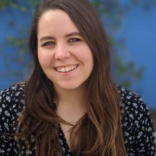
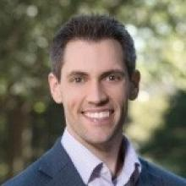
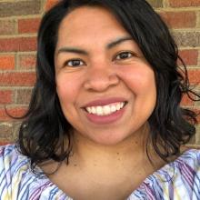
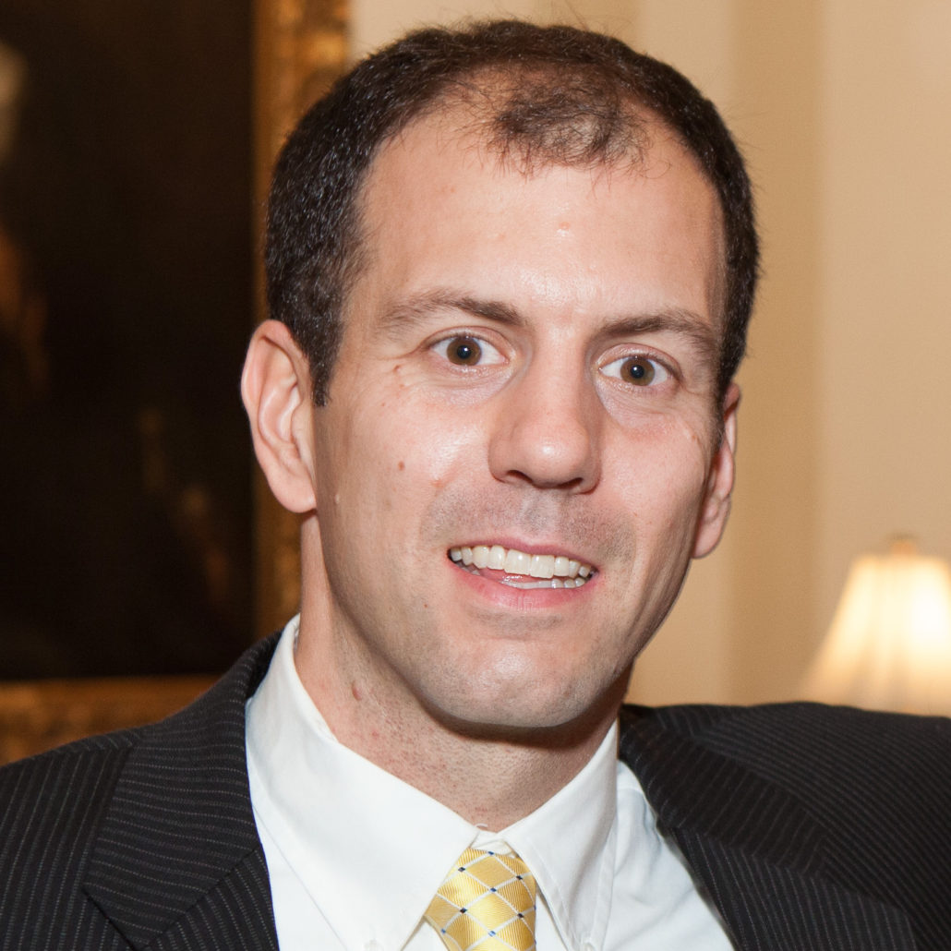
Season of Creation Training:
How to Engage Our Church Leaders for Climate Action
Anna Robertson
Catholic Climate Covenant
Dr. Dan DiLeo
Creighton University
& Catholic Climate Covenant Consultant
Elena Gaona
Catholic Climate Covenant
Christopher Kerr
Ignatian Solidarity Network
Moderators: Dan Misleh and Paz Artaza-Regan, Catholic Climate Covenant

Slide 5
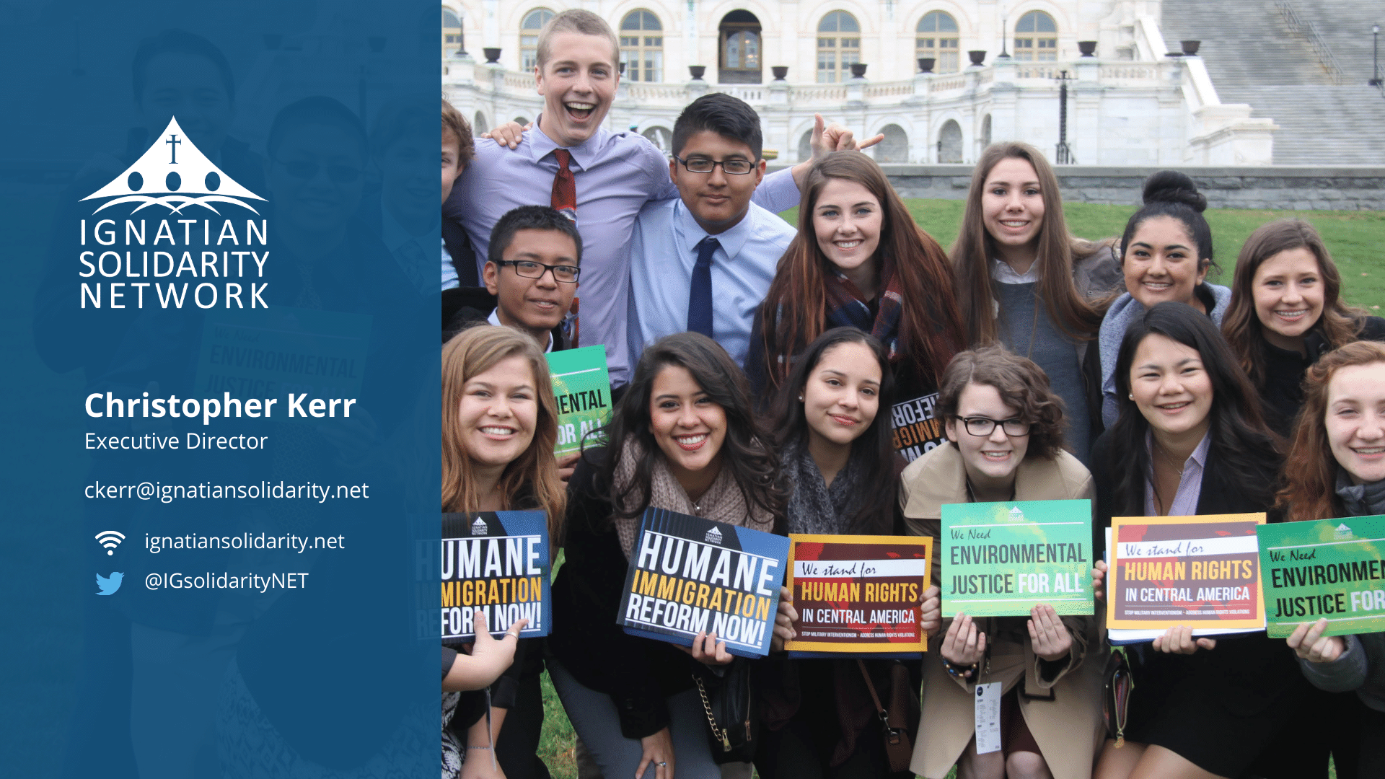

Slide 6
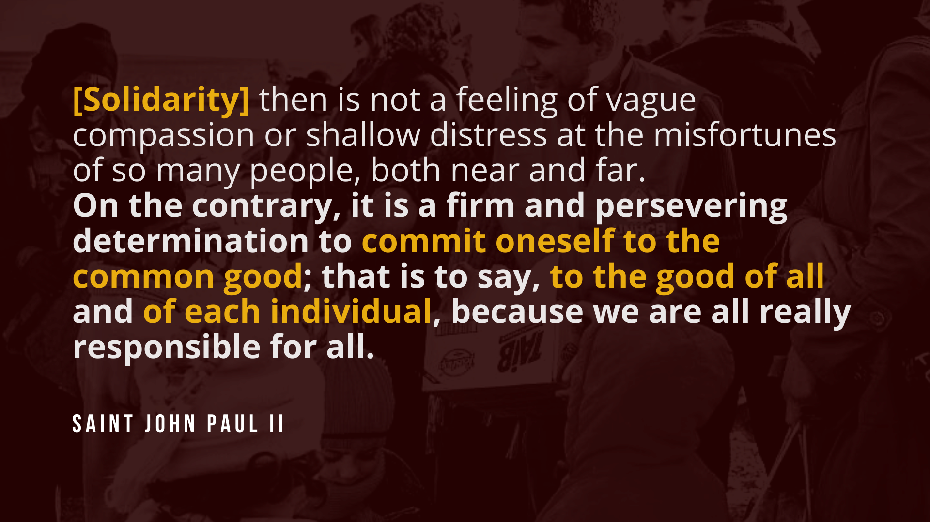

Slide 7


Slide 8
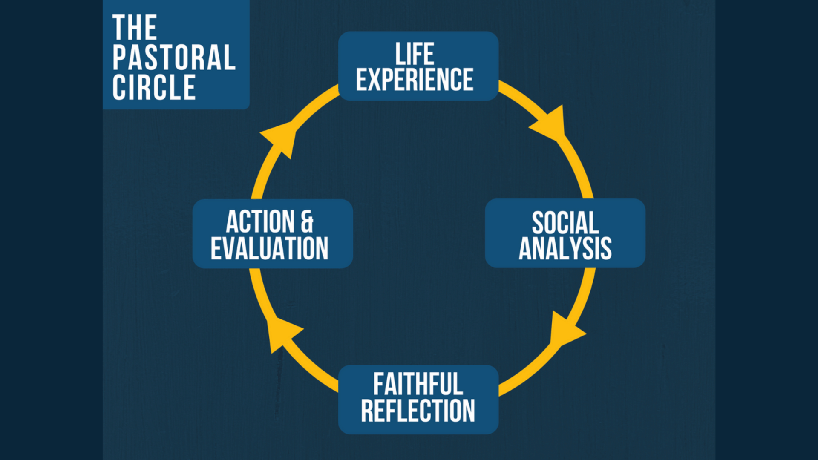

Slide 9
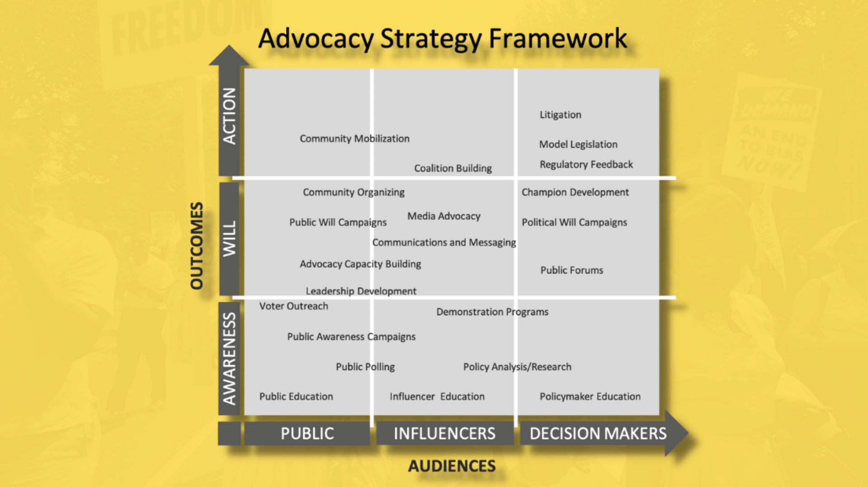

Slide 10
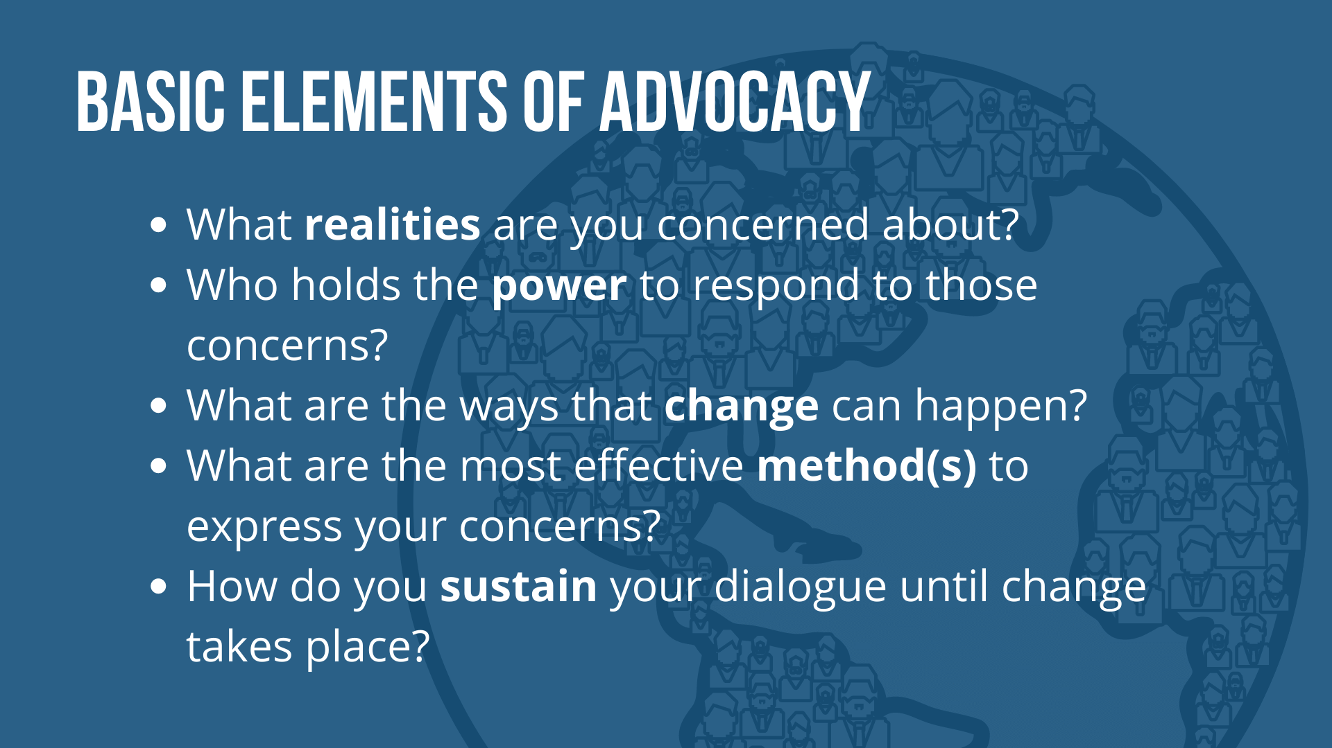

Slide 11
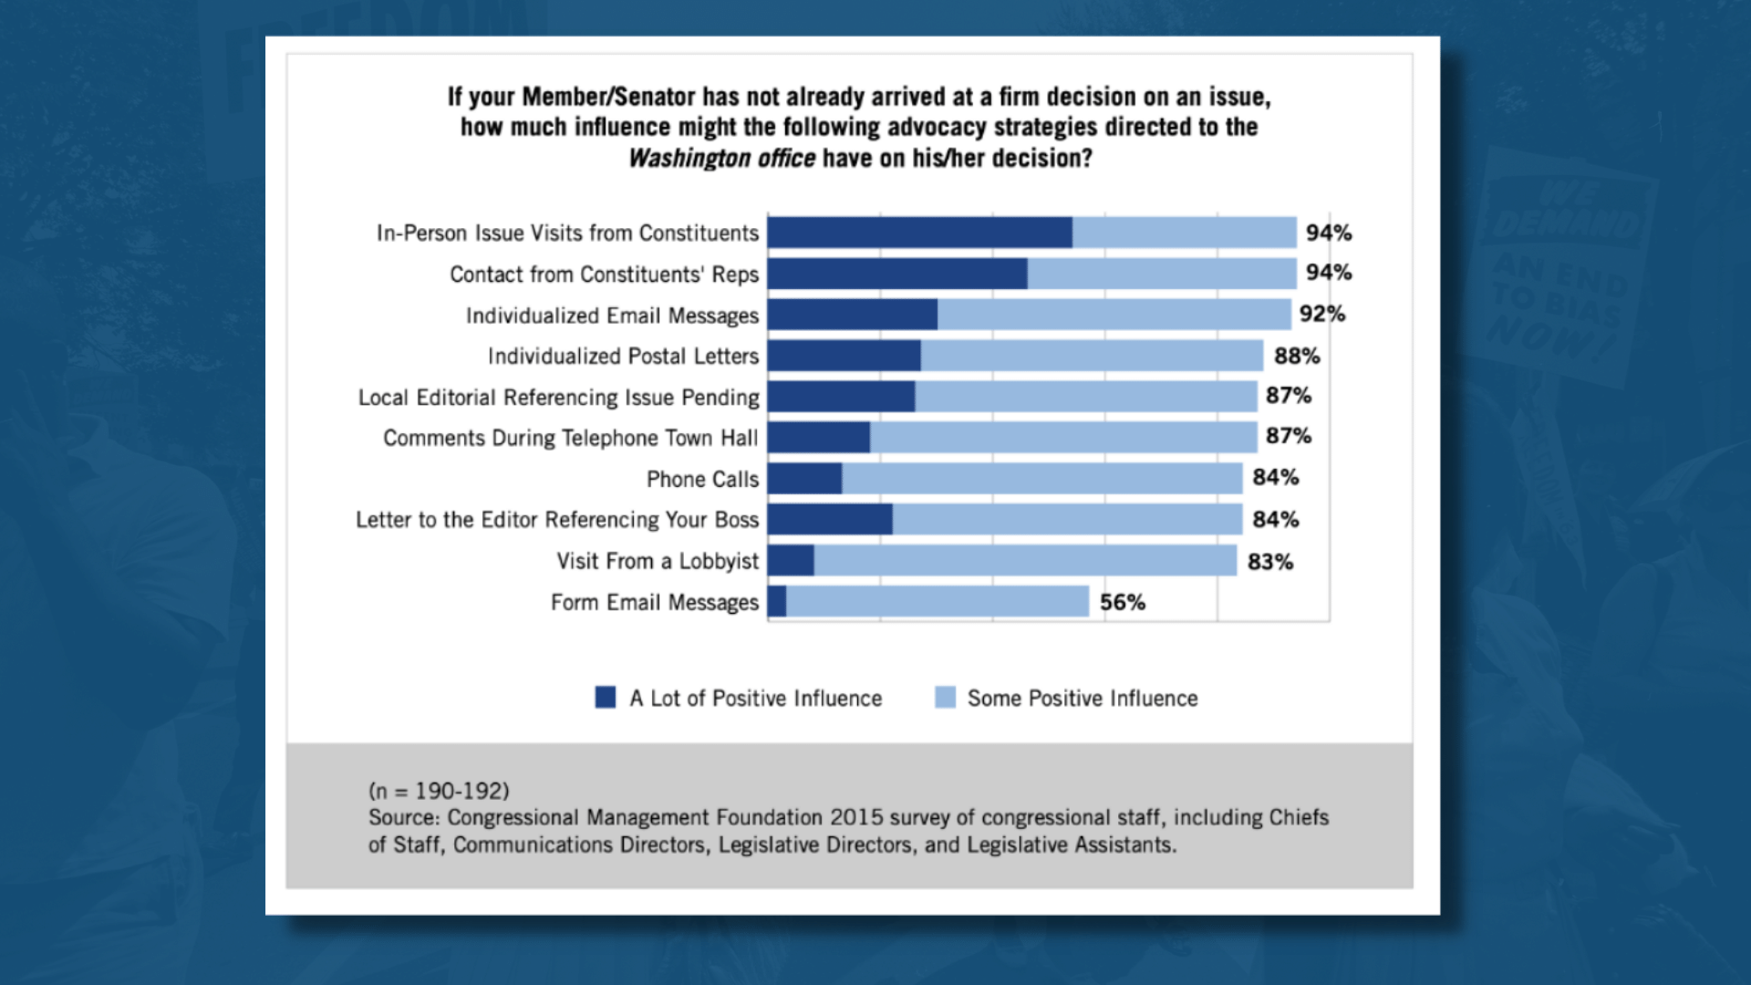

Slide 12
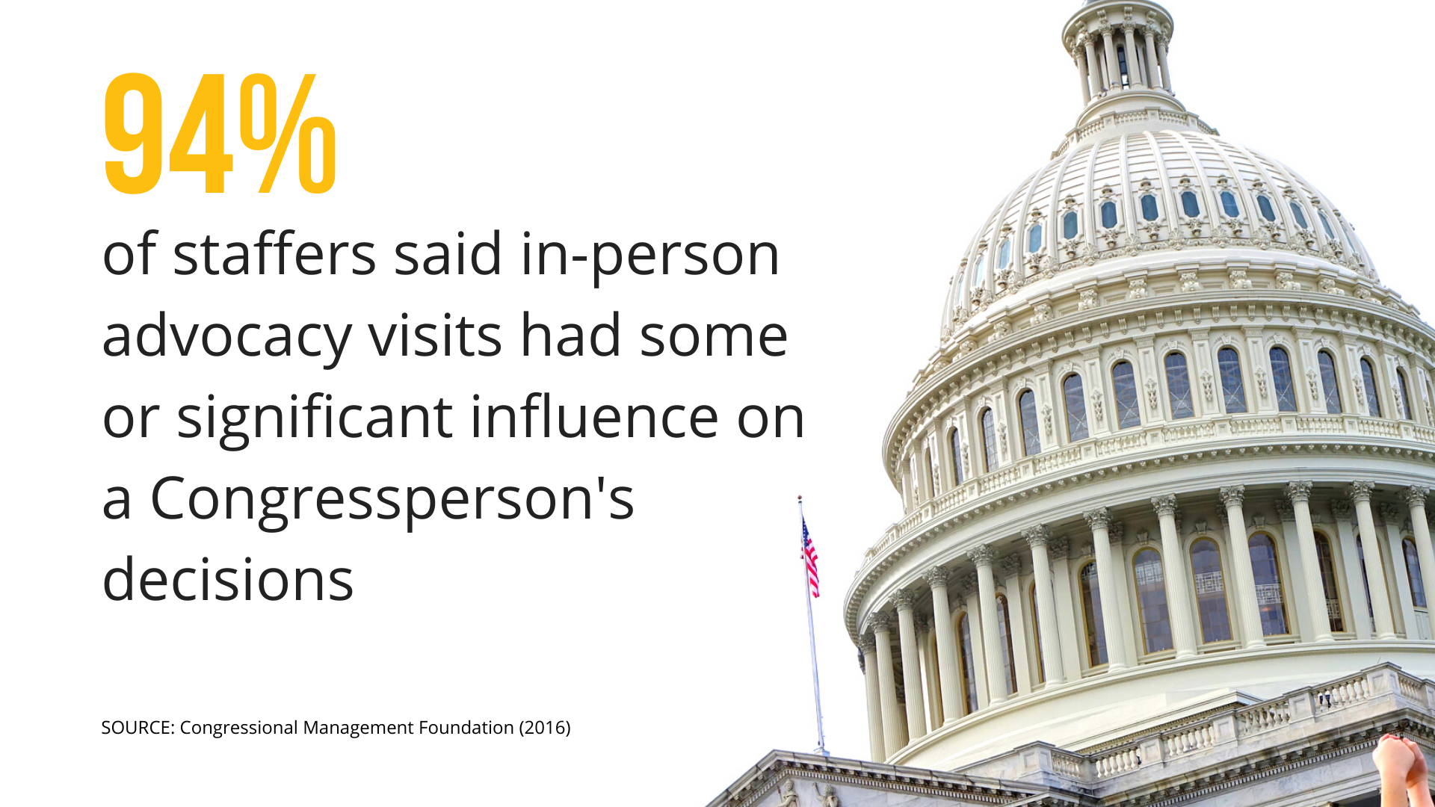

Slide 13


Slide 14
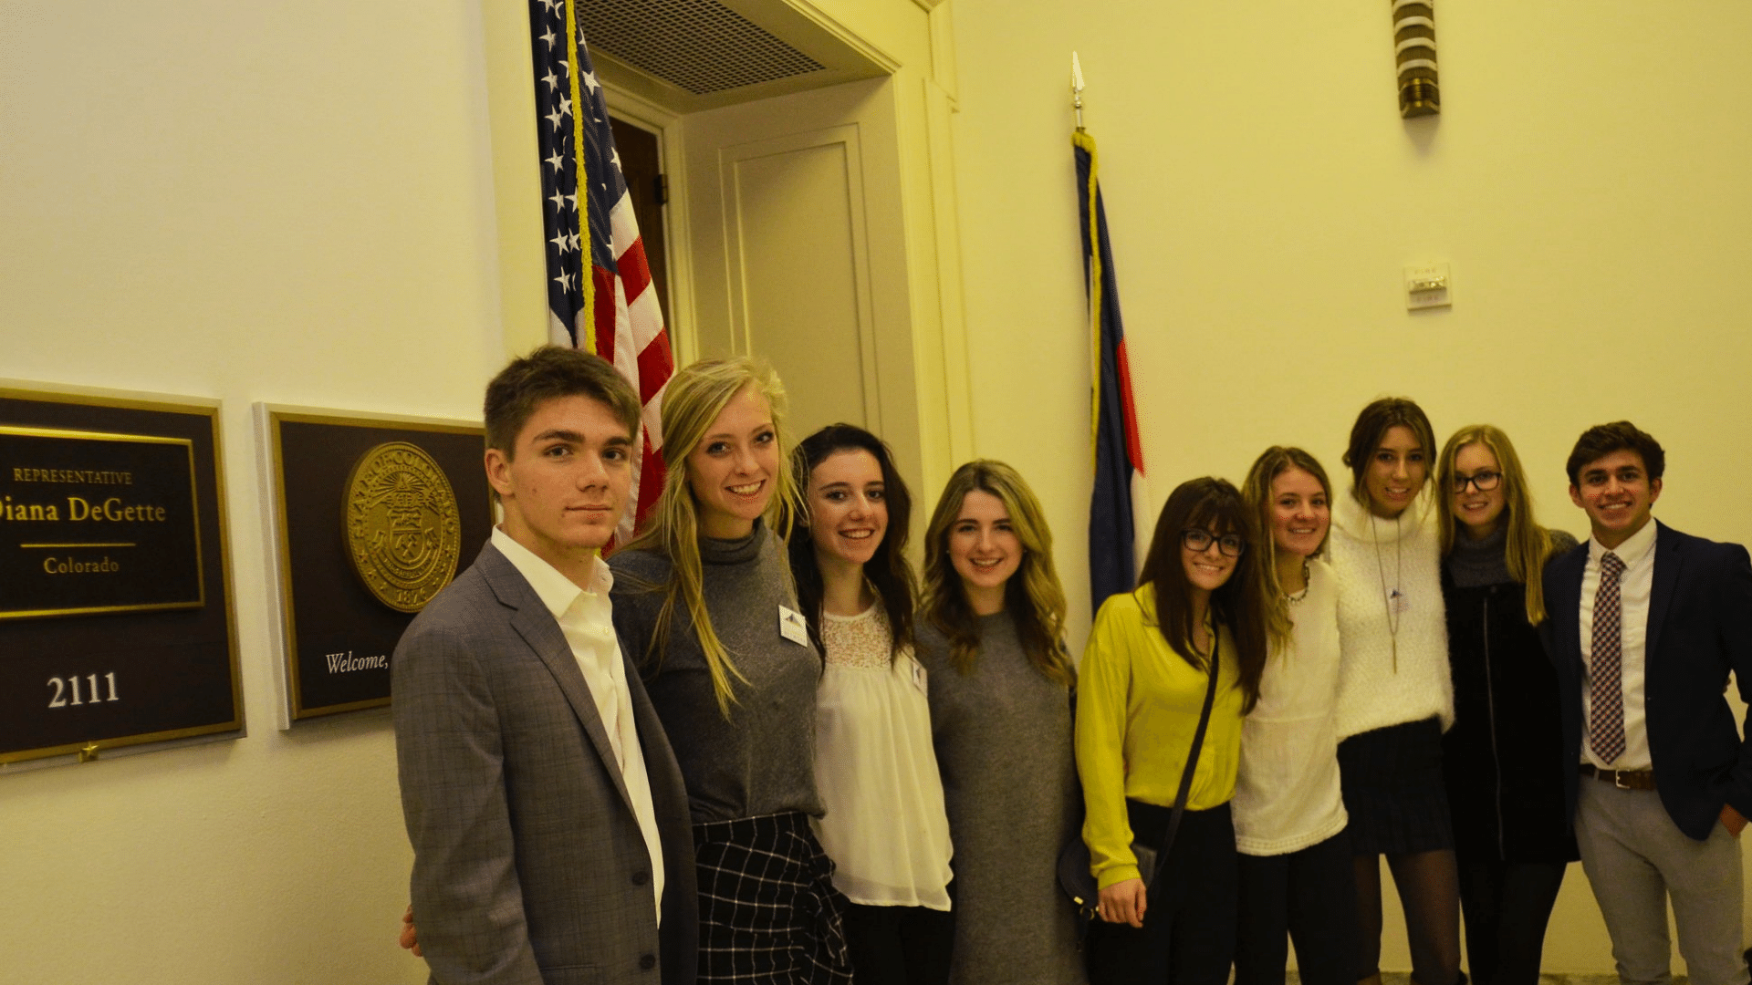

Slide 15
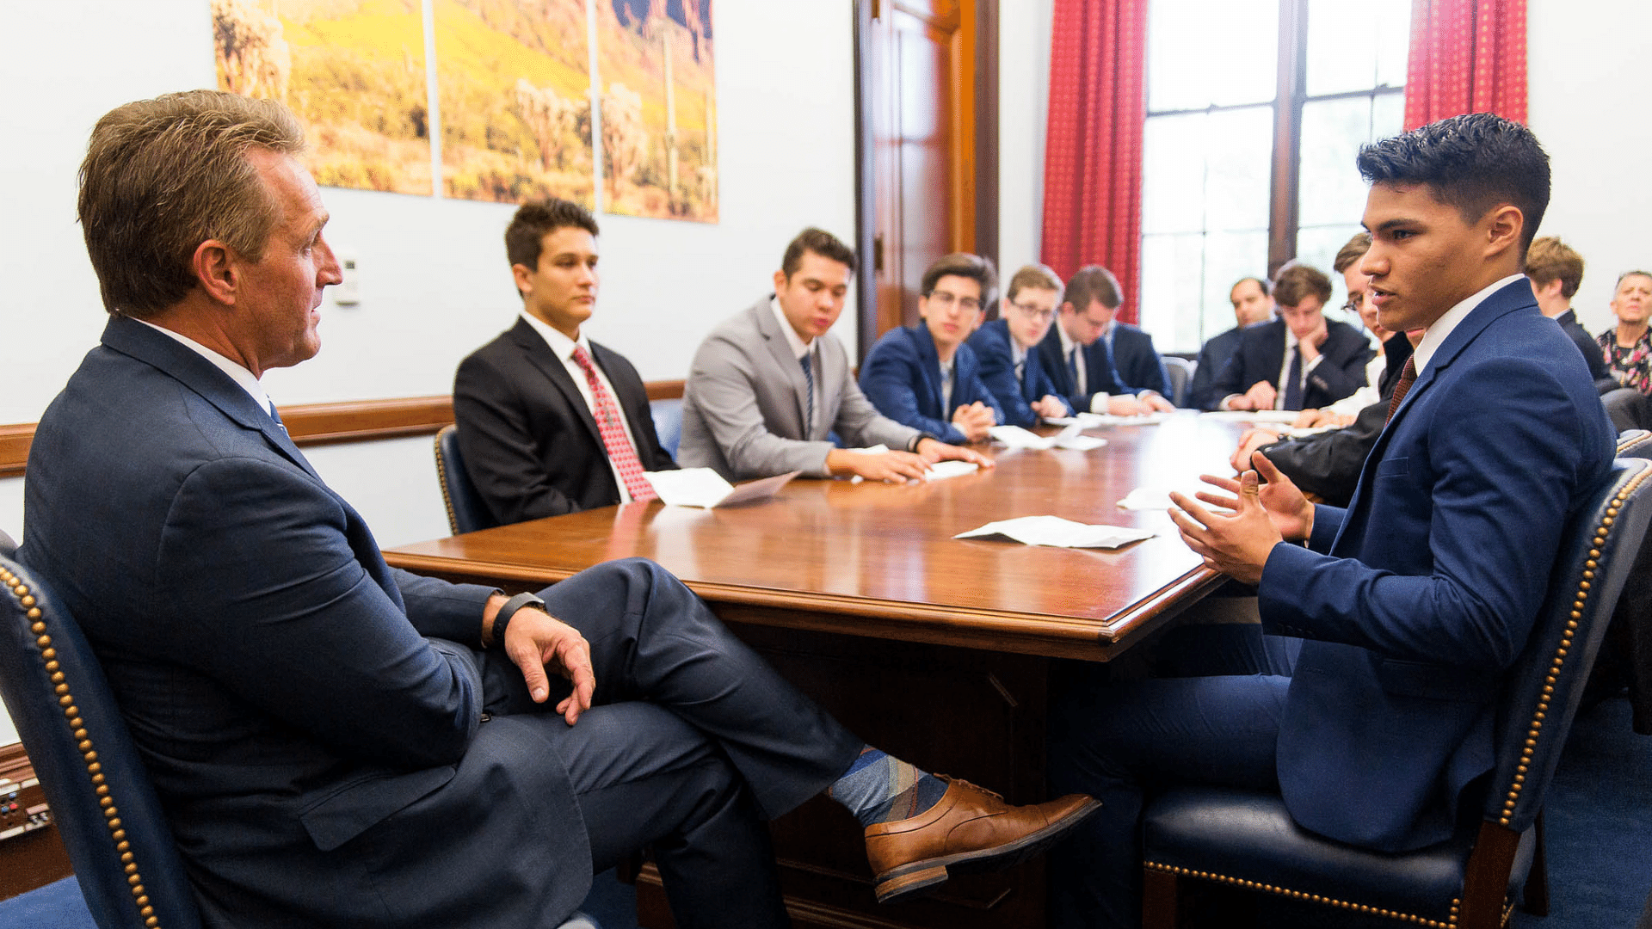

Slide 16
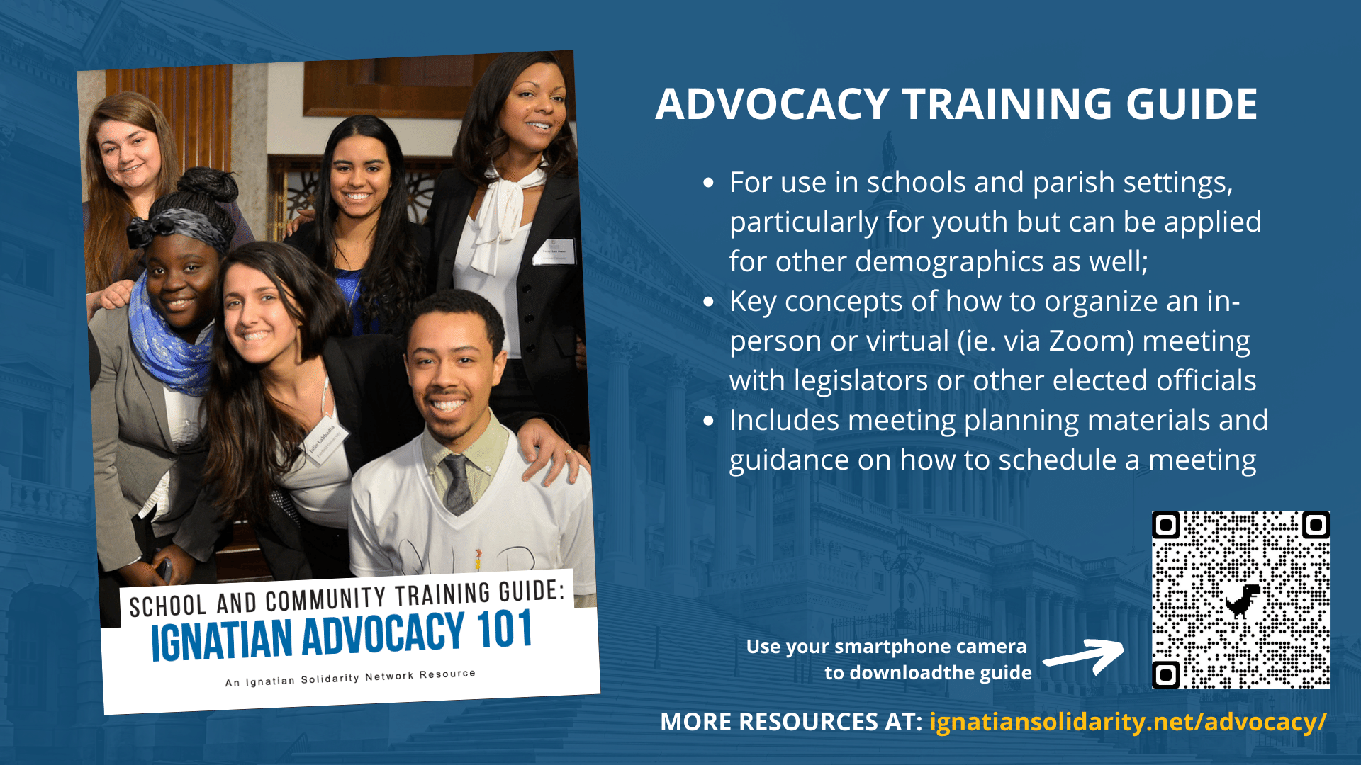

Slide 18
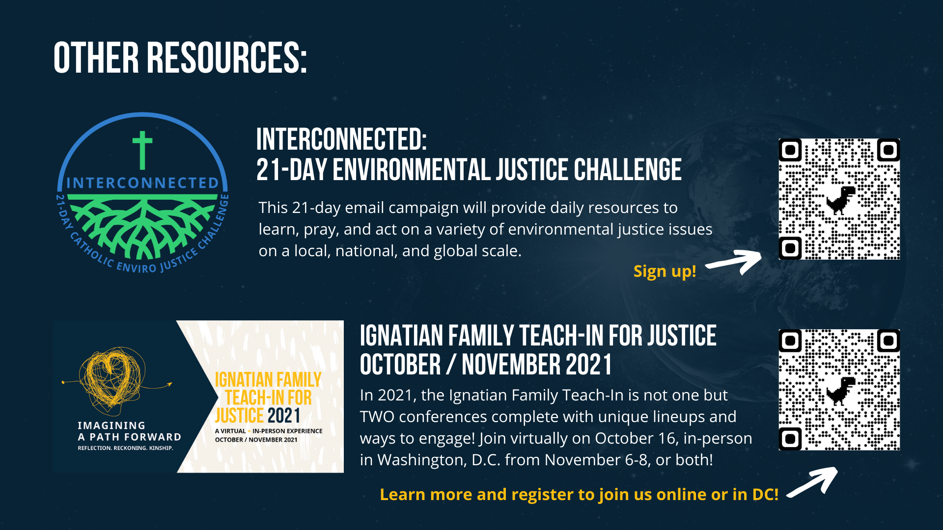

Slide 19

Encounter for Climate Action:
Steps and Resources for Engaging Your Catholic Leader
Climate Action Letter for Catholic Institutions will demonstrate the broad U.S. Catholic support for a strong and just agreement at the 26th U.N. Climate Change Conference November 1-12.
Evidence-based Method to engage Power for change.
Build a “culture of encounter” (Evangelii Gaudium, no. 220).
Respond to calls from Cardinal Hollerich and Cardinal Cupich for Catholics to meet with their bishop about climate change.
  Brian Roewe, “Vatican official: Church divestment from fossil fuels is ‘moral imperative,’” National Catholic Reporter.
  Brian Roewe, “Cardinal Cupich: To save planet, US must reject 'false idol' of money,” National Catholic Reporter.
But it will not work without your action.
Meeting with a Catholic leader may be new for you. It may also be uncomfortable. It will take time and energy. But it is essential to maximizing Catholic support for prudent climate policy that faithfully responds to “both the cry of the earth and the cry of the poor” (Laudato Si’, no. 49).
https://bit.ly/CatholicLeaderEncounter

Slide 20
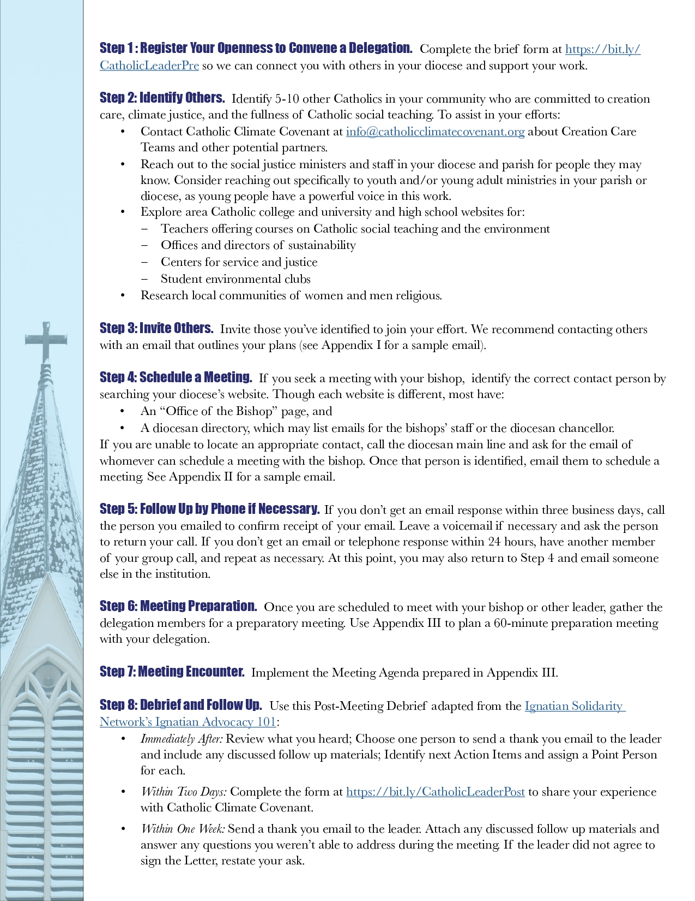

Slide 21
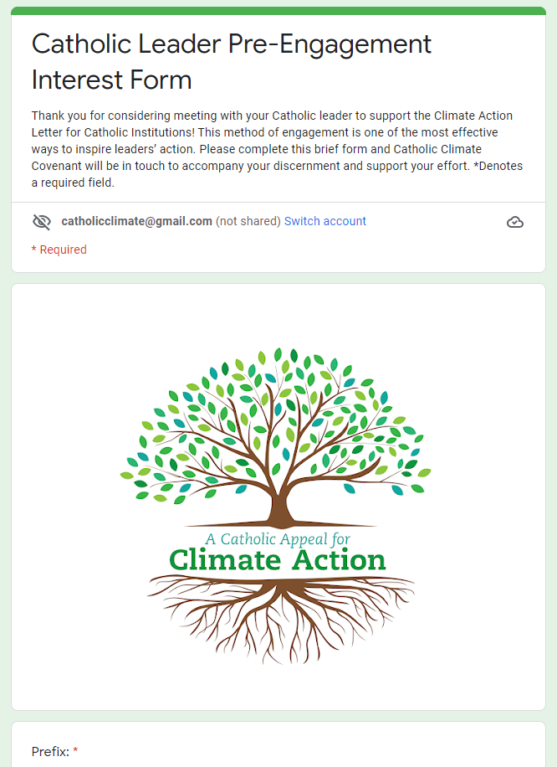
Step 1:
Register Your Openness to Convene a Delegation
Complete the brief form at https://bit.ly/CatholicLeaderPre so we can connect you with others in your diocese and support your work.

Slide 22
Step 2:
Identify Others
Identify 5-10 other Catholics in your community who are committed to creation care, climate justice, and the fullness of Catholic social teaching. To assist in your efforts:
  Contact Catholic Climate Covenant at info@catholicclimatecovenant.org about Creation Care Teams and other potential partners.
  Reach out to the social justice ministers and staff in your diocese and parish for people they may know. Consider reaching out specifically to youth and/or young adult ministries in your parish or diocese, as young people have a powerful voice in this work.
  Explore area Catholic college and university and high school websites for:
    Teachers offering courses on Catholic social teaching and the environment.
    Offices and directors of sustainability.
    Centers for service and justice.
    Student environmental clubs.
Research local communities of women and men religious.

Slide 23
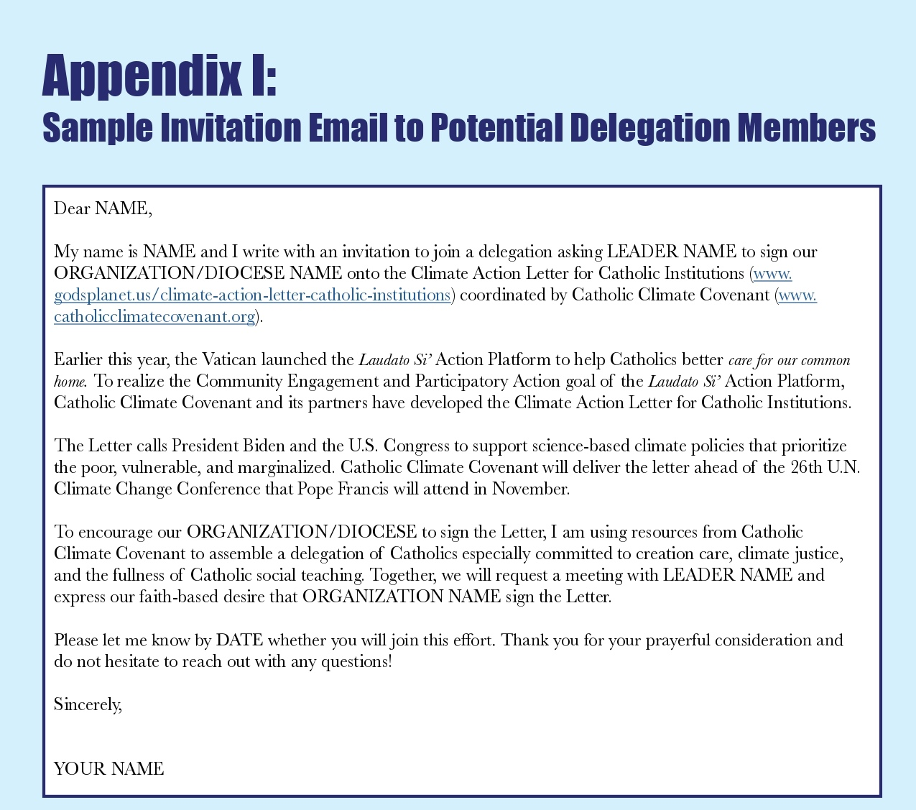
Step 3:
Invite Others
Invite those you’ve identified to join your effort. We recommend contacting others with an email that outlines your plans (see Appendix I for a sample email).

Slide 24
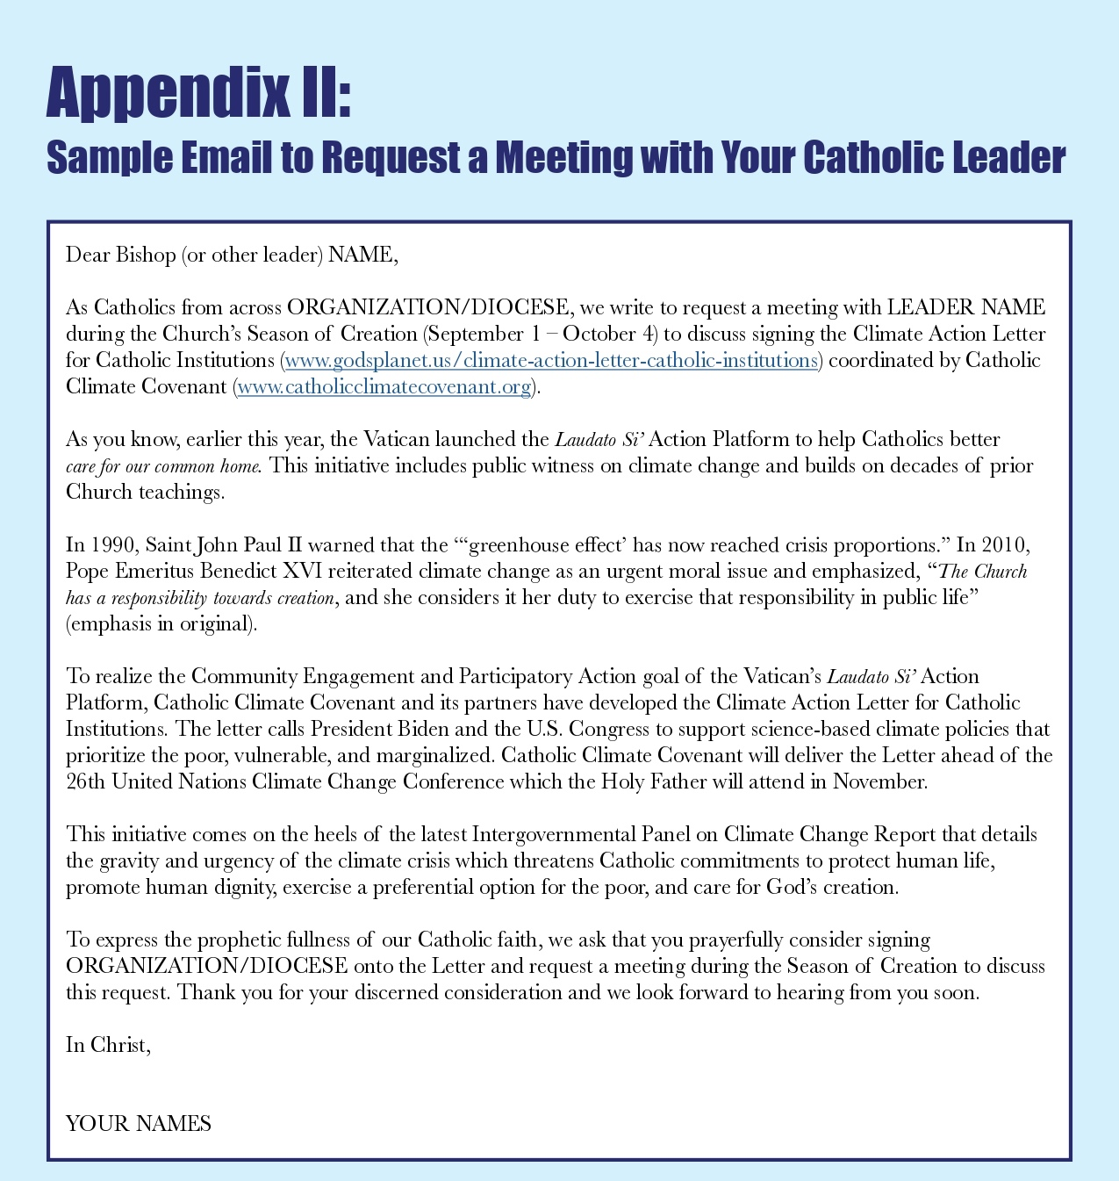
Step 4:
Schedule a Meeting
Season of Creation (September 1 – October 4).
  Letter must be signed by Monday, October 25 to be delivered before U.N. meeting November 1-12.
If you seek a meeting with your bishop, identify the correct contact person by searching your diocese’s website. Though each website is different, most have:
  An “Office of the Bishop” page, and
  A diocesan directory, which may list emails for the bishops’ staff or the diocesan chancellor.
If you are unable to locate an appropriate contact, call the diocesan main line and ask for the email of whomever can schedule a meeting with the bishop.
Once that person is identified, email them to schedule a meeting. See Appendix II for a sample email.

Slide 25
Step 5:
Follow Up by Phone if Necessary
If you don’t get an email response within three business days, call the person you emailed to confirm receipt of your email. Leave a voicemail if necessary and ask the person to return your call.
If you don’t get an email or telephone response to your voicemail within 24 hours, have another member of your group call, and repeat as necessary.
At this point, you may also return to Step 4 and email someone else in the institution.

Slide 26
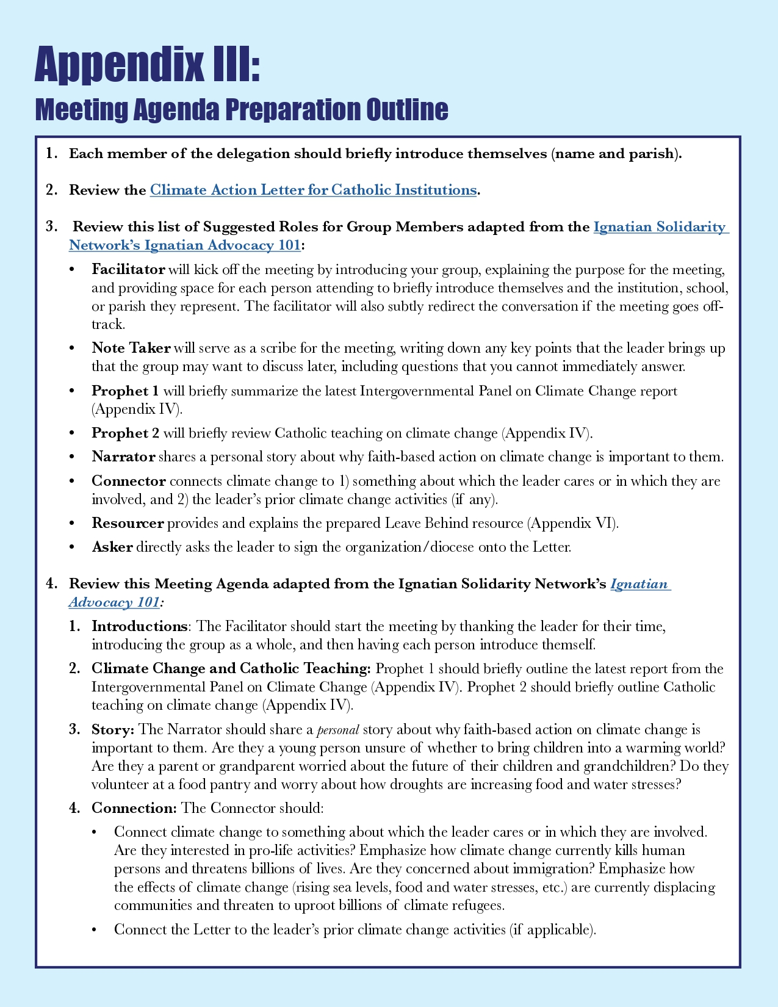
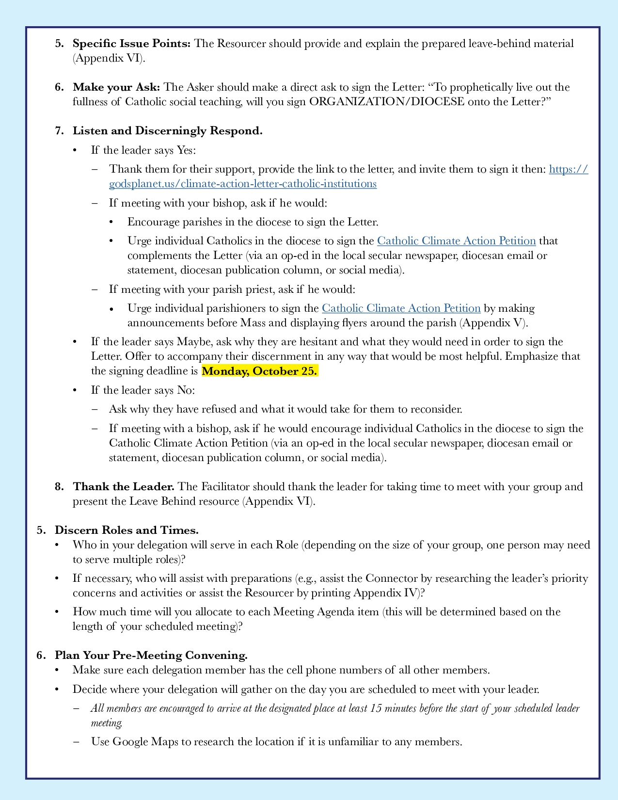
Step 6:
Meeting Preparation
Once you are scheduled to meet with your bishop or other leader, gather the delegation members for a preparatory meeting.
Use Appendix III to plan a 60-minute preparation meeting with your delegation.

Slide 27
Step 7:
Meeting Encounter
Implement the Meeting Agenda prepared in Appendix III.

Slide 28
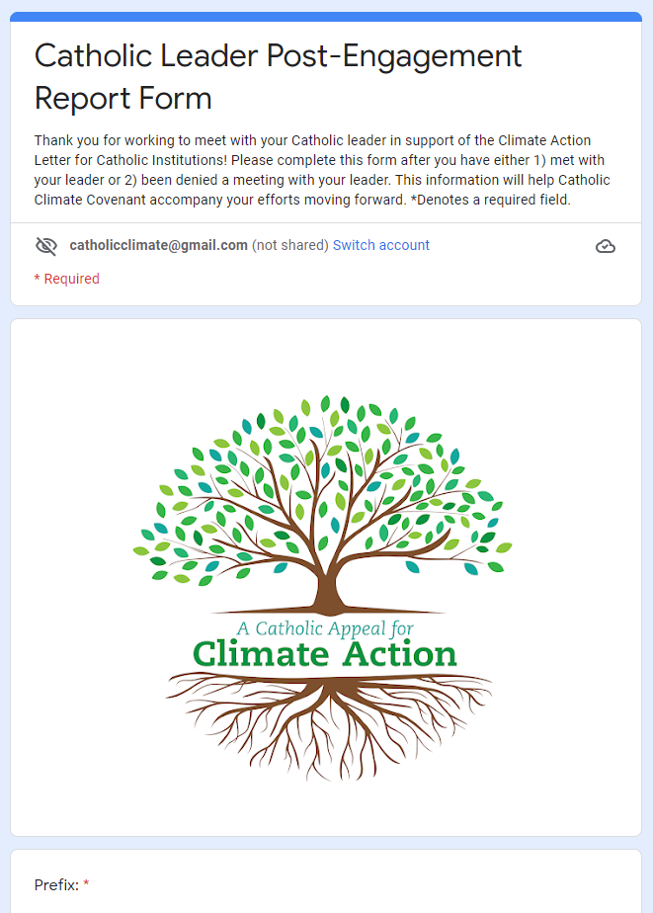
Step 8:
Debrief and Follow Up
Use this Post-Meeting Debrief adapted from the Ignatian Solidarity Network’s Ignatian Advocacy 101:
  Immediately After: Review what you heard; Choose one person to send a thank you email to the leader and include any discussed follow up materials; Identify next Action Items and assign a Point Person for each.
  Within Two Days: Complete the form at https://bit.ly/CatholicLeaderPost to share your experience with Catholic Climate Covenant.
  Within One Week: Send a thank you email to the leader. Attach any discussed follow up materials and answer any questions you couldn’t address during the meeting. If the leader did not agree to sign the Letter, restate your ask.

Slide 29
Sharing Your Story

Slide 30
The Power of a Story: Connection
“Those who tell the stories rule the world.” proverb, attributed to the Hopi Indians
Notes:
Why do we tell stories? A well-told story we can help a person see things in an entirely new way. We can forge new relationships and strengthen the ones we already have. We can change a law, inspire a movement, make people care fiercely about things they’d never given a passing thought.
Stories make us human, It’s how we connect to each other.

Slide 31
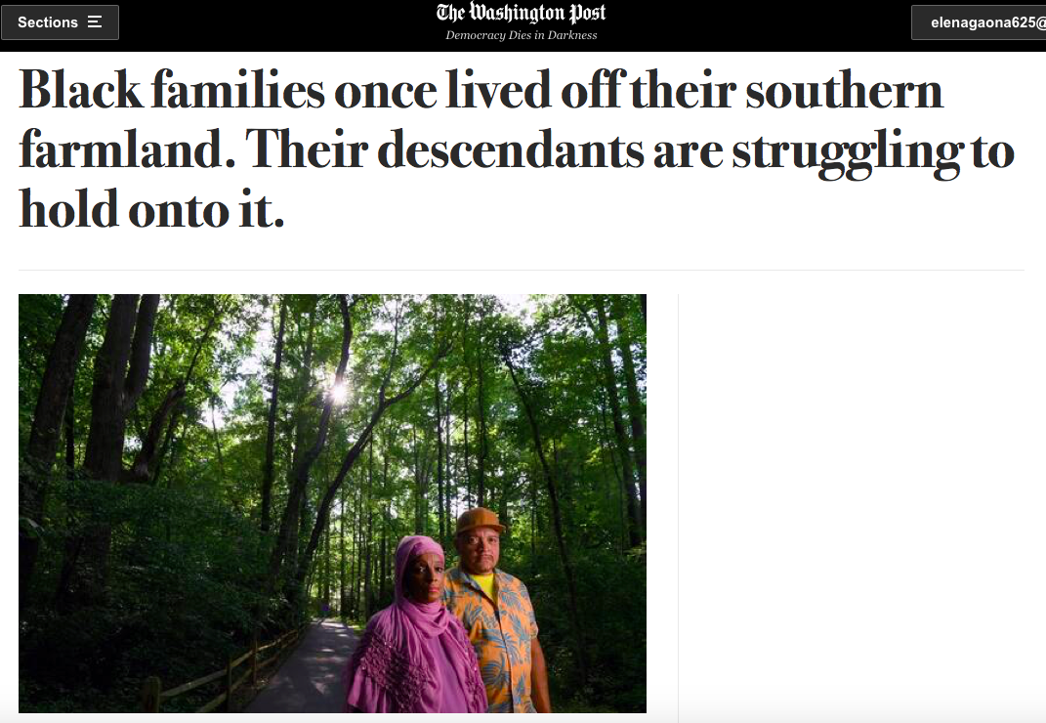
Example: Black Farmers bill
Notes:
Example: Black farmers losing their land in the South. There is a bill now to forgive their debt so they can get loans and keep their farms. The coalition behind this said Cory Booker said he signed on to the bill specifically because he read about the story of the farmers in the Washington Post.

Slide 32
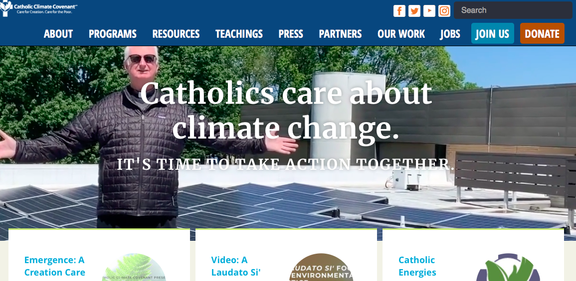
Example: Father
John
Grace
Notes:
Example: Father John Grace at Catholic Climate Covenant conference. The editor of the main newspaper still remembers that story, and it urges him to keep writing on the issue.

Slide 33

Back to school story today WAMU/NPR
Notes:
“I’m excited to make friends and excited to learn new things,” declared Fabiola Rushing, an 8-year-old who is starting third grade. Fabiola had laid out all of her outfits for the week, settling on a new pair of leggings with colorful shapes and a t-shirt with the school’s logo for the first day.

Slide 34
Where do I start?
Your LIFE story – what do you tell yourself, others, about you?
vs. a
Personal Narrative – What is a personal narrative?
  Personal = about you
  Narrative = telling a story
(A story about a moment or event in your life – NOT your life story.)
Notes:
Your life story will always evolve and change, and you will spend your life getting to know it! It’s a LIFE story!

Slide 35
Getting in touch with your personal story
When we write a personal narrative, we write about our own lives, memories, and feelings. A personal narrative tells a true story about you.
You may enjoy or need to start your personal narrative by getting in touch with your life story.

Slide 36

Create a Heart Map
Notes:
Many times we have trouble deciding what to write about. You we can create a heart map to show all of the things you love and are important to you. Each section of your heart map represents something that is important to you.
Later today or this week, you can create your own heart map.
After you complete your heart map you can begin freestyle writing about yourself in a notebook or write a poem about yourself. You can select any topic, but the writing should be about yourself.

Slide 37
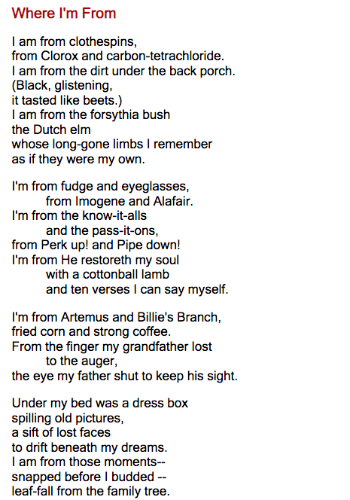
Where I’m From
Poem by George Ella Lyon
Learn more at https://iamfromproject.com/
Notes:
Written by writer and teacher George Ella Lyon
Read or listen to George Ella Lyon read the poem. You’ll notice that it is basically a list of experiences that shaped her into the person she is today. Brainstorm a list of people, places, foods, sports, music, family sayings, etc., that have made you You. Then play with the arrangement of these images until you find one you like. Poems are like jigsaw puzzles made of sound, so reading out loud will help you hear where the pieces fit.

Slide 38
How do I write a Personal Narrative
Write about yourself.
The emphasis should be on something you have experienced personally.
Write about a small moment. Don’t try to write about a giant topic.
Tell the story from your point of view.
Write the same way you would tell the story to someone.
Make sure your narrative has a beginning, middle, and end.

Slide 39
Tell a Compelling Story
Core Elements of a Narrative
The Problem
The Solution
Call to Action
Notes:
We want to shape our narrative into a story arc that has drama and tension.
Remember Storytelling moves people – we want that emotional connection

Slide 40
Personal Narrative/ storytelling worksheet
What is the point you want people to take away upon hearing this story?
What audience would you want to tell this story to?
Who are the main people involved? Is it a single person or a group of people?
Where is your story located? What is the setting? (Include examples for each question if possible)
What barrier(s)/conflict(s) does he or she comes across?
How does your protagonist pursue his or her goal? (What does the protagonist do to try to overcome these barriers? What activities keep the story’s momentum going?)
What is the moment of truth in your story?
What is the meaning or lesson of the story? What do you want your listener(s) to take away?
Notes:
The most compelling stories include key details that make the story come to life for audiences – so they will be able to relate and picture themselves benefitting in similar ways.

Slide 41
Graphic organizers
Notes:
Sometimes when we write, we need a road map to help guide our writing. A graphic organizer can help us make a plan for our writing.

Slide 42
Small moment
Small Moment
Notes:
One of the most difficult parts of writing personal narratives is to not to write a list of events or not to try to write about a too broad of topic. You want to write about a small moment in time,

Slide 43
Graphic organizer
Notes:
Topic
Time
Place
Beginning
Middle
End
Sensory Details
Emotions and Feelings

Slide 44
Ways to begin a narrative
Emotion or Feeling | My daughters mean the world to me.
Action | When my daughters play outside they end up coughing due to asthma.
Dialogue | “Mommy, I can’t breathe.” Hearing these words is always scary.
Description | The dust particles from the construction company near our house fill our neighborhood air with bad air.

Slide 45
Ways to end a narrative
Reflective or Circular | We owe it to our children to care.
Hopes or Wishes | I hope I am able to leave a good planet for my daughters.
Moral or Lesson Learned | Our work made the air quality improve, it can be done.
Decision | Please sign this letter for our future generations.

Slide 46
More opportunities for storytelling: Commentary
Letters to the Editor, op-eds
Blog Posts, articles
Videos, podcasts, social media
Mediums
#1 – IN PERSON!
Notes:
Commentary or opinion pieces are a great way to share your perspective and can also help to demonstrate thought leadership on your issue.
LTEs are the shortest type of commentary. They are really short (150-200 words) and have a very quick turnaround as they usually a direct response to an article or editorial. So this is a good tool if your issue was just in the paper and you can pull something succinct together quickly.
Op-eds or opinion articles are a longer form of commentary (average around 750 words). There is a bit more freedom with an op-ed than an LTE, because op-eds don’t have to be tied to a specific news story, but they have to have a strong connection or reaction to a timely news development. This time sensitive nature of op-eds can be a challenge, as opinion editors seem increasingly overwhelmed with submissions and take longer to respond, making it harder to get your piece placed while its still timely. So its important to plan ahead and submit your op-ed at least a week before you’re hoping for placement. The most important tip for op-eds is to have a strong viewpoint and unique perspective.
Blog Posts: Blog posts are a great option when you’re working on a complicated issue, as it gives you the runway you need to have more nuance and details and freedom to not be so pegged to timely news coverage. While they offer the most editorial freedom, but they are also less likely to reach a wider audience organically. To make your blog post most effective, I recommend using it in conjunction with the other tactics we’ve spoken about so that you are helping to spread the piece yourself– sending an email update to partners and stakeholders or sharing the link on social media.

Slide 47

Season of Creation Training:
How to Engage Our Church Leaders for Climate Action
Questions ?

Slide 48
Season of Creation Training:
How to Engage Our Church Leaders for Climate Action
For more information: info@CatholicClimateCovenant.org
www.Godsplanet.us and www.CatholicClimateCovenant.org

