Slide 1
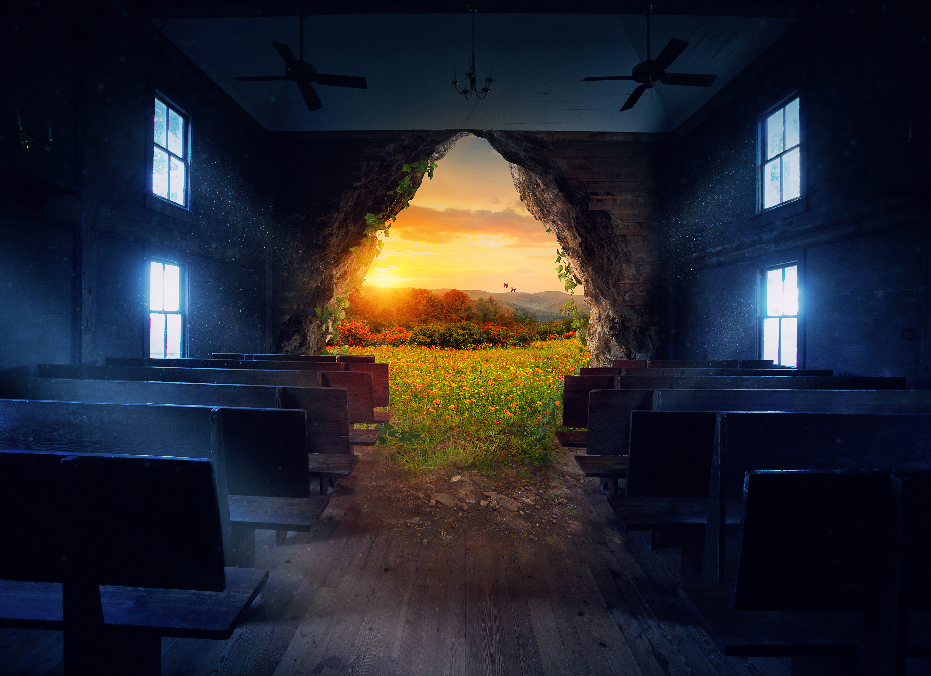

Catholic Climate Covenant
Earth Day at 50/Laudato Si’ at 5: An Urgent Appeal for Action
April 29, 2020

Slide 2
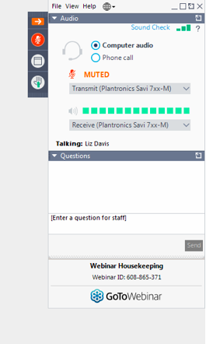
Control Panel >>>>
Your Participation
Open and close your control panel
Join audio:
Choose Mic & Speakers to use VoIP
Choose Telephone and dial using the information provided
Submit questions and comments via the Questions panel
Note: Today’s presentation is being recorded and will be provided within 48 hours.

Slide 3

Catholic Climate Covenant’s Earth Day 2020 Program
https://catholicclimatecovenant.org/program/earth-day

Slide 4
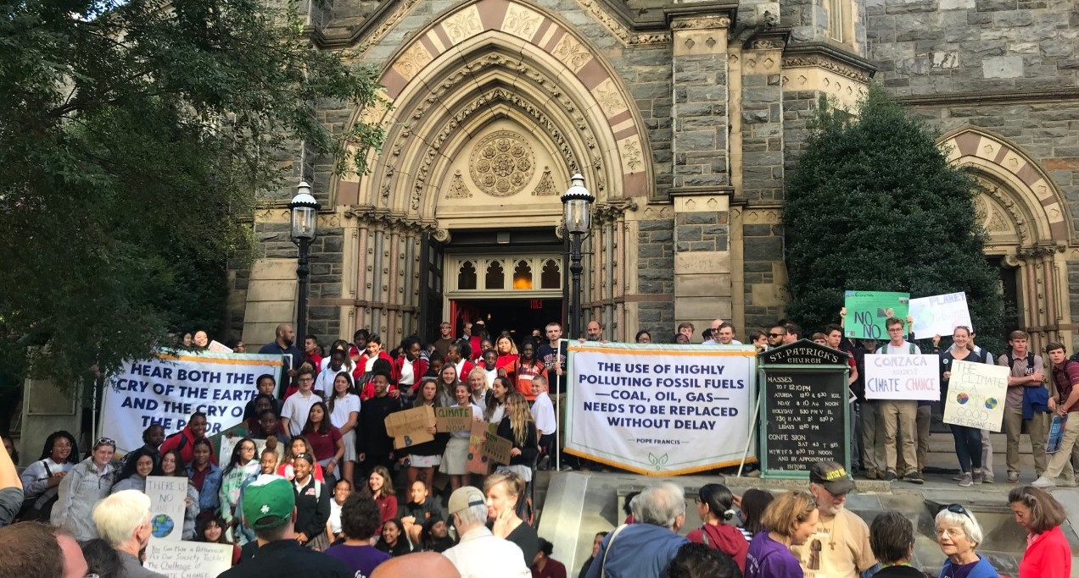
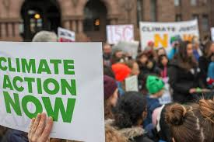
Catholic Climate Covenant’s Earth Day 2020 Program
Earth Day at 50/Laudato Si’ at 5: An Urgent Appeal for Action
Purpose: Mark Earth Day and Laudato Si’ anniversaries
Revision of original program
Spanish version now available of revised program
Climate Action…how will you take action?

Slide 5
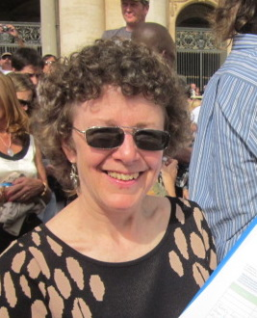
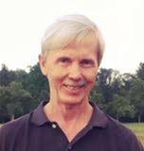
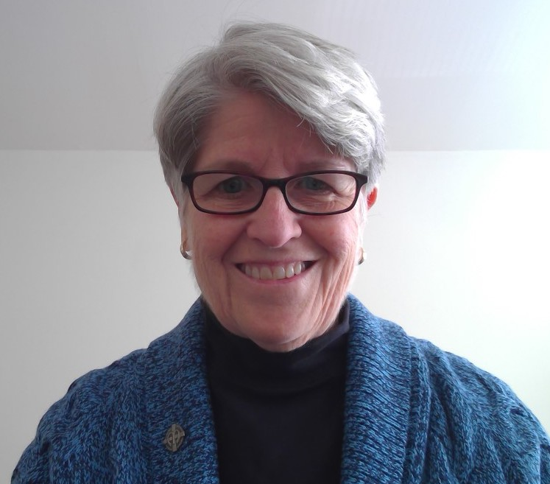
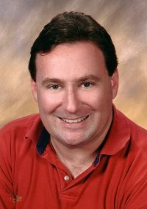
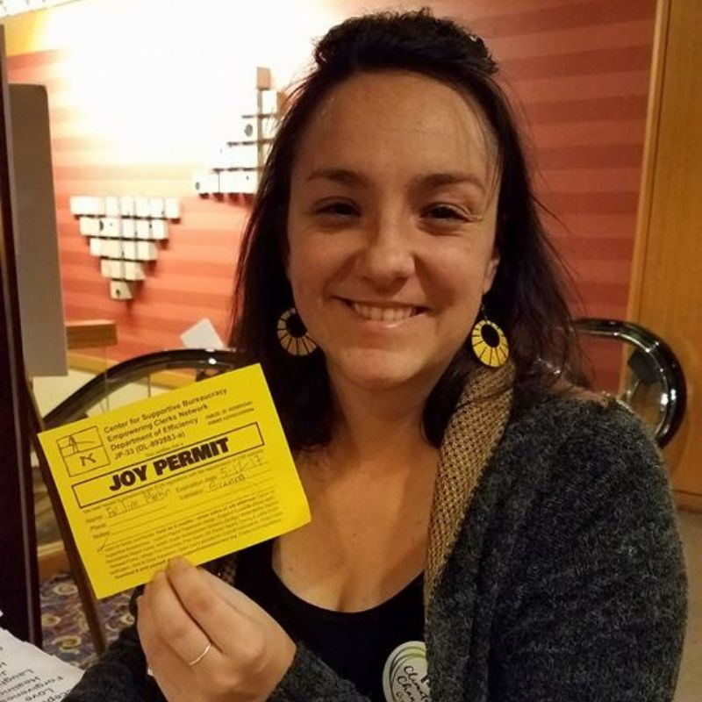
Marianne Comfort Sisters of Mercy of the Americas
Scott Wright Columban Center for Advocacy and Outreach
Sr. Anne Scholz Leadership Conference of Women Religious
Russ Testa Holy Name Province, OFM
Brenna Davis Ignatian Solidarity Network
Moderator: Paz Artaza-Regan, Catholic Climate Covenant

Slide 6
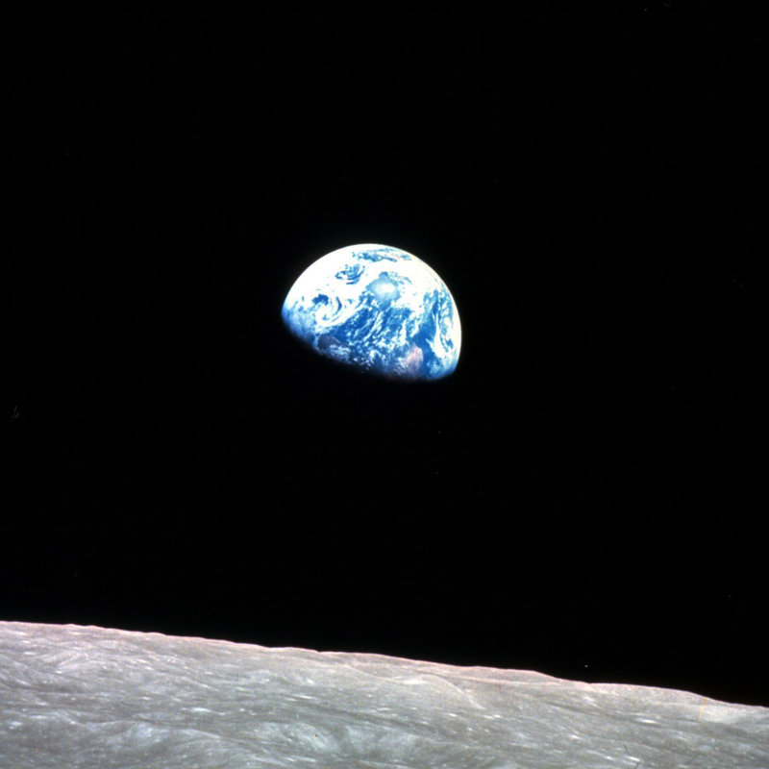
Opening Prayer (1 minute)
O Creator,
Our world is large, and yet your Creation is so fragile.
We glimpse the needs of our common home, of our sisters and brothers,
and those needs are great.
We want to turn away, but you call us back.
We want simple solutions,
but you want us to help solve the complex problems.
Through your Church, you call us to listen, to learn, to reflect and to act.
Give us a deep sense of our place in this web of Creation.
Give us the wisdom of mind and generosity of heart to seek your will in the world today.
Inspire us to respond to the call to live in solidarity with all of your creation,
so that the Earth, and all children of God might live in dignity and peace.
Amen
(Written by Education for Justice staff. Copyright © Reprinted with permission.)

Slide 7
(After each reading, silently reflect on the message of the reading)
Reading #1: “Be doers of the word and not hearers only, deluding yourselves. For if anyone is a hearer of the word and not a doer, he is like a man who looks at his own face in a mirror. He sees himself, then goes off and promptly forgets what he looked like. But the one who peers into the perfect law of freedom and perseveres, and is not a hearer who forgets but a doer who acts, such a one shall be blessed in what he does.” (James 1: 22-25)

Slide 8
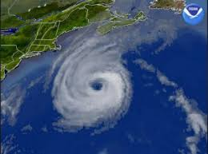
(After each reading, silently reflect on the message of the reading)
Reading #2: “The Earth's climate is changing. Temperatures are rising, snow and rainfall patterns are shifting, and more extreme climate events – like heavy rainstorms and record high temperatures – are already happening. Many of these observed changes are linked to the rising levels of carbon dioxide and other greenhouse gases in our atmosphere, caused by human activities.” (Climate Change Indicators in the United States, US EPA, https://www.epa.gov/climate-indicators)

Slide 9
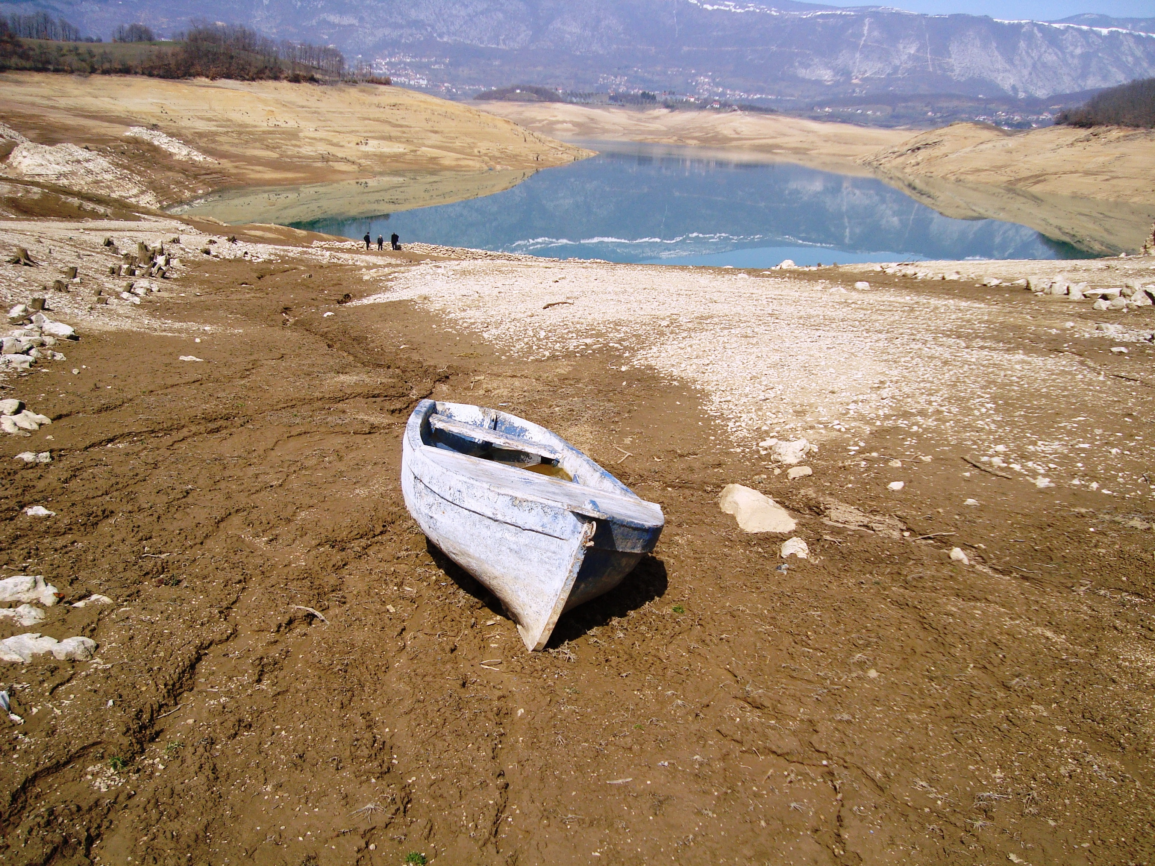
(After each reading, silently reflect on the message of the reading)
Reading #3: “Climate models project robust differences in regional climate characteristics between present-day and global warming of 1.5°C, and between 1.5°C and 2°C. These differences include increases in: mean temperature in most land and ocean regions, hot extremes in most inhabited regions, heavy precipitation in several regions, and the probability of drought and precipitation deficits in some regions…Limiting the risks from global warming of 1.5°C in the context of sustainable development and poverty eradication implies system transitions.” (Intergovernmental Panel on Climate Change (IPCC) Special Report Oct. 2018)

Slide 10
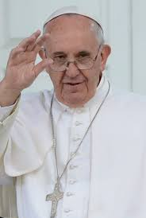
(After each reading, silently reflect on the message of the reading)
Reading #4: “The urgent challenge to protect our common home includes a concern to bring the whole human family together to seek a sustainable and integral development…Humanity still has the ability to work together in building our common home. Young people demand change. They wonder how anyone can claim to be building a better future without thinking of the environmental crisis and the sufferings of the excluded. (Laudato Si’ 13)
I urgently appeal, then, for a new dialogue about how we are shaping the future of our planet. We need a conversation which includes everyone, since the environmental challenge we are undergoing, and its human roots, concern and affect us all. (Laudato Si ‘14)

Slide 11
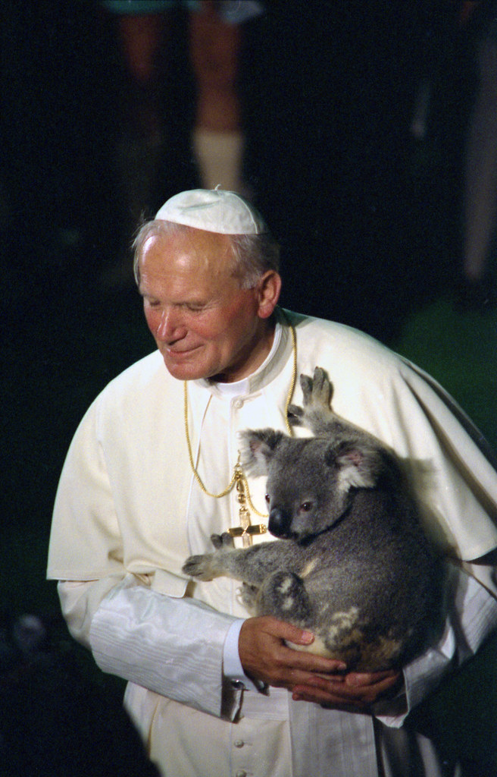
(After each reading, silently reflect on the message of the reading)
Reading #5:
“An education in ecological responsibility is urgent: responsibility for oneself, for others, and for the earth.” (World Day of Peace Message in 1990, Pope Saint John Paul II)

Slide 12
Video
https://www.youtube.com/watch?v=n_umVeme93U

Slide 13
Reflection and Discussion
If you are participating as an individual, we urge you to follow-up these individual reflections with discussions on the phone or online with members of your faith community or your school, or with your family. Some of these questions can be answered by you and your family. Follow-up with others in your community to discuss how they are taking action. Once we are again able to meet as communities, you can discuss how we will respond communally.
Silent Reflection
What impacted you most from the video?
Both the Environmental Protection Agency and the United Nations predict dire climate impacts. What more can I be doing to lessen the impacts?
Were you surprised that both Pope St. John Paul II and Pope Francis speak of the urgency of responsibility for the Earth?
If you met one of the young Catholics in the video, imagine your conversation. How would you respond to their calls for action? Write down some of the ways you would respond.

Slide 14
Discussion/Reflection questions You have listened to the readings and watched the video. 1) What can you (and/or your community) do to become doers and not just “hearers”?
2) How could you (and/or your community) respond to the Holy Father’s urgent appeal for dialogue and action?
3) What actions could you and (or your community) undertake to lessen the projected impact on creation and our most vulnerable brothers and sisters? If you and your community have already taken action(s), what more can you do? Write down possible future actions that your community could undertake. Think about calling your friends, fellow parishioners, schoolmates, colleagues and discuss future actions.

Slide 15
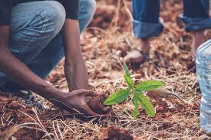
Possible Actions:
Look at this list of possible climate actions you might consider taking as an individual and/or as a community. These actions can help lower your carbon footprint or make yourself and others aware of climate vulnerabilities. Feel free to add your own ideas. To get more information (and links to resources) for each of these actions go to https://catholicclimatecovenant.org/files/2020_Climate_Action_Pledges.pdf

Slide 16
Calculate my carbon footprint and commit to reduce it by at least 10% in 2020
Refuse disposable plastic bottles, bags, straws, cutlery and cups! Say NO to single-use plastic.
Walk, cycle, carpool, or use public transport
Plant pollinator-friendly flowers and spread wildflower seeds.
Switch to renewable energy
Go meatless on Mondays and/or Fridays (at least)
Reuse, recycle, lower my consumption of resources
Use less water
Speak to my elected officials about climate change
Fly less and offset travel when possible
Plant at least two trees in 2020
Wash clothes in cold water and hang-dry clothes
Install a programmable thermostat
Replace appliances with Energy Star-rated ones
Replace incandescent and compact fluorescent lights with LED lights
Reduce my food waste
Compost leaves and food waste
Start conversations about climate change with family and friends
Support youth-led climate movements
Start/join a Creation Care Team in my parish or school
Begin conversations about climate change with family and friends
Pray for our common home and all Earth protectors
Participate in public witness events that lift up care for creation.
Other (name it)
Possible Actions:
Look at this list of possible climate actions you might consider taking as an individual and/or as a community. These actions can help lower your carbon footprint or make yourself and others aware of climate vulnerabilities. Feel free to add your own ideas. To get more information (and links to resources) for each of these actions go to https://catholicclimatecovenant.org/files/2020_Climate_Action_Pledges.pdf

Slide 17
Make a pledge of how you will take climate action in 2020.
Your Pledge: My 2020 climate action pledge is ______________________________ (fill in the blank)
As you make your 2020 Climate Pledge(s), please pray: Creator God, grant us the wisdom to better care for the earth.
Help us to act now for the good of future generations and all your creatures. Help us to become instruments of a new creation, Founded on the covenant of your love.
(Adapted from Cry of the Earth in Jesuitresource.org)
Please submit your pledge here: https://catholicclimatecovenant.salsalabs.org/EarthDayPledges/index.html

Slide 18
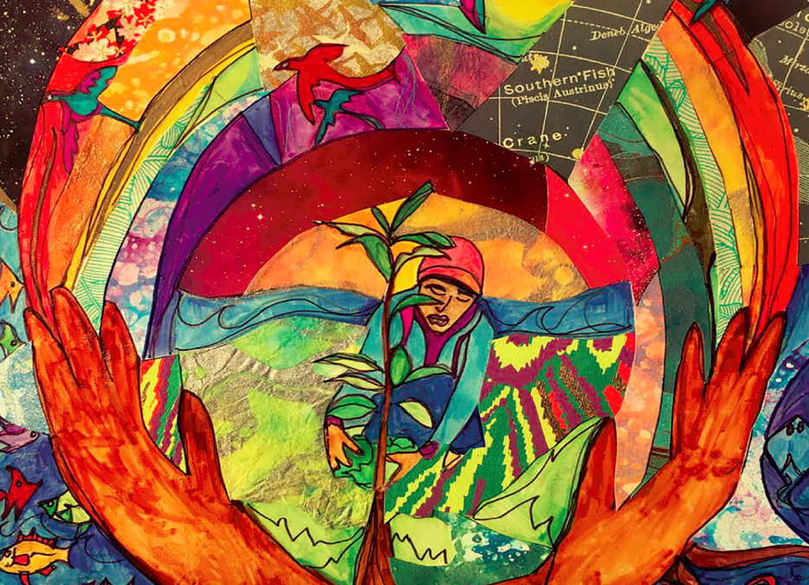
Closing Prayer
O God, your creative love brought forth our world,
Once a garden where humans could taste and see beauty and goodness.
But our eyes do not always see the sacredness of Creation.
We do not always remember that it is Gift
Given so that all humans may live and flourish.
Inattention can change the world.
Even mighty glaciers weep now.
Lifestyles create pollution that blot out the sun.
The very skies above us are threatened.
Seas rise and whole peoples lose their homes.
O God, we ask you to
Call us to renewal and to stewardship.
Call us to solidarity with the earth and all its creatures.
Give us new vision to see the fragile beauty that remains with us.
Give us new spiritual energy to become active in loving the world
through our daily lives,
Give us new voices to speak out for environmental solidarity.
Bless us with a love of your Creation
So that we may glimpse your Eden once again.
(Adapted from a prayer by Jane Deren, Education for Justice. Copyright © Reprinted with permission)

Slide 19
Thank you for participating in this Earth Day/Laudato Si’ at 5 program! This program is a beginning. We hope you and your community will continue to work with us to protect all of God’s creation.
— Catholic Climate Covenant
For more information go to: www.CatholicClimateCovenant.org
Email us at info@Catholicclimatecovenant,org

